Slide 1

Trends in Services for Children with Hearing Loss Karen L. Anderson, PhD, Director Supporting Success for Children with Hearing Loss

Slide 2
Trends
Identification
Placement in education programs
Assuring communication access
Goal development for services
Assessment of progress
Technology

Slide 3
Identification
97%+ of newborns are screened at birth
National goals – 1 – 3- 6
In some states up to 50% of newborns identified continue to be lost to follow up
No data about whether children were evaluated or not
No data of outcome of hearing evaluation
68% were diagnosed with HL before 3 months
Lack of audiologists with pediatric expertise is influencing success of EHDI programs
No uniform healthcare system that guarantees access to appropriate hearing evaluation services

Slide 4
Relative Prevalence by Laterality of Hearing Loss
Bilateral
Unilateral
Bilateral
Bilateral
Previously
unidentified
group
For every 4 babies identified with bilateral hearing loss there is 1 with unilateral hearing loss.
Greater prevalence of atresia/microtia in Hispanic populations.

Slide 5
Relative Prevalence by Degree of Hearing Loss
Even conservatively
there should be 2x the
number of children with
mild loss identified compared to the total of all other degrees
Severe - Profound
Moderate
Mild
For every 1 child identified with bilateral severe to profound hearing loss there are 2 with moderate and 9 with mild degrees of hearing loss.

Slide 6
Technology –Bilateral HL
Services for families of infants/toddlers pay for hearing aids in some states, not all
About 2/3 of children are fit with ‘economy’ hearing aids that lack sophisticated listening in noise signal processing features
97% using hearing aids wear BTE style
Aggressive trend toward cochlear implantation for all candidates by age 12 months (payment permitting)
Increasing number receiving bilateral implants
Bone anchored devices being fit; ‘softband’ use in children < age 6; even for UHL

Slide 7
Growth of Cochlear Implants for Children
1987 first child implanted
2002 Total 10,000 children
2010 Total 28,400 children
Including 1600 bilateral
1:10 deaf kids implanted in 2000
1: 2 children who are deaf implanted by end of 2010

Slide 8
Relative Prevalence by Potential Functionality of Hearing Loss
Severe - Profound
Moderate
Mild
C I

Slide 9

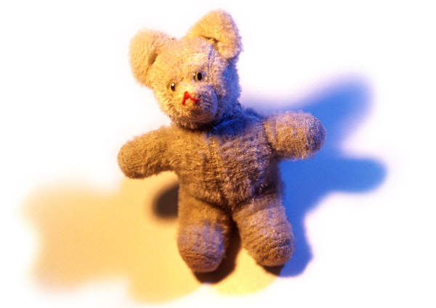
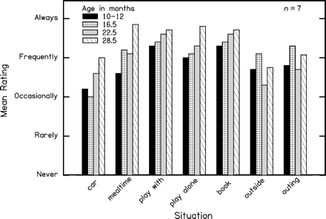
Amplification Wear Findings
Average hearing aid use patterns for group.
Only 3/7 families achieved frequent wear.
Notes:
None of these highly motivated, educated families achieved full time hearing aid wear in all settings by one year of age, much less by 3 weeks
highly supervised activities, like mealtime and book reading resulted in the earliest and most consistent wear rates.
riding in the car and outings were the least consistent wear times.
3 of the 7 families (43%) achieved full time wear in most settings by 16 months.
Three patterns of use were revealed:
full-time use was accomplished by 16.5 months and consistently maintained (3 families)
Consistency of use fluctuated across the ages due to temperament and independence issues (2 families)
Frequent but not full-time use occurred across most ages and situations; related to family routines (2 families)
So if the possibility of early identification is to be realized and hearing aid use is pivotal to success, what were the problems?

Slide 10

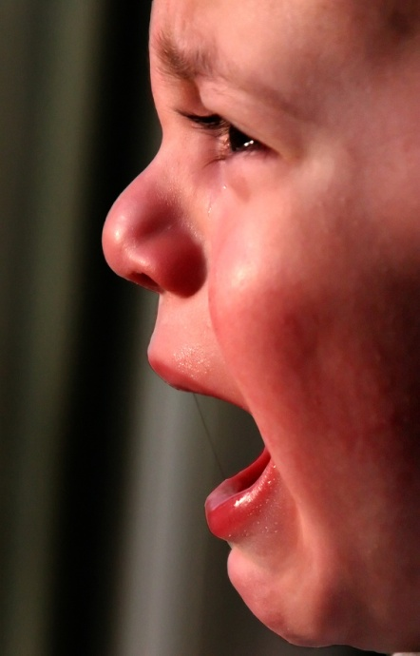
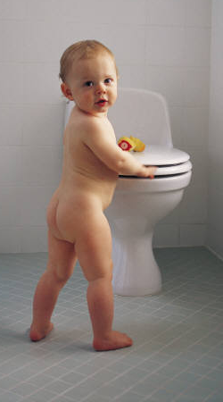
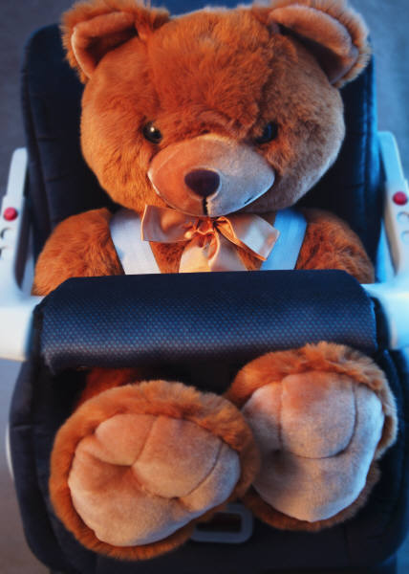
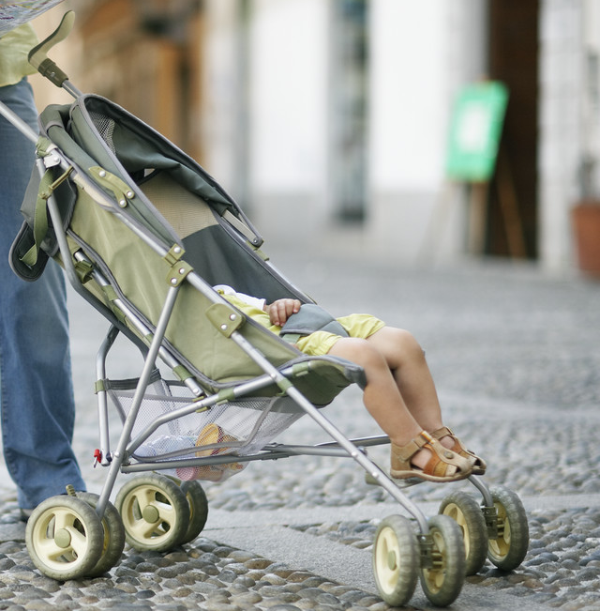
Challenges to Achieving Full-time Amplification Wear
On-off-on-off transitions throughout the day
Child temperament issues
Activity-based issues (car!)
Notes:
Family schedules and routines influenced device wear. Some families got the aids on immediately after naps and other’s didn’t accomplish that.
Temperament played a big role – some children learned that they could control parental attention by removing their aids, others just went through phases of exploration and independence (not wanting to wear hats, shoes, etc). Equivalent to toddlers running away, just so parents run after them.
Activity based issues were a challenge – only two families achieved full-time use in the car and that was because they used an FM system to maintain communication contact with their child
Time in a stroller, any unsupervised time playing alone
Parents are also very concerned about safety – their child swallowing the aid or part of the aid or the expense and inconvenience of repairing or replacing an aid
Professionals may guide parents to "just keep putting the hearing aid back in" whenever the infant pulls it out. However, a responsive parent may realize the child needs to calm down and regulate himself or herself before he or she will accept the hearing aid. This illustrates the bidirectional influences on the hearing aid adjustment process; both parental and infant behaviors play a role.

Slide 11
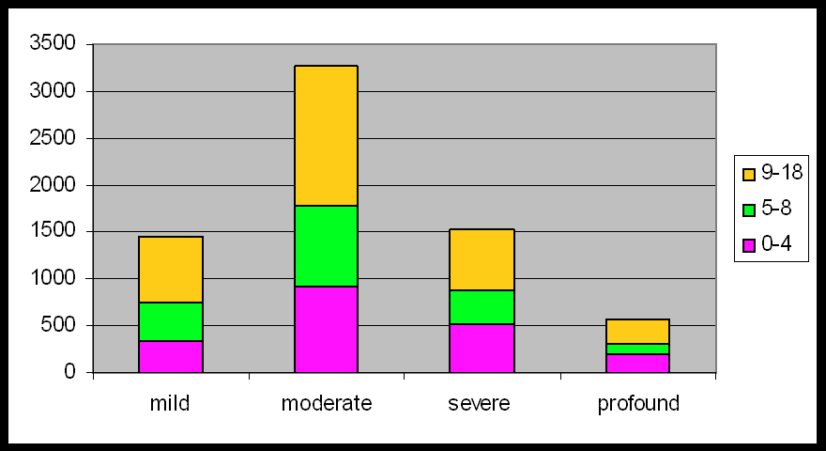
Data logging study – almost 5000 children
AGE
TOTAL HOURS OF USE
Notes:
72 clinics
28 schools
8 months of data logging
4918 children
8669 ears (1167 unilateral amplification users)
Average AC hearing loss – 56 dB (94% SNHL)
97% wore BTE hearing aids
63% of children in the study used economy aids, 10% basic aids, 22% advanced and 5% had premium hearing aids
NOTICE – fewer aided children in the mild hearing loss category – if they are being fit with aids, they are not wearing them!

Slide 12

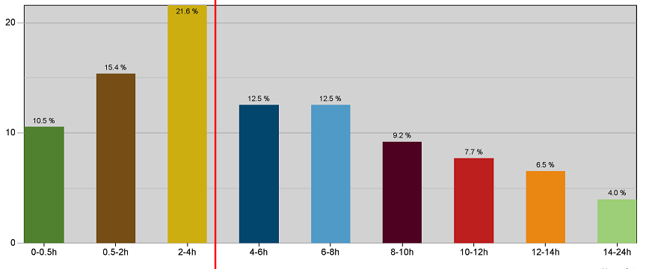
Findings
40%
Percentiles by usage time
40% of children use their devices
less than 4 hours per day
Notes:
40% of kids use their devices less than 4 hours per day
Only about 10% achieve hearing aid wear all waking hours
School-aged are in noise about 30% of time – they are more likely to be using FM in classroom settings
Infants are in noise about 20% of listening time – If an infant only has hearing aids on a few hours per day, then 20% of listening time in noise can substantially interfere with incidental exposure to language (language is caught, not taught)
http://www.phonak.com/content/dam/phonak/b2b/Events/conference_proceedings/soundfoundation_chicaco2010/pdf/SoundFoundation_Chicago2010_Jones.pdf

Slide 13
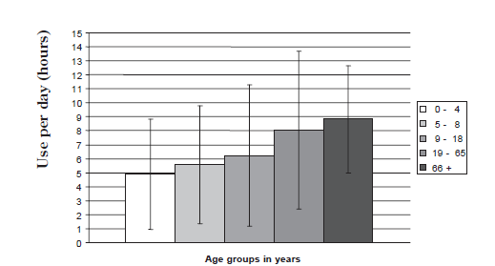
Data logging study – 5000 children Number of hours by age
FM use
3 hrs
in
noise
2 hrs
in
noise
Age
9-18
6 hrs
Age
5-8
5.5
hrs
Age
0-4
5 hrs
adult

Slide 14
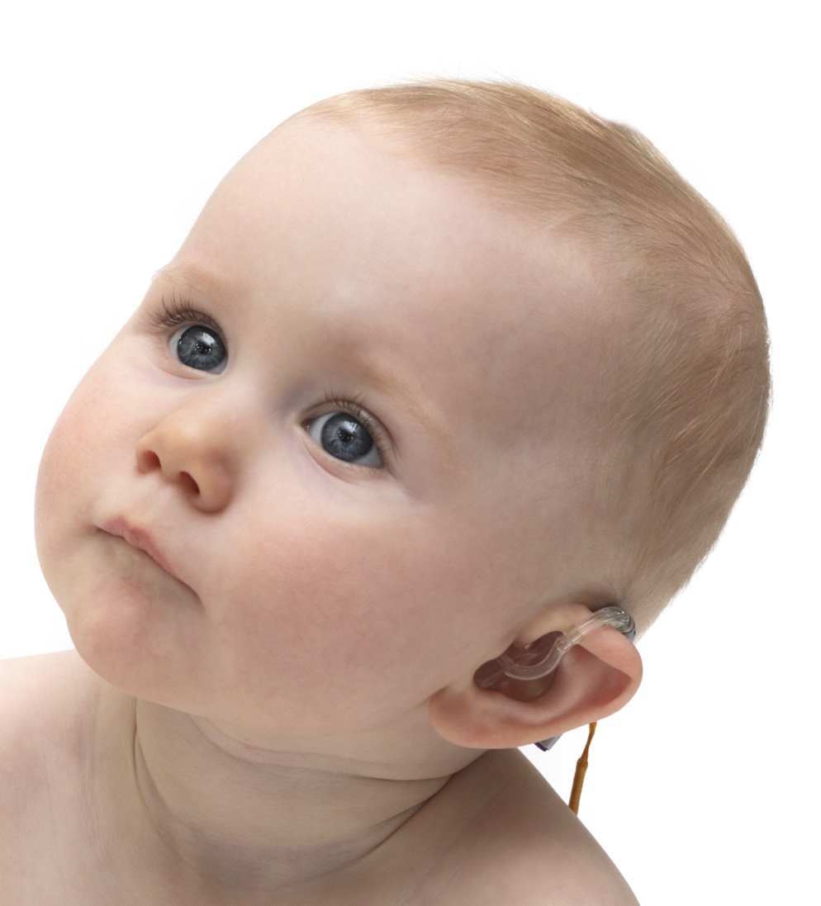
Technology –Unilateral HL
Not all states allow eligibility for services for families of infants/toddlers with UHL
Audiologists are NOT consistent in amplifying poorer hearing ear, even if very useable hearing is evident
CROS hearing aids are fit on children even though research suggests poor performance in noise
Research indicates importance of fitting in first 4 years for best ability to localize sound; age 7+ is too late; HA may diminish performance
Bone anchored devices being fit even for UHL
FM use results in best performance for UHL

Slide 15
Educational Program – 0-3 years
91% of infants were found eligible for local early intervention services
Some EI programs still wait for a delay
The minority purchase hearing aids (no CI)
Poor to less than optimal outcomes at age 3 are due to ‘general EI teachers’ serving families of children with hearing loss
Increasing number of parent ‘guide by your side’ opportunities and Deaf mentors
Biased information is still a problem re: communication choice by families
Deaf culture members are becoming more militant toward requiring all infants to sign

Slide 16
Continuum of communication modality
Communication modality needs can change
throughout the school day
A
Av
AV
VA
V
Changes: background noise, new vocabulary, interest, fatigue, etc
Increasingly trying to move away from the view of parents making one ‘choice’ for their child’s communication

Slide 17
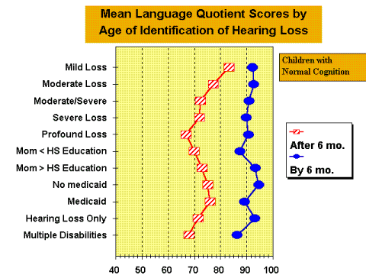
Importance of Early Identification & Intervention
NORMAL
RANGE OF
DEVELOPMENT
Published
2000

Slide 18
Educational Program – school age
‘Classically trained’ deaf educators are primarily skilled in serving Deaf students with sizable delays in center-based programs
Most DHH students are now in the mainstream with few other DHH peers
Little or no training provided to deaf educators on how to provide itinerant services
Other school ‘expert’ on HL is the SLP – they are not required to have any training in aural habilitation as part of their degree program
Increase in number of LSLS trained providers

Slide 19
Following up early early identified children
New data from Christi Yoshinaga-Itano (2010)
Language growth of 135 children age 4-7
Children were cognitively normal from English speaking families with hearing parents
Assessed 3-4 times from 48-84 months of age
Median age of ID – 3 months, EI start – 8 months
Both cochlear implant users and hearing aid users (mild – severe/profound)
Results: children fell into one of 4 groups

Slide 20
Language Learning during age 4-7 years
Desired Outcome!
Result of lack of access
or appropriate intervention
Notes:
Children seem to fall into different groups based on how their language was developing:
delayed performers (10th percentiles – signif lang delayed)
gap closers – delayed at 4 but caught up by 7
gap openers – okay at 4 but delayed significantly by 7
normal /high performers – 12 m – 7 yrs lang developmt normal or above age level consistently
N=135 children with longitudinal data (3 or more assessments) from 48 to 87 months of age.
– Children with non-verbal cognitive development within the normal range
– English-speaking families
– Hearing parents
Four assessment occasions: 48, 60, 72, 84 (+/- 3 months)
• Median age of identification: 3 months
• Median age of intervention start: 8 months
• N=87 had severe to profound HL.
• N=48 had mild to moderate HL
Delayed Performers: Similar percentage of children with CIs and children with HAs
• Normal/High Performers: Similar percentage of children with CIs and children
with HAs
Only 1 in 4 children with CI maintain normal or above language development.
• Another 1 of 4 children with CIs are gap closers.
Over half of CI have mothers with 16+ years of education

Slide 21
Which child characteristics differentiate language trajectories?
Similar percentage of children with CIs and HAs who are Delayed and Normal/High Performers
More CI gap closers (21%) than HA (13%)
CI gap closers either had severe or progressive HL (not born with profound HL)
Most CI gap closers had mother’s with college degrees and graduate education

Slide 22
Placement Trends:
Over the past quarter century the percentage of deaf and hard of hearing students:
Attending special schools has declined by more than half
In separate and residential facilities has largely been in decline, as has the share of students receiving greater than 60% of their instruction outside of the regular (mainstream) classroom.
Instructed in regular education settings more than 40% of the school week (i.e., less than 61% outside of the regular classroom) has climbed from 45% to about 65%.
Mitchell, R., & Karchmer, M. (2006). Demographics of deaf education: more students in more places. American Annals Of The Deaf, 151(2), 95-104.

Slide 23
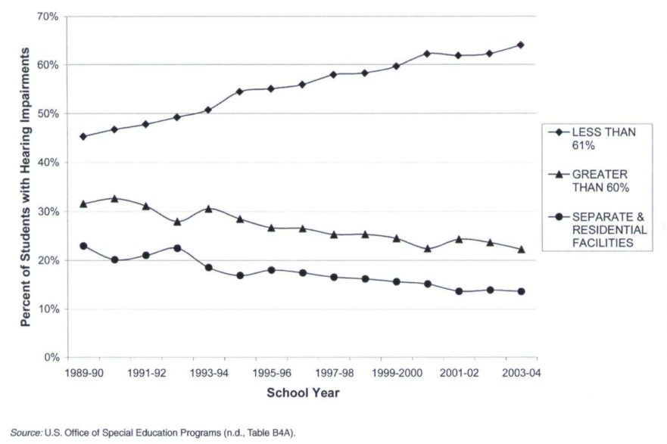
Educated
outside of
mainstream
Mitchell, R., & Karchmer, M. (2006). Demographics of deaf education: more students in more places. American Annals Of The Deaf, 151(2), 95-104.

Slide 24
Changes to Population Served 2008 annual OSEP report
Percent – Deaf/Hard of Hearing | 1996-1997 | 2005-2006 | Change
High school completion | 74% | 87% | +13%
Graduate with regular diploma | 62% | 69% | +7%
Percent of population age 6-21 | 0.1% | 0.1% | --
Time inside regular classroom 80%+ | 39% | 49% | +10%
Time inside regular classroom 40-79% | 19% | 18% | -1%
Time inside regular classroom <40% | 25% | 20% | -5%
Other environments | 17% | 14% | -3%
http://www2.ed.gov/about/reports/annual/osep/2008/parts-b-c/index.html

Slide 25
Percent of the number of schools serving students with hearing loss by number per school
Mitchell, R., & Karchmer, M. (2006). Demographics of deaf education: more students in more places. American Annals Of The Deaf, 151(2), 95-104.

Slide 26
Percent of total student population with hearing loss by number at each school
Mitchell, R., & Karchmer, M. (2006). Demographics of deaf education: more students in more places. American Annals Of The Deaf, 151(2), 95-104.

Slide 27
Assuring communication access
Consideration of special factors. --The IEP Team shall--
(iv) consider the communication needs of the child, and in the case of a child who is deaf or hard of hearing, consider the child’s language and communication needs, opportunities for direct communications with peers and professional personnel in the child’s language and communication mode, academic level, and full range of needs, including opportunities for direct instruction in the child’s language and communication mode; and
(v) consider whether the child requires assistive technology devices and services.

Slide 28
Communication Plans
Several states require a Communication Plan in addition to the IFSP and IEP
1. a. The child’s/student’s primary language is one or more of the following. Check all that apply.
Receptive Expressive
English
Native language (ASL, Spanish etc), specify___________________
Combination of several languages
Minimal language skills; no formal primary language
The child’s/student’s primary communication mode is one or more of the following. (receptive and expressive language)
Auditory; American Sign Language; Signing Exact English;
;Cued Speech/Cued English; Conceptual signs (Pidgin Signed English); Fingerspelling; Gestures; Tactile/objects; Picture symbols/pictures/photographs; Home signs

Slide 29
Goal development for services
All IEP goals must be written to conform to the Common Core Standards
The Standards provide a consistent, clear understanding of what students are expected to learn.
They are designed to be relevant to the real world
Example: Ask and answer questions in order to seek help, get information, or clarify something that is not understood.

Slide 30
Assessment of Progress
HIGH STAKES TESTING!
Schools/teachers are being ‘graded’ based on how well their students perform on state standardized tests
Funding can be cut, educators/principal fired or reassigned
Now ALL students count and must take the test, even if it seems inappropriate
Reinforces non-grouping of lower performing students with special needs
All schools and students are expected to make annual yearly progress

Slide 31

In a nutshell
More have language/skills similar to peers
More ‘deaf’ are functioning as children with mild hearing loss due to cochlear implants
More children are entering their neighborhood schools
More children who never or very rarely see another child using hearing technology
Even with several children in one school, they may not see one another as ‘he’s like me!’
Comparison ‘typical peers’ for annual yearly progress via high stakes testing

Slide 32


Questions?
Thank You!

Slide 33
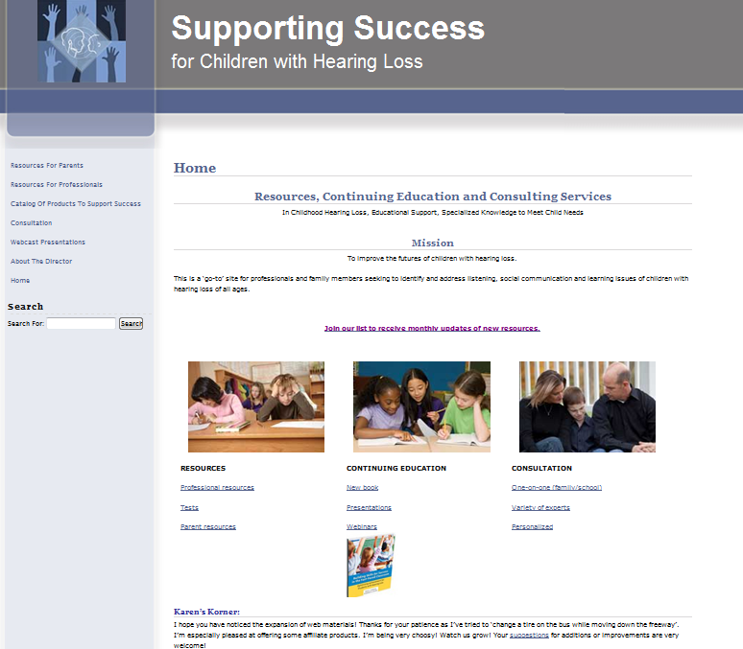
Resources available:
Professionals:
Tests
Many topics
Resources!
Book:
Building Skills for
Success in the
Fast-Paced
Classroom
http://successforkidswithhearingloss.com

