Slide 1
Turn-and-Talk:
What will the school team need to include in their planning for An Li to ensure that he has the best auditory access possible?
What will An Li need to be able to do to help ensure that he receives the same level of instruction as his class peers?
Audibility; functional listening ability; listening
challenges in the environment
Independence with technology, advocate for himself;
repair communication breakdowns

Slide 2

Communication Repair

Slide 3

What is Communication Repair?
Communication breakdowns occur whenever the speaker is not understood by the listener.
Many variables can contribute to communication breakdowns, including:
background noise
physical distance
speech intelligibility
fragmented hearing
unfamiliar vocabulary and more.
Everyone experiences communication breakdowns regardless of hearing ability.

Slide 4

Communication repair from the start….
Young children develop repair strategies as they experience communication breakdowns
It is an integral part of the language acquisition process
Repair strategies are an early developing mechanism
Strategies used to provide clarification change with age

Slide 5
Contributing to Classroom Access
Students who are aware of communication breakdowns when they occur
And who effectively address the breakdown, via
Use of communication repair strategies
Addressing environmental barriers
Advocating with other communicators for their listening/communication needs
Are more likely to be empowered and perceived as a respected class member who deserves communication accommodations for full access
Lifelong skills contributing to full independence

Slide 6

How has Communication Repair been Studied?
Various methods have been used.
To assess knowledge of CR strategies, researchers identify what strategies children use when they are asked to clarify WHAT THEY SAID
Typically one of a set of pictures or objects is described by the child. The clinician asks the child:
Huh?
What?
I don’t understand

Slide 7
How are CR strategies classified?
3 broad categories of verbal CR; also nonverbal CR
Each broad category has several strategies for a total of 13 plus inappropriate responses to equal 16
REPETITION – no information is added to the original utterance
REVISION – meaning of original utterance unchanged; form is altered
ADDITION – Simple - information is added to the original utterance - Clarifying – specific information added to define, clarify
NONVERBAL - student uses strategies other than verbal
INAPPROPRIATE – student did not comply with request for clarification
Notes:
Have SCRIPT Inventory Response Summary and Scoring Interpretation as handouts.

Slide 8
Mom, can you say that more slowly please? | Repeat at a slower rate | REPEAT
Mom, can you say that again more clearly please? | Repeat spoken more clearly
Mom, did you say we were stopping for fast food? | Emphasize key word(s)
Mom, I didn’t hear you – could you say that again louder? | Repeat louder
Did I hear you say food? Where can we stop for food? | Break into two sentences | CHANGE FORM
Can we go to a restaurant for lunch? Fast food? | Different words, same meaning
I would like to stop for fast food too. | Different form (word order)
Are we stopping for fast food now? | Add just a little information (Simple Addition) | ADD INFO
It’s lunchtime and I am hungry. | Define terms (Clarifying Addition)
I’m hungry too. I like Burger King more than McDonald’s. | Add background context (Clarifying Addition)

Slide 9

How CR strategies develop
Repetition develops first – repeat slower, louder, clearer or repeat a key word with emphasis
Revision also develops early, but isn’t a major strategy – use 2 sentence, alternate words, alter form grammar
Addition is the most useful strategy for achieving clarification – simple addition or complex addition, i.e., define terms, add background context
By age 8-9, children use more addition repair strategies as their linguistic skills become more complex
Inappropriate responses no longer occur by age 8-10
There are no norms for use of nonverbal strategies
Notes:
Have SCRIPT Inventory Response Summary and Scoring Interpretation as handouts.
Communication Repair Strategies Summary (pg 36 of 75)

Slide 10
SCRIPT – Student Communication Repair Inventory & Practical Training
SCRIPT Inventory
obtains a baseline of the strategies that the student already uses when communication breakdowns occur.
The baseline is used to guide the teacher in what other strategies to familiarize the child
Developmental Trends provide guidance on specific skill building objectives

Slide 11
Developmental Trends

Slide 12

Reality Check – Transfer of student’s skills responding when HE is not understood to when he doesn’t understand others
Repetition – these examples transfer easily into how a student can ask appropriately for a speaker to repeat. Emphasizing a key word is the most useful skill.
Revision – these skills are specific to responding when someone doesn’t understand you. These are ‘form changes’, including using different words with the same meaning, different word order, 2 sentences.
Addition – these are the most useful skills to develop and rely on the student to add a little information. This lets others know that he has been paying attention but just misunderstood/misheard a portion.
Visual strategies are also an option – use of appropriate facial expression may be a key strategy to work on.

Slide 13
So don’t they already know how to repair communication?
In 1998 a study compared children with NH to DHH children using Total Communication
The two groups used different strategies: DHH were more likely to repeat what they had said
NH repeated, revised, and also provided background cues (addition)
As NH became more linguistically skilled they used fewer non-verbal revisions
DHH used linguistic responses less often and relied heavily on non-verbal information to clarify messages

Slide 14
Will it really help?
A study set up 7 small groups of 9-12 year olds, each with 3 hearing children and 1 child with hearing loss
4 of the 7 children with hearing loss were trained in communication breakdown management
RESULT: There were fewer communication breakdowns for those who were trained
They added effective addition strategies to the frequently used strategy of repetition

Slide 15
Implications
Typical language tests used may not be sensitive enough to detect differences in pragmatic use of language specific to communication repair strategies
Children with hearing loss do not spontaneously learn how to cope with communication breakdowns at the same rate, or in the same way, as individuals with normal hearing

Slide 16
SCRIPT INVENTORY – What it looks like
You and the student will be looking at set of 12 pictures. (barrier game or computer)
The pictures included in the set are intentionally similar and somewhat unclear to make it more natural to have to ask for clarification.
You will ask the student to choose one of the 12 pictures and describe it to you so you can locate the same picture.
You will ask the student ‘Huh’, ‘What’, ‘I don’t understand’ when you are both looking at the set of pictures.
You need to obtain 3 communication repair responses for each set of pictures you obtain data

Slide 17
SCRIPT INVENTORY – What it looks like
Mix it up to keep it motivating
You will ask the student clarifying questions for some of these picture sets and not others in order to maintain motivation – the total number of picture sets used is up to you.
For five of the picture sets, you will ask the student three questions to clarify what the student said.
There will be a total of 15 responses that you will categorize into a communication repair strategy type.
The total SCRIPT Inventory score is based on 15 responses

Slide 18
SCRIPT INVENTORY – Instructions for Students (1)
“I will show you some groups of pictures. I want to know how clearly you can describe just one of the pictures.
Out of the 12 pictures, you will choose whichever picture you want to. I am interested in how well you can describe that one picture to me. Do your best to describe it clearly enough for me to identify which picture it is.
You are not allowed to identify the picture by where it is (no pointing). You must use words to describe what you see in the picture you chose.”

Slide 19
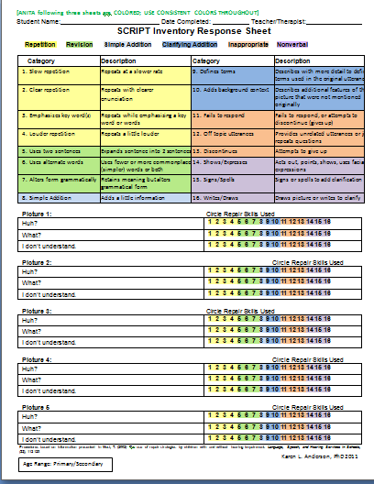
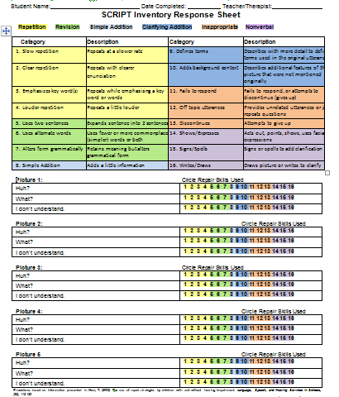
Administering
the SCRIPT
Inventory

Slide 20
SCRIPT INVENTORY – Instructions for Students (2)
“This is also a test about what you do when people can’t understand what you say. Think about different times that someone has asked you “What?” It happens to everybody.
For some of the pictures, I will be pretending that I do not understand you. It is important for you to answer like you would if anyone who didn’t understand you asked a question like “What?” There are different ways that people can answer. I want to find out the ways that you know.
I will be writing down some of what you say.”

Slide 21
SCRIPT INVENTORY – Instructions for Teachers
To elicit communication repair, you will respond to the student as if the description was not clearly understood. For each test picture set (group of 12 pictures), you will ask the student to repeat what he said three times by saying:
“Huh?” Write down the response to your “Huh?” in the space provided on the response sheet.
After the student has further described the picture, say “What?” and write down that response.
After the student has shared more, say “I don’t understand” and write down that response.
You can adjust the wording so that the student stays motivated (e.g., “Pardon me?” “Excuse me?” “Hmmm?” “I still can’t get it.” “I still don’t understand.”). However, three responses per test picture are needed.

Slide 22
SCRIPT INVENTORY – Scoring for Teachers
STEP 1: Collecting Student Responses on the SCRIPT Inventory Response Sheet
While administering the SCRIPT Inventory you can choose to do one of the following:
Make an audio recording of how the student responds to each of your questions (“Huh?” “What?” “I don’t understand”).
Write the student’s response down verbatim in the spaces provided on the sheet.
Listen carefully and then select the category of repair strategy the student’s response best fits into.

Slide 23
SCRIPT INVENTORY – Scoring for Teachers
Step 2: Completing the SCRIPT Inventory Response Sheet
After eliciting responses to the question, circle the communication repair strategy number that best represents the student’s response.
For example, if the student responses to your “Huh?” by simply repeating the same words at a slower rate, you would circle response category “1.”
You can mark multiple response types for each question, but you select only one type of repair strategy for scoring each of the 15 questions you ask the student.

Slide 24
Scoring Tips
The most important point is to determine which of the 5 categories the student’s response is in.
If the student response could fall into two categories choose the higher developed skill category to capture emerging skills.
Ex: There’s a red skateboard with a duck on it. (#5 revision – different word order) There’s also a green baseball and an orange football. Another ball with a map-thing on it too. #10 – adds background, more features. Score as #10.
Ex: I see a duck on a skateboard with a green baseball. There’s an orange football too.
Both key word (#3 repetition) and adding a little information (#8 simple addition). Score as #8.
An alternative would be to circle the highest response and put an X on the other response type present. You would still score the highest, but would capture the existence of other skills too.
Ultimately, you make the call about which category best represents the students use of CR strategies

Slide 25
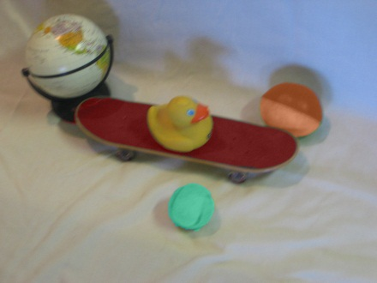
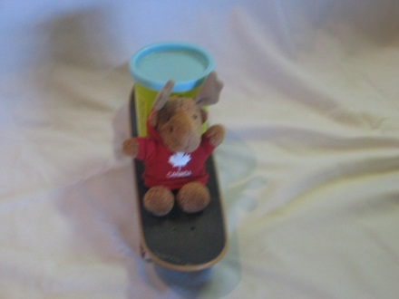
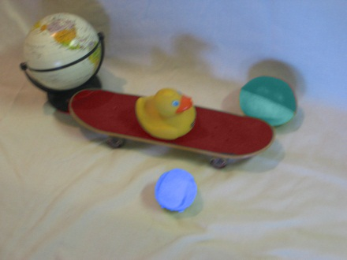
Practice scoring (1)
Student: A duck on a skateboard and a green ball.
You: Huh?
Student: There’s a duck on a skateboard. A green ball too.
You: What?
Student: I see a duck on a skateboard with a green baseball.
You: I don’t understand.
Student: There’s a red skateboard with a duck on it. There’s also a green baseball and an orange football. Another ball with a map-thing on it too.

Slide 26
Practice scoring
Student: A duck on a skateboard and a green ball.
You: Huh?
Student: There’s a duck on a skateboard. A green ball too.
#2 – clear repetition and #5 – two sentences
You: What?
Student: I see a duck on a skateboard with a green baseball.
You: I don’t understand. #3 – emphasize key word
Student: There’s a red skateboard with a duck on it.(#7 alters form) There’s also a green baseball and an orange football. Another ball with a map-thing on it too. #10 – adds background, more features

Slide 27
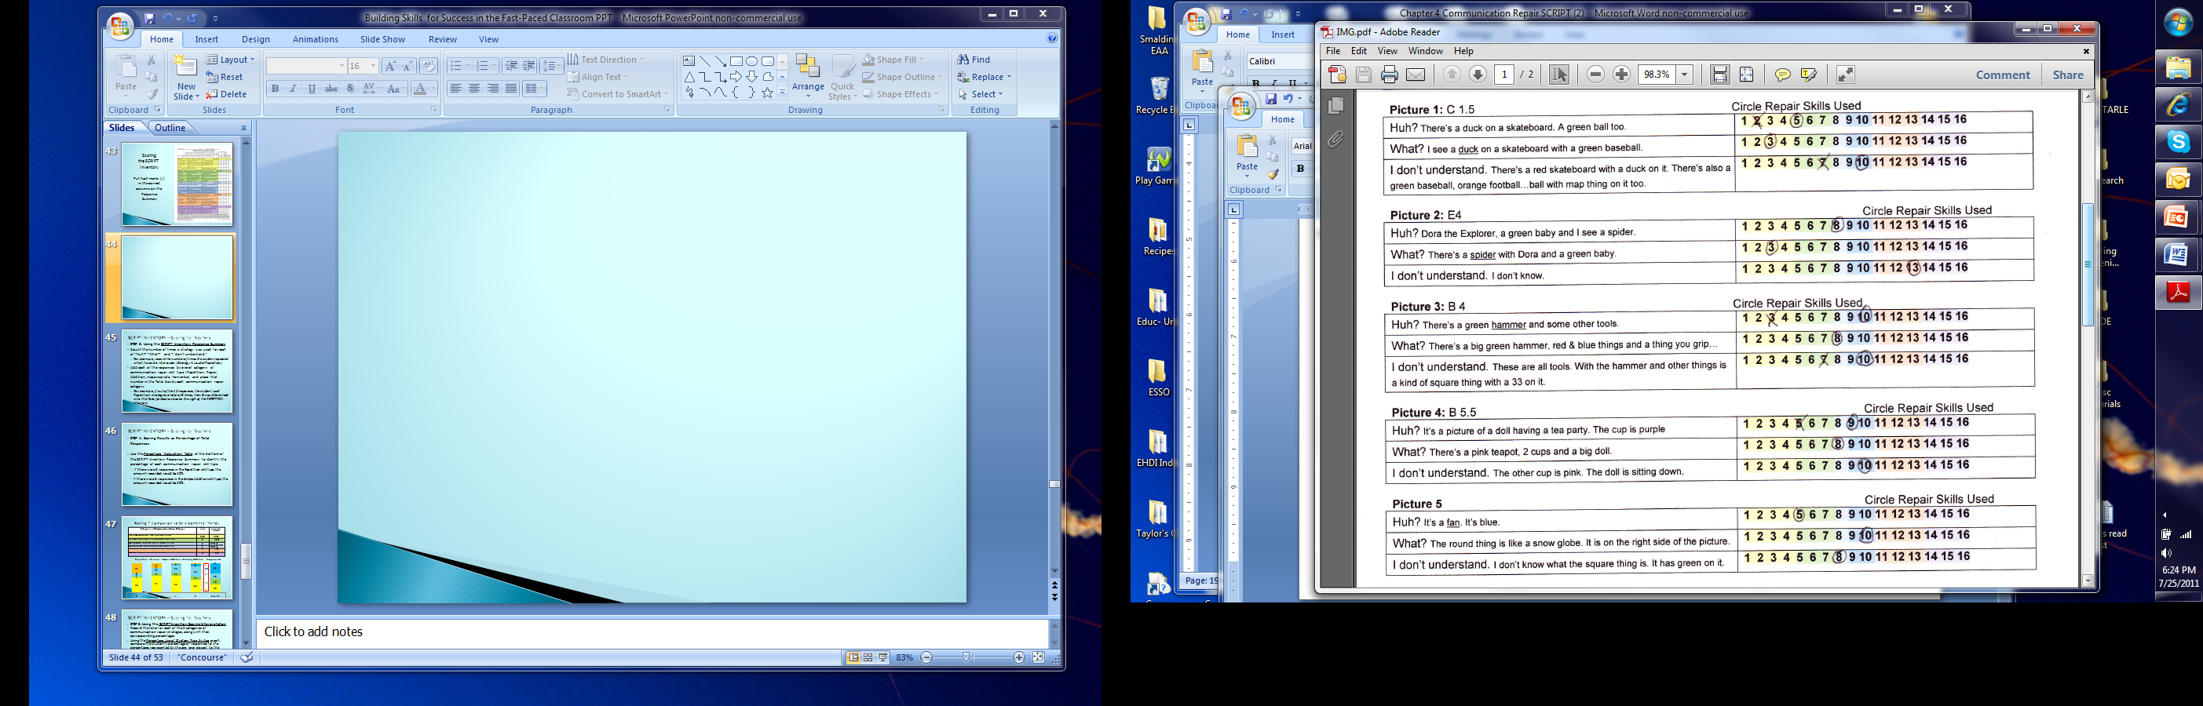
Is this how you recorded the responses?

Slide 28
SCRIPT INVENTORY – Scoring for Teachers
STEP 3: Using the SCRIPT Inventory Response Summary
Count the number of times a strategy was used for each of “Huh?” “What?” and “I don’t understand.”
For example, record the number of times the student repeated what he said a little louder (Strategy 4: Louder Repetition).
Add each of the responses by overall category of communication repair skill type (Repetition, Repair, Addition, Inappropriate, Nonverbal) and place that number in the Total box by each communication repair category.
For example, if out of the 15 responses, the student used Repetition strategies a total of 8 times, then 8 would be entered into the Total for Section box on the right of the REPETITION title row.

Slide 29
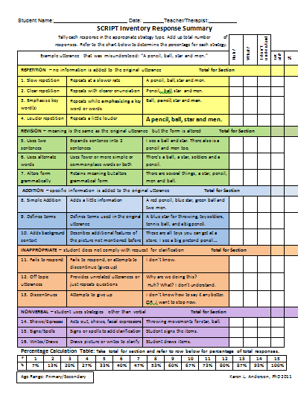
Scoring
the SCRIPT
Inventory
Put hash marks (/)
in the correct
columns on the
Response
Summary

Slide 30
SCRIPT INVENTORY – Scoring for Teachers
STEP 4: Scoring Results as Percentage of Total Responses
Use the Percentage Calculation Table at the bottom of the SCRIPT Inventory Response Summary to identify the percentage of each communication repair skill type.
Categories of Communication Repair Strategies | Total for section | Percentage of responses
REPETITION – no information is added to the original utterance
REVISION – meaning of original utterance unchanged; form is altered
ADDITION – Simple - information is added to the original utterance
ADDITION - Clarifying – specific information added to define, clarify
INAPPROPRIATE – student did not comply with request for clarification
NONVERBAL - student uses strategies other than verbal

Slide 31
SCRIPT INVENTORY – Scoring
STEP 5: Using the SCRIPT Inventory Scoring Interpretation
Record the total for each of the 5 categories of communication repair strategies, along with their corresponding percentages.
Using the Percentage Use of Strategy Type by Age graph, compare the student’s percentage of responses to the percentages represented by the age level closest to the student’s age in order to approximate strength and weakness in strategies used.
If an age 9 student scored 20% in Simple Addition, it would be less than the expected 34%. If the student was age 5, then 20% would appear to be developmentally appropriate.
The developmental trends should be used as a general guideline of developmental advancement of skills as the data that supports this chart are too few for precise demarcations of normal/delayed development.

Slide 32
Scoring & Comparison to Developmental Trends ( example for An Li, age 9)
Categories of Communication Repair Strategies | Total for section | Percentage of responses
REPETITION – no information is added to the original utterance | 2 | 38%
REVISION – meaning of original utterance unchanged; form is altered | 3 | 14%
ADDITION – Simple - information is added to the original utterance | 4 | 19% | 30%
ADDITION - Clarifying – specific information added to define, clarify | 5 | 11%
INAPPROPRIATE – student did not comply with request for clarification | 1 | 12%
NONVERBAL - student uses strategies other than verbal | 0 | 6%
12
11
19
14
38

Slide 33
Turn-and-Talk
1. How do you currently
gather information on student’s use of communication repair strategies?
2. What skills do you think it would be appropriate for An Li to develop?

Slide 34
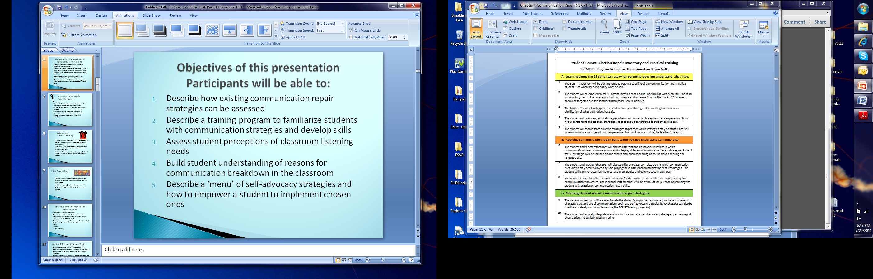
SCRIPT Inventory
is Step 1
of the
SCRIPT
SCRIPT Program Overview

Slide 35
Example Instructional Goals for Communication Repair
Skill area | Objective
Repeats slowly, clearly or in a louder tone | During a 5-minute conversation with an adult, the student will repeat his response to a question more slowly and loudly when asked for clarification 4 out of 5 times as measured by clinician tally.
Repeats what he thought was said as part of a request for clarification | During a 5-minute conversation with an adult, the student will repeat what he thought was said to clarify 3 out of 5 times as measured by clinician tally.
Ask for restatement or clarification | During a presentation by a peer, the student will ask for repetition or clarification 3 out of 5 times as measured by teacher observation.

Slide 36
SCRIPT Program
SCRIPT Inventory is Step 1

Slide 37
SCRIPT – Practical Training – Step 2
Familiarization Strategies
Building on the strategies the student already has, the teacher will familiarize the student with all of the communication repair ‘tools’ (13)
The familiarization phase is intentionally SHORT
Familiarization should result in the student being aware that there are various ways to ask for clarification
When you say “huh” or “what,” the other person will usually just repeat what he or she has said. When you use these specific strategies, the other person will know what exactly you missed and then you both will understand each other.

Slide 38

Familiarization materials
All have the same format
Define the strategy group
Define each of the individual strategies
If someone does not understand what the student says
If the student does not understand what someone else says
Summarize the overall strategy
All have the same examples
All have practice items set up in the same way
This allows the teacher to quickly go to the strategies the student is missing – be strategic
Again, it is NOT intended that this phase be very time consuming
PARTICIPANTS REVIEW FAMILIARIZATION MATERIALS

Slide 39
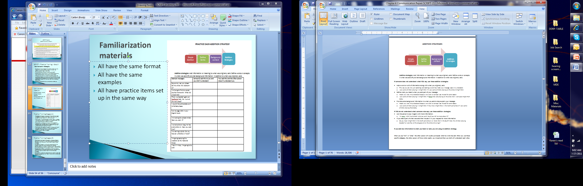
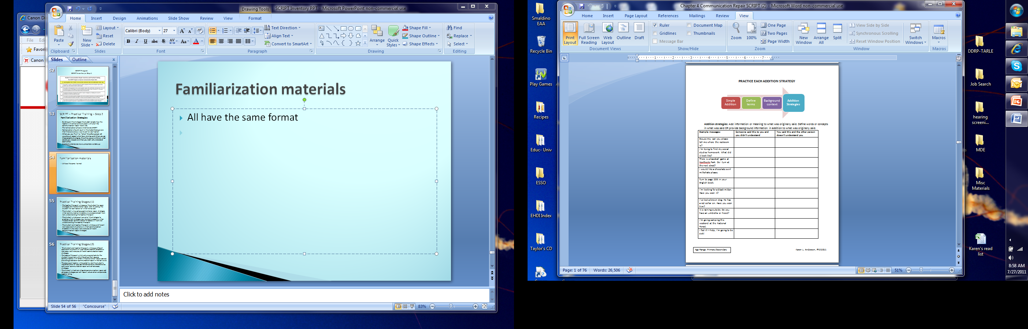

Slide 40
SCRIPT PRACTICAL TRAINING STAGES
1. You model listener repair skills by asking the student for clarification of what he has said.
2. Student practices specific repair strategies when not understanding the teacher (you) then chooses strategies that are most successful.
3. Role-play different non-classroom situations and classroom situations in which communication breakdown may occur.
4. Teacher-structured tasks for the student to perform within the school to provide practice on communication repair in the real world

Slide 41
Modeling Listener Repair Strategies: Step 3
The Concept:
Tell the student that you will be pretending that you don’t clearly understand what s/he says.
You will be showing him how people can respond when they don’t understand.
The basics:
The teacher says a sentence or two
The student repeats the sentence
The teacher models a repair strategy.

Slide 42

Modeling CR Strategies
Make the point that the student already knows some CR strategies (results of SCRIPT Inventory)
Before you can teach someone how to repair something, there has to be something broken first.
Start with strategies that the student has already shown that he can use.
Approach this as a game since the student’s failure at repeating is the starting place for developing communication repair skills.

Slide 43
Example for Pre-K and Early Elementary
Example Story: The Three Bunnies
Chart story: Basic technique for focusing on new vocabulary and comprehension of language forms.
Early readers: teacher reads a line and then covers it up when it is the student’s turn to repeat.
Non-readers: story and picture cues remain visible
Any appropriate grade/ability-level materials can be used.
Reinforce materials used in class
Enrichment or vocabulary building materials
Informal story or series of sentences based on toys or materials available at the moment

Slide 44
Modeling strategies
You can choose to model one type of strategy. OR-
It may be most natural to respond using a number of the strategies, based on the repetition error made by the student.
Example provided for The Three Bunnies has 2-3 examples of repair strategies that could be modeled.
Spend most of your time providing examples of strategies in areas that the student does not already use and that are most useful (i.e. Addition strategies)
Notes:
Provide pg 45-47 of Chapter 4 -

Slide 45
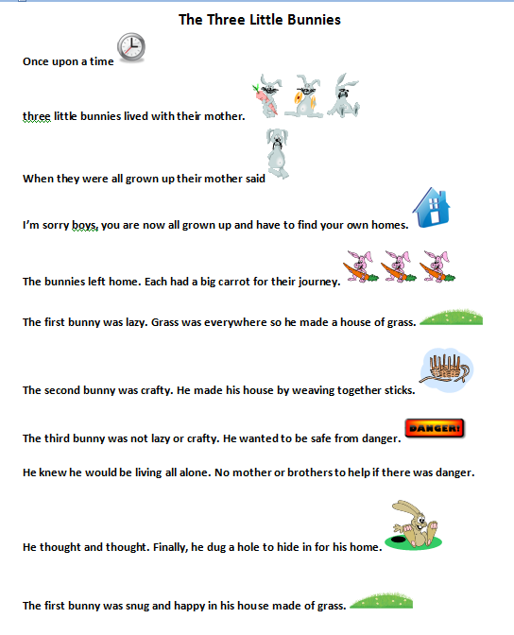
The Three Little Bunnies
Once upon a time three little bunnies lived with their mother.
Could you say that again please? Three what lived with their mother? Excuse me, did you say they were big
or little?
When they were all grown up their mother said
Could you say that more slowly please? Did you say the bunnies were now grown up?
I’m sorry boys, you are now all grown up and have to find your own homes.
What did they have to do because they are all grown up now? The bunnies need to find what?
Notes:
Provide copies of The Three Bunnies
Participants work in pairs. Each one takes a turn to be the student for a page and the teacher for a page.

Slide 46

Phase 2 of Training
In Phase 1 the teacher was modeling how to respond with repair strategies
In Phase 2 the teacher will start to shape the student’s use of repair strategies
Phase 2 works on identifying what ‘broke down’ in communication (raising awareness)
Phase 2 also develops CR skills to address breakdowns
Again, be clear that in order to teach someone how to repair something, it must be broken first.

Slide 47

Phase 2 provides opportunities to target awareness & problem solving skills
When the student misses repeating what was said the teacher/therapist should say something like:
I heard you say X. Where in this sentence do you think something is missing or does not sound right?
Does what I said make sense without that part? What do you think the sentence I said means?
In order to really understand, do you think you need to get more information? (Develop problem solving “does this make sense” skills, use of context, redundancy of language, use of world knowledge, etc.).

Slide 48

Primary task is to practice CR skills
When the student misses repeating what was said the teacher should say something like:
“Let’s use the communication repair strategy. How could you use it to repair the breakdown?”
“Let’s try this again.” (Repeat the sentence and encourage the student to use the communication repair strategy).
Be strategic on strategies to work on most - at this stage you are still providing examples of all strategies
Developing CRITICAL THINKING skills

Slide 49
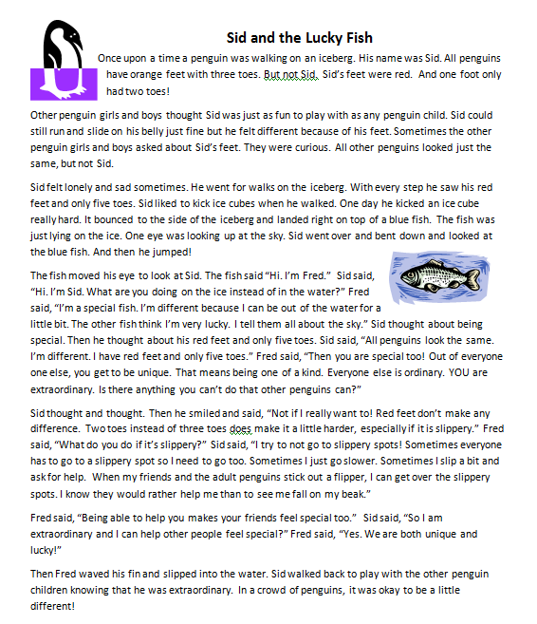
Phase 2
Any text can be used
Good time to reinforce content area vocabulary and concepts
Sid & the Lucky Fish was provided for practice – it serves to empower students about how okay it is to be different

Slide 50
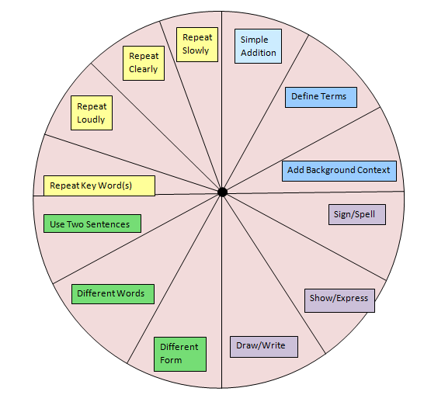
Phase 3 – Random CR Practice
The teacher intentionally mispronounces words to cause a communication breakdown
Short phase to force use of CR strategies
Can use the Communication Repair Skill Wheel
Notes:
Provide participants with copies of the CR Skill Wheel

Slide 51
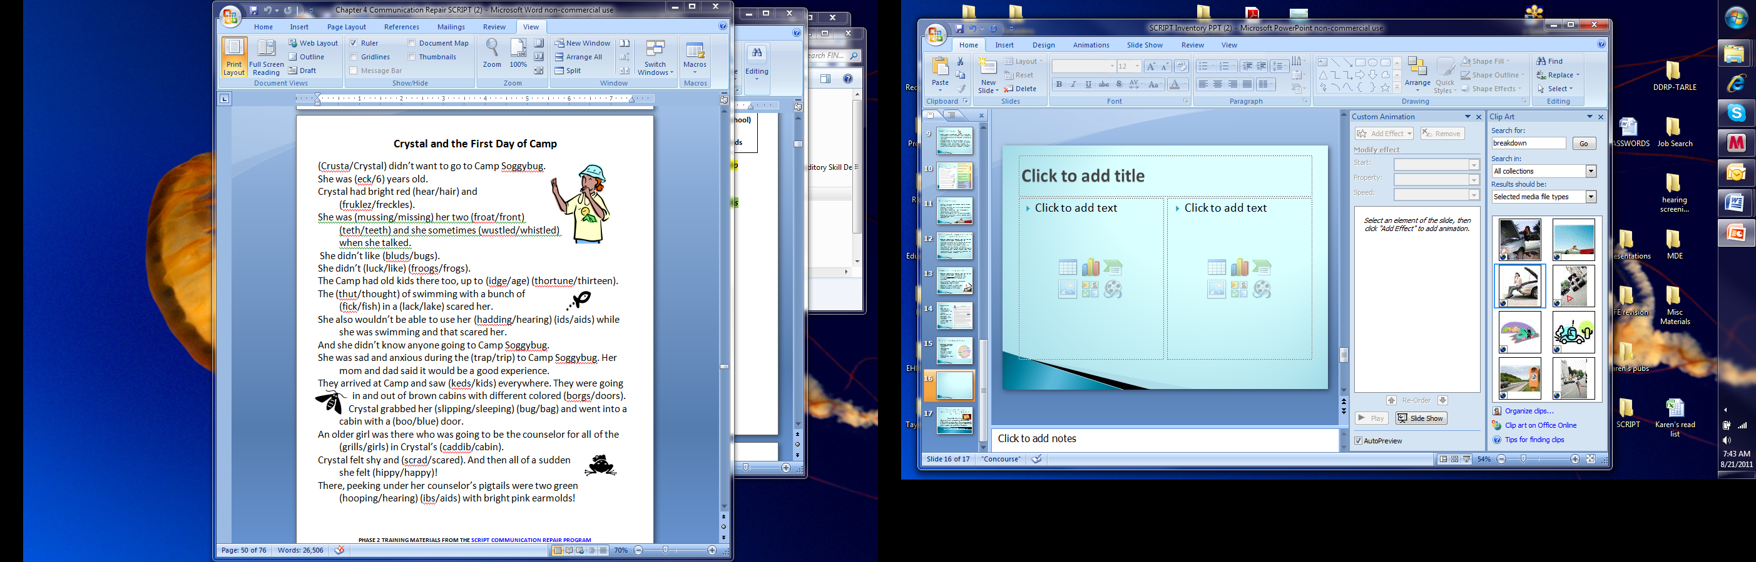
Phase 3
Teacher reads a sentence
Student uses a CR strategy to repair what was not heard clearly
Good time to practice using context to guess meaning
Reinforce most useful CR strategies (addition)
Notes:
Participants role play using pages 50-51 of Chapter 4

Slide 52

Phase 4 – Role Playing Scenarios
You are in a fast food restaurant and it is very busy. Many people are standing in line to order food and it is noisy. It is your turn to order. You want a hamburger, fries and a strawberry milkshake. The person taking your order asks you a question about what you want, but you only understand part of what he says. No one you know is next to you to help you.

Slide 53

Phase 4 – Introducing CR use at School
Now that the student is familiar with CR strategies and has had practice with them, they begin to be applied to school situations
Talk about :
why it is important to use CR strategies
When you know you missed something, ask yourself these questions
If the teacher is ready to start and you still don’t know, what can you say or do
This is also a time to start introducing self-advocacy activities
Homework is provided (can also be used for discussions at school)
Notes:
Participants review Communication Repair at School – pg 55 of Chapter 4
and page 59 – Homework for Practicing CR at a Restaurant

Slide 54
Phase 5 – Practicing in Real Situations
Practice with the teacher is integrated into other 1:1 teaching tasks
Add noise, use unknown/unfamiliar vocabulary
Turn away from student in mid-sentence or walk across the room
Reinforce the student’s use of communication repair strategies when you are working with him/her – expect him to repair!
CR strategies should be practiced and reinforced intermittently until the student demonstrates comfort with consistently implementing CR strategies

Slide 55

Phase 6 – Structured Practice in the Real World
Real world communication activities can be role-played with the teacher/therapist prior to the student doing the activity.
Suggested activities are:
Integrate communication repair opportunities into work with small groups of students (chatting during lunch period, cooperative small group work).
Game playing (i.e., Go Fish) with peers
The student will go ask the office assistant for an office supply (i.e., a blank envelope).
The student will ask the educational audiologist for spare batteries, etc.

Slide 56
Competence in communication Repair
Competence in repairing communication is based on three skills:
(1) the ability to persist in the communication process until comprehension is achieved
(2) the ability to take on the perspective of the communication partner, allowing for the recognition that a communication breakdown has occurred and
(3) the development of effective alternative communication options.

Slide 57
Communication Repair Goals
Skills | Objectives
Emphasizes key word(s) | During a 5-minute conversation with an adult, the student will emphasize key words in responding to a request for clarification 4 out of 5 times as measured by clinician tally.
Repeats what he thought was said | During a 5-minute conversation with an adult, the student will repeat what he thought was said to clarify 3 out of 5 times as measured by clinician tally.
Ask for restatement or clarification | During a presentation by a peer, the student will ask for repetition or clarification 3 out of 5 times as measured by teacher observation.

Slide 58
Turn-and-Talk:
How many students on your caseload have IEP goals related to CR skill development?
What do you do now to teach students CR strategies?
What do you think you may do differently?

