Slide 1

Building Skills for Communication and Learning Success in the Classroom for Students with Hearing Loss
Karen L. Anderson, PhD
March 18-19, 2012
http://successforkidswithhearingloss.com

Slide 2
Today’s agenda
9:15 – 9:45 Foundation & Framework
9:45 – 11:15 Auditory Access in the Classroom
11:30 – 12:30 Communication Repair
2:00 – 3:15 Self Advocacy & Independence
3:30 – 4:30 Social/Interaction Access
There will be a case study used and ‘Turn and Talk’ activities to help you integrate the concepts into your daily work with students.

Slide 3
Foundation
What have we learned about changes in student needs due to the successes of early identification of hearing loss?
1. Children being identified with hearing loss
  Hearing loss in only 1 ear
  Different degrees of hearing loss in both ears
2. Changes in early learning outcomes (US)
3. Trends in educational placement

Slide 4
Relative Prevalence by
Laterality of Hearing Loss
Bilateral
Unilateral
Bilateral
Bilateral
For every 4 babies identified with bilateral hearing loss there is 1 with unilateral hearing loss.

Slide 5
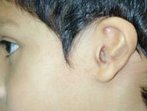
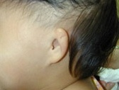
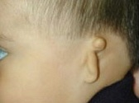
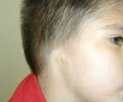
Different types of unilateral hearing loss (UHL)
Total prevalence = 4-8/10,000 (5 studies)
Two normal outer ears
One abnormal outer ear = congenital microtia/aural atresia is
  rare with an incidence of 1:10,000 births
  More than 75% of these cases are unilateral, resulting in maximum bilateral conductive hearing loss (around 60 dB HL) in one ear
Notes:
Microtia = “small ear” – It comes in different grades in terms of how much the outer ear is underdeveloped. Microtia is usually accompanied by aural atresia or ear canal stenosis.
Atresia - Aural atresia refers to the absence an external ear canal – always results in hearing loss. Often also malformation of the external ear and middle ear, but the inner ear and auditory nerve are frequently normal.
Approximately 25% of individuals with one "normal" ear have a hearing loss in their best side also.
A narrowed ear canal is called a stenotic canal or referred to as ear canal stenosis, which may not affect hearing.

Slide 6
Potential impact of hearing loss in one ear on language learning
As many as one out of every three children with only one good hearing ear develop delays in the number of words they say by the time they are 15 – 18 months old.
1/3
Evidence of at least a 6 month average delay in total language

Slide 7

Potential behavior & social issues
Children with unilateral hearing loss may find it hard to hear directions and soft speech. That can lead to frustration and poor behavior. One out of five children develop behavior or social issues.
1/5
As children get older
they may think that
other people are talking about them when they really just did not hear what was said, especially by peers.

Slide 8

Challenges with only one good ear
Poorer ability to listen in noisy environments
Poorer ability to localize sound
Need speech to be louder than noise!
RESULT:
10x risk of school
difficulty/failure
UHL
versus

Slide 9
Hearing does not always stay the same.
It appears that one out of
every four children with one normal hearing ear will develop hearing loss in their better hearing ear.
1/4
This appears true for the children normal
looking ears, not those born with a deformed
ear. We cannot predict which children will
end up having permanent loss in both ears!

Slide 10
Amplification Findings for UHL
Younger children (6-9 yr) who received their first hearing aid by age 5 showed benefit in sound localization when using the aid in their poor ear
Older children (10-14 yr) who received an aid at age 7 or older results showing that the hearing aid was detrimental to localization
CROS aids were also found to be detrimental when listening in noise
FM systems are the only assistive technology that has been found to improve word recognition abilities in quiet and in noise for children with UHL in all listening conditions

Slide 11

Basic Information on Hearing Loss

Slide 12
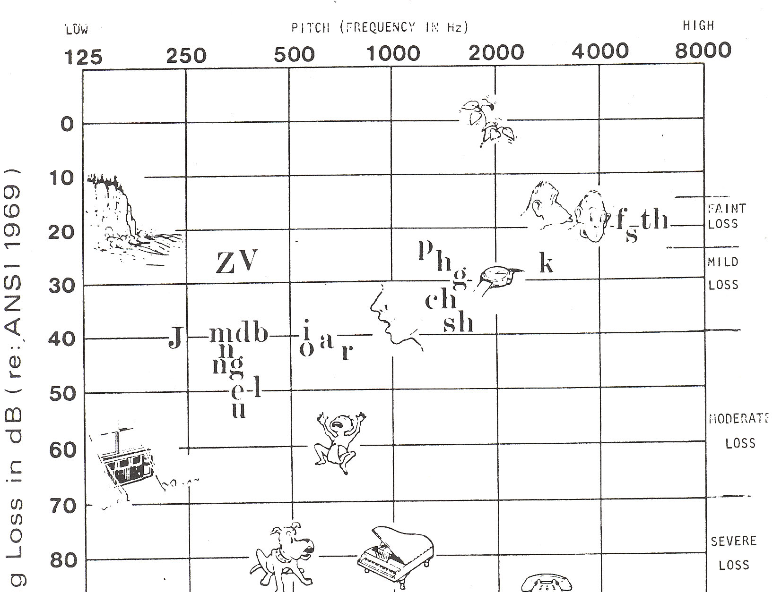

The Sound Audiogram
NORMAL
SLIGHT
MILD
MODERATE
MODERATE- SEVERE
SEVERE

Slide 13
Degree of Hearing Loss & Listening
Mild hearing loss (26-40dB)
  At 30 dB may miss 25-40% of classroom speech
  At 40 dB may miss 50% of classroom speech
Moderate hearing loss (41–55 dB)
  At 55 dB may miss 100% of classroom speech when not using amplification
  Without hearing aids, it isn’t unusual for children with mild hearing loss to have a 2 year language delay by school entry due to having a smaller listening bubble and reduced ability to overhear language

Slide 14
Relative Prevalence by
Degree of Hearing Loss
Severe - Profound
Moderate
Mild
1
2
9
Even conservatively there should be two times the number of children with mild loss served compared to the total of all other degrees.

Slide 15
Growth of Cochlear Implants for Children in the US
1987 first child implanted
2002 Total 10,000 kids
2010 Total 28,400 kids
Including 1600 bilateral
1 out of 10 deaf children implanted in 2000
1 out of every 2-3 deaf children implanted by end of 2010

Slide 16
Relative Prevalence by Potential Functionality of Hearing Loss
Severe - Profound
Moderate
Mild
C I
Simulation of listening with a cochlear implant
1, 4, 8, 12 and 20 channel cochlear implant simulations for speech and music

Slide 17
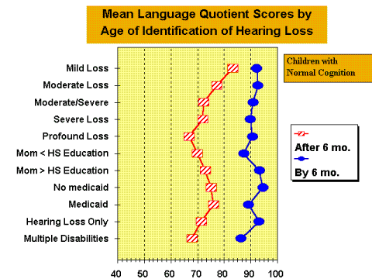
Importance of Early Identification & Intervention
NORMAL
RANGE OF
DEVELOPMENT
Published
2000

Slide 18
Today’s young learners with hearing loss
New data from Christi Yoshinaga-Itano (2010)
Language growth of 135 children age 4-7
Children were cognitively normal from English speaking families with hearing parents
Assessed 3-4 times from 48-84 months of age
  MCDI: Minnesota Child Development Inventory – Expressive Language (includes cognitive function)
  EOWPVT: Expressive One Word Picture Vocabulary Test – 3
  TACL: Test of Auditory Comprehension of Language - 3

Slide 19
Today’s young learners with hearing loss - results
Median age of identification – 3 months
Median age of start of early intervention – 8 months
49 cochlear implant users
38 hearing aid users (mild – profound loss)
Results were categorized into 4 groups:
  Delayed performer: any score below age level
  Gap Closer – delayed at age 4 but caught up by 7
  Gap Opener – okay at 4 but significantly delayed by 7
  Normal/High performer

Slide 20
Language Learning during age 4-7 years
Desired Outcome!
Result of lack of access
or appropriate intervention
Notes:
Children seem to fall into different groups based on how their language was developing:
delayed performers (10th percentiles – signif lang delayed)
gap closers – delayed at 4 but caught up by 7
gap openers – okay at 4 but delayed significantly by 7
normal /high performers – 12 m – 7 yrs lang developmt normal or above age level consistently
N=135 children with longitudinal data (3 or more assessments) from 48 to 87 months of age.
– Children with non-verbal cognitive development within the normal range
– English-speaking families
– Hearing parents
Four assessment occasions: 48, 60, 72, 84 (+/- 3 months)
• Median age of identification: 3 months
• Median age of intervention start: 8 months
• N=87 had severe to profound HL.
• N=48 had mild to moderate HL
Delayed Performers: Similar percentage of children with CIs and children with HAs
• Normal/High Performers: Similar percentage of children with CIs and children
with HAs
Only 1 in 4 children with CI maintain normal or above language development.
• Another 1 of 4 children with CIs are gap closers.
Over half of CI have mothers with 16+ years of education

Slide 21
Which child characteristics differentiate language trajectories?
Similar percentage of children with CIs and HAs who are Delayed and Normal/High Performers
More CI gap closers (21%) than HA (13%)
CI gap closers either had severe or progressive HL (not born with profound HL)
Most CI gap closers had mother’s with college degrees and graduate education

Slide 22
Which child characteristics differentiate language trajectories?
More HA gap openers (18%) than CI (3%)
More children with HA who had severe to profound HL were below 10% than children with CI
No children with profound HL were gap closers
The difference in trajectories was related to the amount of language a child had access to from 0-4 yrs.

Slide 23
Introducing An Li Age 9
Aided hearing
No hearing aids
First hearing aids at age 5 months. Worn ½ - ¾ of the time until he started school.
Language about 1 to 1.5 years delayed.
In regular classroom with speech support.

Slide 24

Access is at the center of most of the struggles of the student with hearing loss
Six Facets of Access
Auditory Access to Communication & Learning
Environmental Access to Listening
Access via Communication Repair
Access via Self-Advocacy & Independence
Social/Interaction Access
Instructional Access to the
Curriculum
Today
Tomorrow

Slide 25
Auditory Access

Slide 26
Access is at the center of most of the struggles of the student with hearing loss
Access is so important that the US law that defines special education services says schools must: support the use of assistive technology devices and assistive technology services, to maximize accessibility for children with disabilities.”
How do we know that
we maximized
accessibility if we
don’t know baseline?
How can we assess
student access ?

Slide 27
Continuum of communication modality
Communication modality needs can
change throughout the day
A
Av
AV
VA
V
An Li
Noise, new vocabulary, interest/motivation, fatigue…

Slide 28
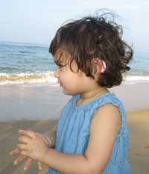
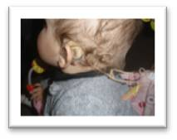
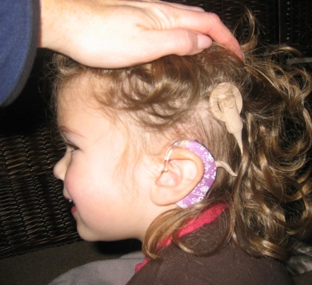
We know..
For most children, the single most effective means to address learning and development issues associated with hearing loss is through the consistent use of hearing technology (hearing aids, cochlear implants, BAHA, FM)

Slide 29
Ingredients of
Communication Confidence
Consistent, dependable communication
Developing attitudes about self in relation to others
Skills socializing and communicating with others
hello

Slide 30

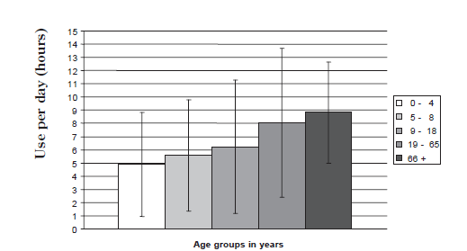
Data logging study – 5000 children
Number of hours by age
3 hrs
in
noise
FM use
2 hrs
in
noise
Age
9-18
6 hrs
Age
5-8
5.5
hrs
Age
0-4
5 hrs
adult

Slide 31
More language used, more language learned!
Families’ Language and Use Differ Across Income Groups
 | Professional |  | Working-class |  | Poor
 | Parent | Child | Parent | Child | Parent | Child
Recorded vocabulary size | 2,176 | 1,116 | 1,498 | 749 | 974 | 525
Average utterances / hour | 487 | 310 | 301 | 223 | 176 | 168
Average different words/ hour | 382 | 297 | 251 | 216 | 167 | 149
1995 Hart-Risley 30 Million Word Gap by age 3
http://archive.aft.org/pubs-reports/american_educator/spring2003/catastrophe.html

Slide 32
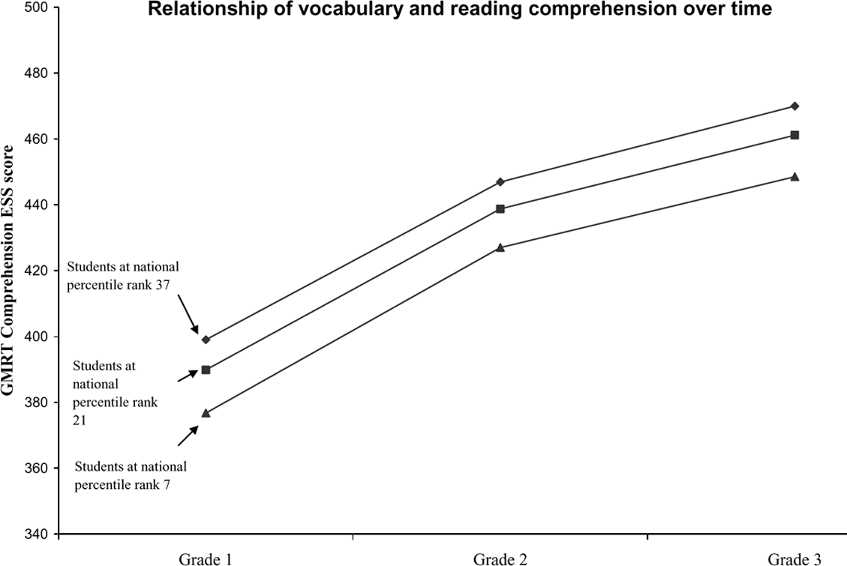
Low vocabulary = low reading
37th %
21st %
7th %
2008 National study of poor children. Word attack and word reading at or close to grade level but reading comprehension declined relative to grade-level expectations. Early vocabulary skills predict later performance.
GRADE 1 GRADE 2 GRADE 3
http://www.decd.sa.gov.au/northernadelaide/files/links/Importance_of_early_vocabu.pdf

Slide 33
How much of speech does a child with hearing loss perceive?
Using hearing aids and being exposed to language does is a necessary first step to successful learning
Hearing aids or other hearing devices do NOT return normal hearing
A child with hearing loss will ALWAYS miss more information with a greater level of effort as their hearing peers
It is necessary to KNOW how much of speech is perceived by the child under various conditions if we are to estimate access to verbal instruction

Slide 34
Functional Listening Evaluation
Child age appropriate repeats words or phrases
Lists presented close (3 ft) and far (12 ft) to represent different classroom communication
Quiet/Noise while Watching/Not Watching
Compare estimated ability to perceive speech
 | close/quiet 50 dB | close/noise +5 S/N 50 dB | distant/quiet 35 dB | distant/noise +5 S/N 35 dB
Auditory only | 95% or better? | 90% or better? | 95% or better? | 90% or better?
Auditory and visual
Typically hearing children age 3-17 can repeat 90% or better even if very noisy.
FLE is at http://successforkidswithhearingloss.com/tests/tests-by-other-authors

Slide 35
Functional Listening – An Li
 | close/quiet 50 dB | close/noise +5 S/N 50 dB | distant/quiet 35 dB | distant/noise +5 S/N 35 dB
Auditory only | 84% | 76% | 72% | 60%
Auditory and visual | 92% | 84% | 80% | 68%
An Li has a 1 – 1.5 year language delay

Slide 36
Turn-and-Talk
 | close/quiet 50 dB | close/noise +5 S/N 50 dB | distant/quiet 35 dB | distant/noise +5 S/N 35 dB
Auditory only | 84% | 76% | 72% | 60%
Auditory and visual | 92% | 84% | 80% | 68%
With hearing aids, An Li has a ____hearing loss
How much would he hear/understand when a peer answers a question from across the room?
What would you expect about his reading comprehension?
Why do you think he is delayed in language?

Slide 37
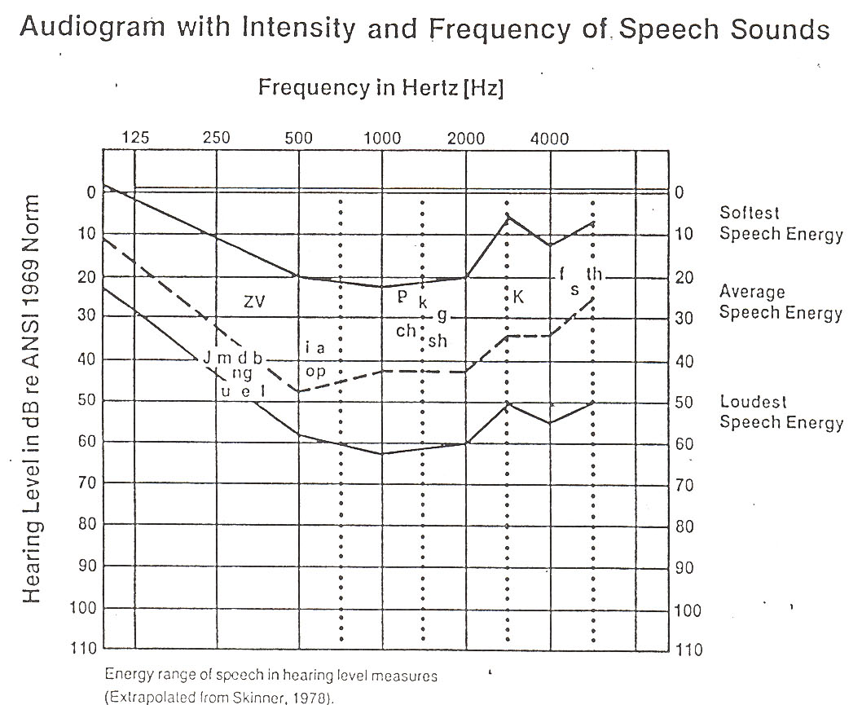
Listening Access – Auditory Perception
An Li
How much speech can he hear without HAs?
What kinds of sounds are hardest to hear with HAs?

Slide 38
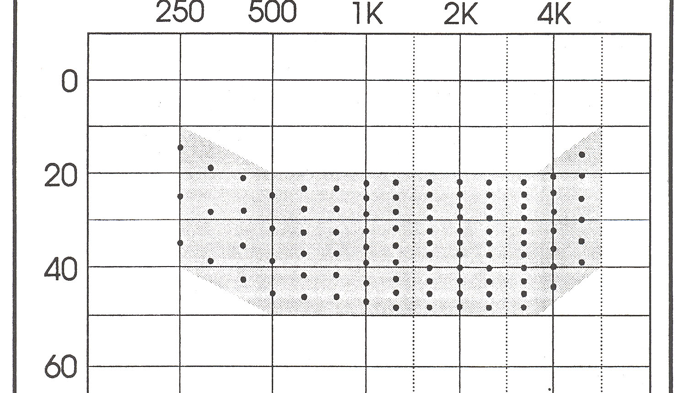
The Count the Dot Audiogram presents a representation of audible speech energy for a 45 dB HL input (audibility)
45 dB HL input
-24%
76%

Slide 39
The Count the Dot Audiogram adaptation to represent speech energy for a 35 dB HL input
-10
Imposing a 20-25 dB threshold range
for a 35 dB HL input
10
30
40 dots representing 40% audibility
50

Slide 40
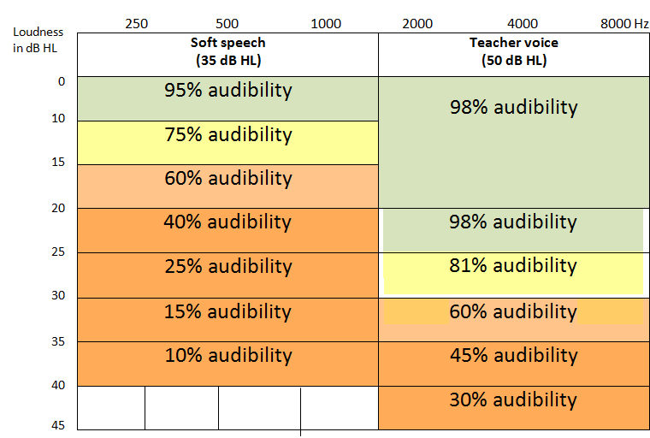
An Li for quiet/distant speech
An Li for teacher/close speech

Slide 41
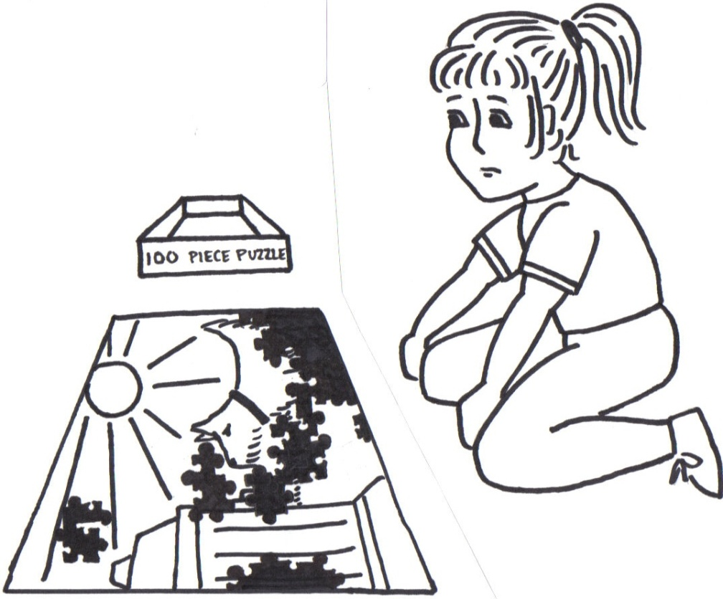
AUDIBILITY ≠ SPEECH UNDERSTANDING
An analogy for Audibility - Recognizing the subject of a picture puzzle depends on what pieces are missing and the complexity of the picture.
Opportunity
missing 20%
  of teacher speech

Slide 42
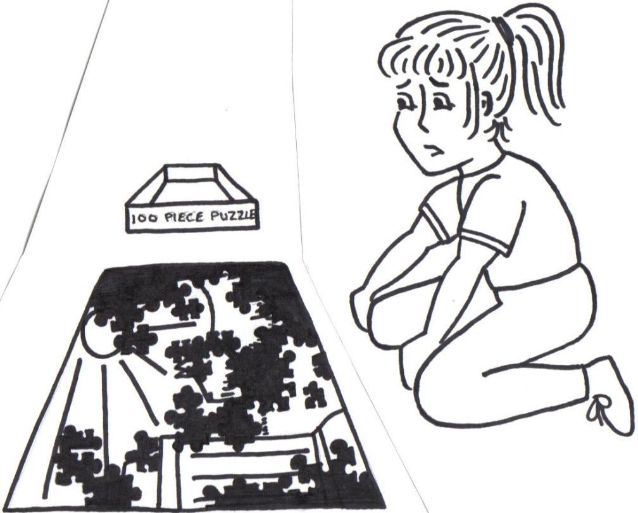
AUDIBILITY ≠ SPEECH UNDERSTANDING
An analogy for Word Recognition - Recognizing the content of a puzzle made out of written words depends on knowledge of vocabulary, syntax, the general topic and effort to figure out the missing pieces, especially when there is new vocabulary words and concepts. Function
Trying to make sense of
meaning when you only
perceive 60%

Slide 43

Audibility ≠ word recognition
Understanding with limited audibility depends upon:
  Clarity of speech signal (hearing loss, noise)
  Attention / Motivation/ Ease of listening
  Knowledge of topic
  Language complexity to be able to guess from context
  These factors all vary between children every day.
Adults with 50% audibility may identify 70% of single words and 95% of sentences (Miller & Heise, 1951)
Audibility is compromised by noise and reverb.
Visual cues can help understanding.
This is why it is necessary to do a Functional Listening Evaluation

Slide 44
Considering Audibility
+
Speech Recognition
+
Listening in Noise at
35 and 50 dB HL inputs
 | close/quiet 50 dB | close/noise S/N 50 dB | distant/quiet 35 dB | distant/noise S/N 35 dB
Auditory only | 95% or better? | 90% or better? | 95% or better? | 90% or better?
Auditory and visual
How do think your students are able to understand in comparison to typical listeners in classroom noise?

Slide 45
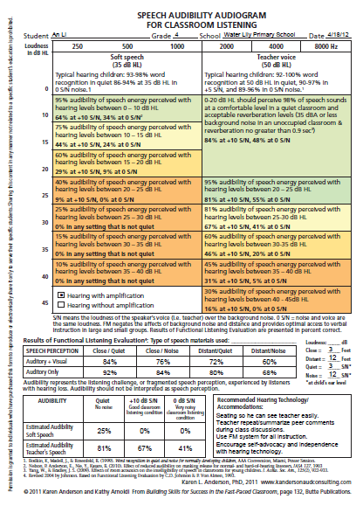
Sample Speech Audibility Audiogram for Classroom Listening
Completed for An Li

Slide 46
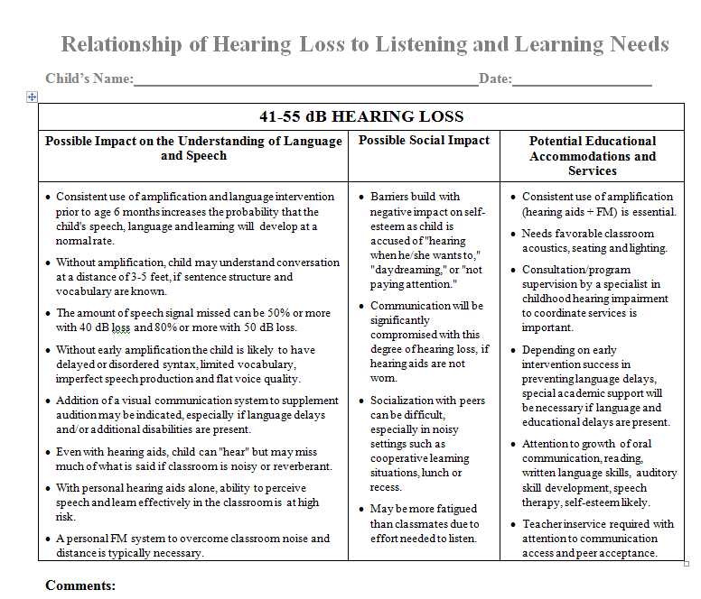
Relationship of Hearing Loss to Listening and Learning Needs
Impact on Understanding Language and Speech
Possible Social Impact
Potential Educational Accommodations and Services
9 hearing loss degrees / types
http://successforkidswithhearingloss.com/impact-on-listening-and-learning

Slide 47
Also raising your awareness this session on:
How to gather information on the student’s level of independence and challenges as a learner with hearing loss

Slide 48
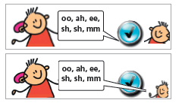
SEAM for School Success:
Student Expectations for Advocacy & Monitoring Listening and Hearing Technology
What SHOULD we expect RE: independence?
The following expectations assume early identification of hearing loss, consistent amplification wear from infancy and supportive parent involvement in facilitating effective communication.
Age expectations should be adjusted as necessary due to lack of optimal audibility and/or early intervention services that include a focus on auditory independence.

Slide 49
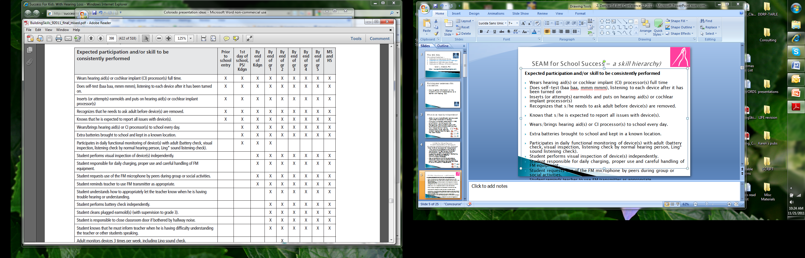
SEAM for School Success = a skill hierarchy)
Prior to School Entry

Slide 50
SEAM for School Success = a skill hierarchy)
1st day of school, Preschool, Kindergarten

Slide 51
SEAM for School Success = a skill hierarchy)
By end of Grade 1

Slide 52
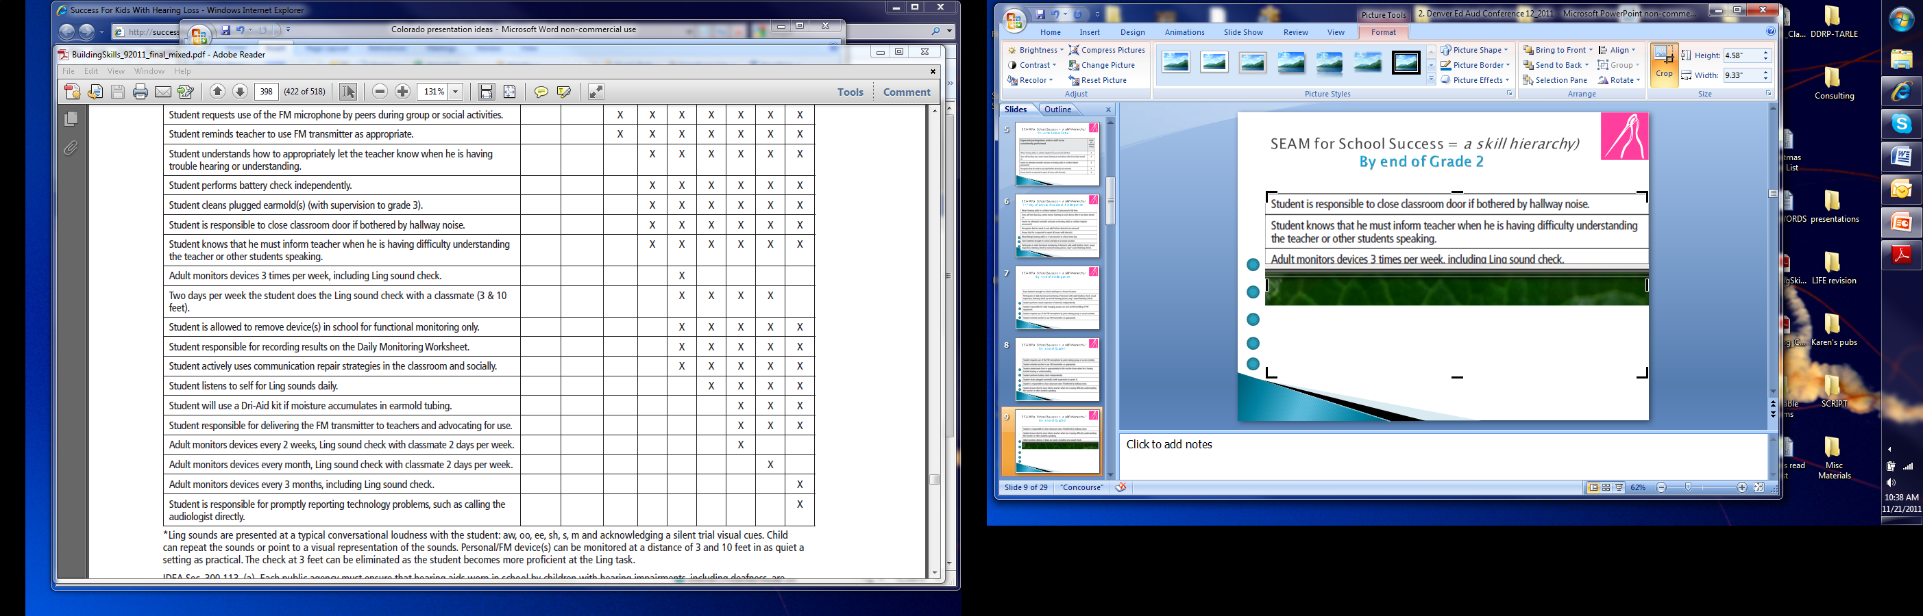
SEAM for School Success = a skill hierarchy)
By end of Grade 2

Slide 53
SEAM for School Success = a skill hierarchy)
By end of Grade 3

Slide 54
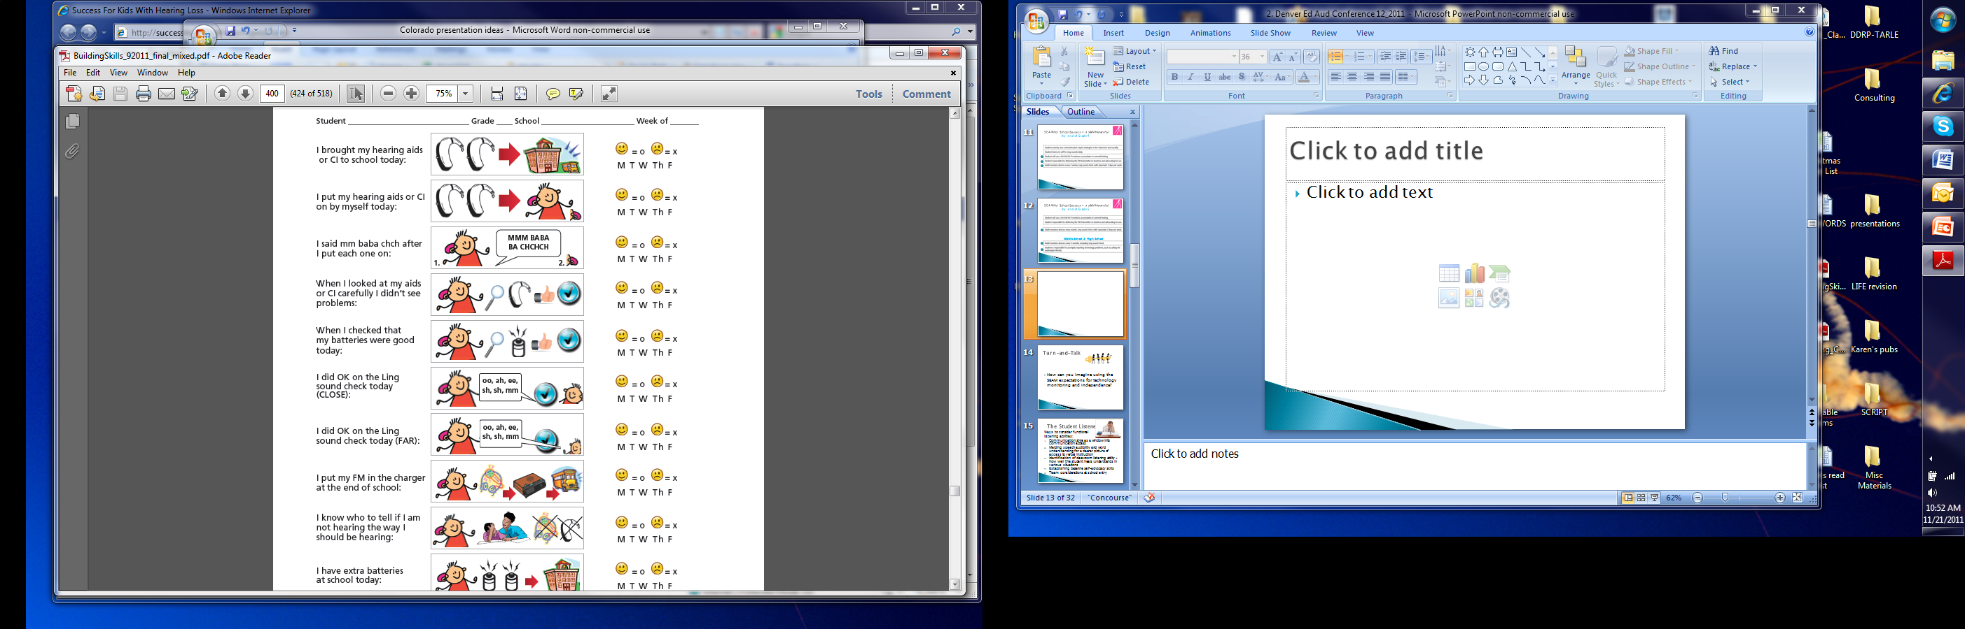
Child friendly
monitoring
tools need to
be available
Age appropriate
tools for older
students too

Slide 55

Assessing student ability to perceive and understand classroom communication
Should be a focus of systematic classroom observation techniques
Obtain information from the teacher
  Teacher LIFE-R
Obtain information from the student
  Student LIFE-R
    Classroom Situations
    Additional School Situations

Slide 56
Obtaining Input from the Teacher
Teacher Appraisal of Listening Activity – Teacher LIFE-R
Can be used as a stand-alone checklist or as an amplification pretest/post-test
Focus is the areas of attention and class participation.
Teacher rates the level of challenge that she observes when the student encounters15 different situations.
TEACHER
L.I.F.E.

Slide 57
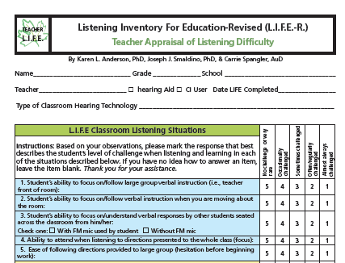

Slide 58

Obtaining the Student’s View of Challenging Classroom Listening
Listening Inventory For Education – REVISED!
Self-report for students in Grade 3+
Before LIFE questions
LIFE questions about school listening situations
After LIFE questions
STUDENT
L.I.F.E.

Slide 59
Student Appraisal: LIFE Classroom Situations
Ten revised situations.
Now include media and a variety of listening challenges as well as easy listening situations.
Sum just the items for verbal instruction and class discussion situations.
Total out of a possible 100 points.
Pretest/Post-test use for amplification trials
Choices:
Always easy,
Mostly easy,
Sometimes difficult,
Mostly difficult,
Always difficult.

Slide 60
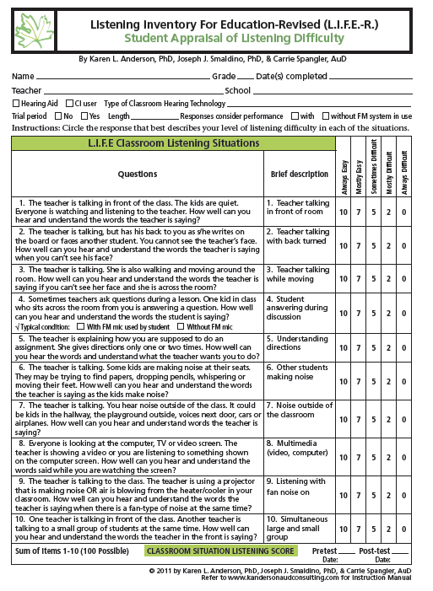
Teacher talking in front of room
2. Teacher talking with back turned
3. Teacher talking while moving
4. Student answer during discussion (FM mic?)
5. Understanding directions (given 1-2)
6. Other students making noise
7. Noise outside of room
8. Multimedia
9. Listening in fan noise
10. Simultaneous large and small group

Slide 61
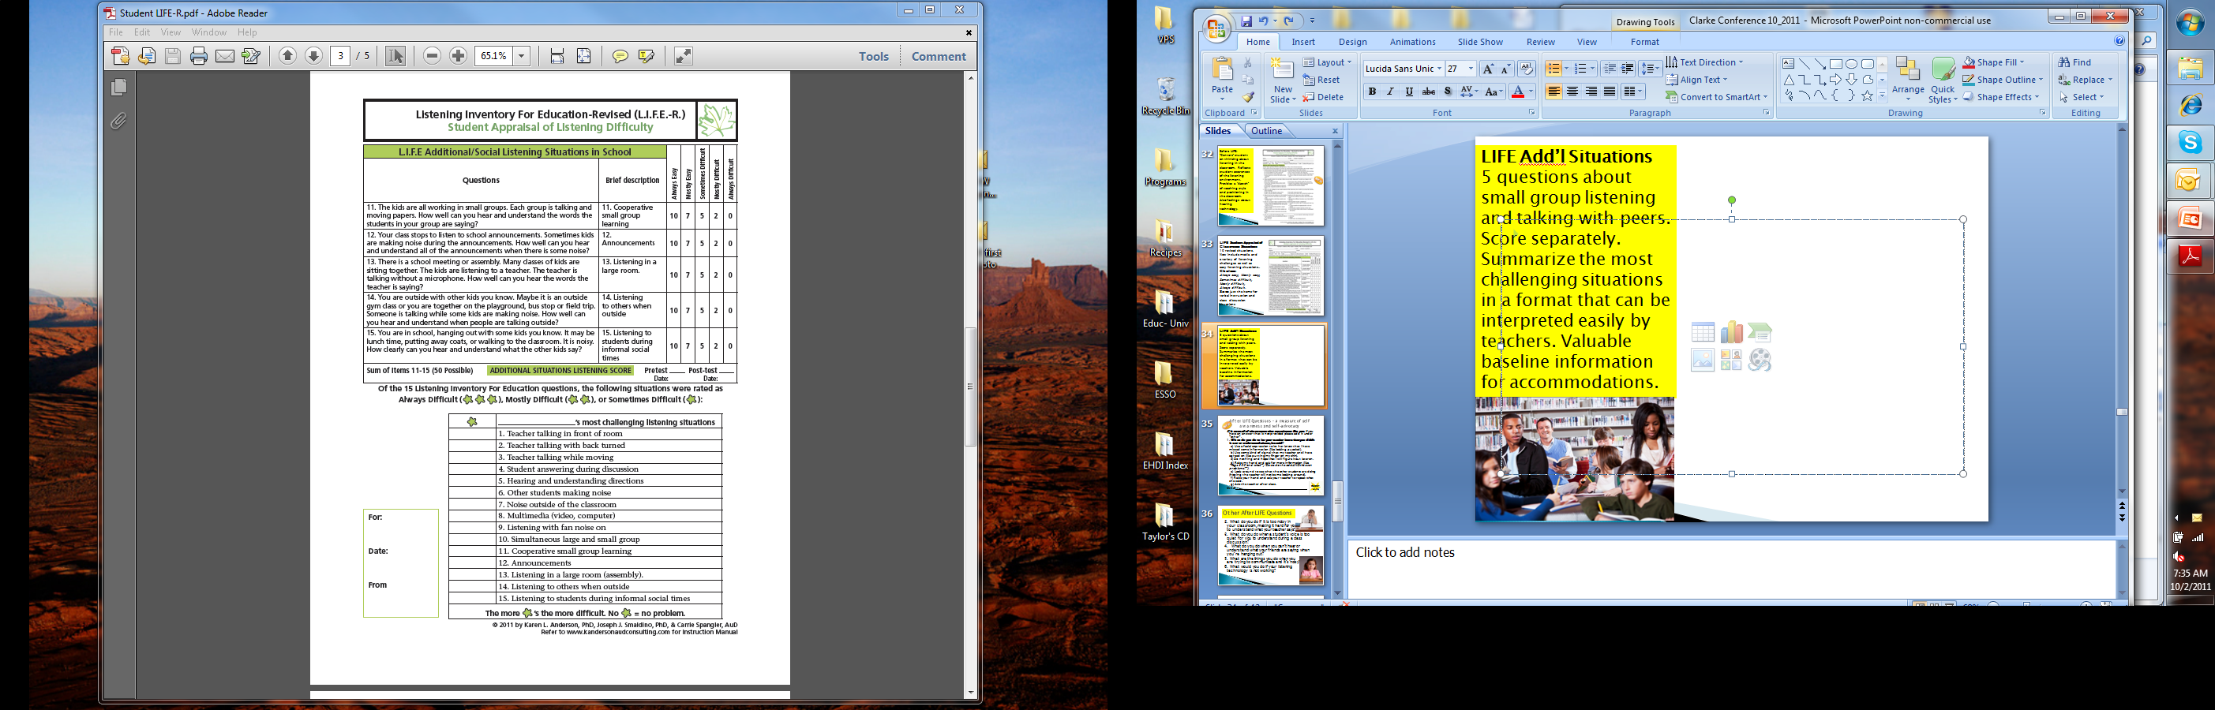

LIFE Additional/Social Listening Situations
Cooperative and small group learning
Announcements
Listening in a large room
Listening to others when outside
Listening to students during informal social times

Slide 62
Summarizes the most challenging situations in a format that can be interpreted easily by teachers.
Valuable pre/post test information.
Easily prioritized for discussions on self-advocacy activities.

Slide 63
Turn-and-Talk An Li’s results
What individualized teacher/classroom accommodations would you recommend based on the responses below?
?

Slide 64
Environmental Access

Slide 65

The ‘cost’ of challenged listening
Remember - children with normal hearing do not have to look at a speaker to understand what was said, even if it is noisy or very noisy.
A child with hearing loss with diminished audibility has to expend more energy to listen carefully to try to catch what is being said.
This increased attention requires more energy.
This leaves fewer cognitive resources for understanding what was said.
The effort causes fatigue that further affects the energy available to listen.

Slide 66
Slower pace = increasing learning gaps
Federal laws regarding grade-level content standards do not release students with disabilities from the need to demonstrate proficiency related to state and federal benchmarks (US Department of Education, 2004).
To do so, students must be able to
  access curriculum and instruction and
  be able to demonstrate knowledge efficiently and precisely.
This ability is dependent upon accurately receiving information from others as well as their capability to communicate their thoughts.

Slide 67
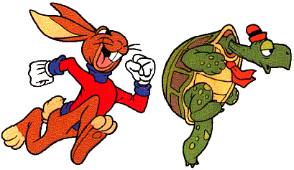
These factors can affect the PACE of learning

Slide 68
Classrooms are auditory-verbal environments
Listening is the cornerstone of the educational system
If a child cannot clearly hear and attend to spoken instruction, the entire premise of the educational system is undermined
Classrooms can be noisy, reverberant learning environments

Slide 69
Average loudness
Average loudness of teacher’s voice in a classroom is 50-60 dB HL
This means her speech signal ranges from
35 – 65 or 45 – 75 dB HL
Typical loudness of background noise in a classroom is 50 - 60 dB HL
Noise often varies from 0 S/N to +10 S/N and is likely closer to +5 S/N most teaching minutes
Adequate signal to noise level for children to be able to perceive the entire speech sound envelope is +15 S/N

Slide 70
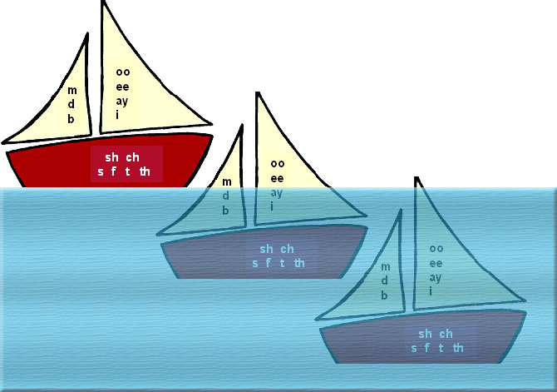
Listening in a Sea of Noise
30 dB speech range
(45-75 dB)
{
+15 S/N
{
Typical loudness of background noise in classrooms
is 60 dB when little attention to room acoustics is given)
}
NOISE typically
60 dB, can be same as loudness of teacher voice
{
+6 S/N
{
0 S/N

Slide 71
Average is not ‘real’
However voice loudness and loudness of background noise are constantly CHANGING!
Signal to noise level is not a constant in typical listening environments
Inconsistent ability to perceive speech
BEHAVIOR EFFECTS?
  Not paying attention -daydreaming
  Distractibility -socially out of step

Slide 72

Successful amplification fitting does not mean
‘normal’
Successful hearing aid fittings and cochlear implant mapping
  normal hearing ability (0 dB thresholds) is NOT restored
The goal is to provide aided response to a 20-25 dB HL input
“Excellent” hearing aid fittings can compare to a plugged ear hearing loss
Again, aided response at 20-25 dB HL does not mean that all soft speech will be audible

Slide 73
Classroom acoustic conditions & listening

Slide 74
Analogy tool:
Picking speech out of background noise
I see some beautiful flowers.
+20
Big dogs can be dangerous.
+15
I like to go to school.
+10
It is lunch time soon.
+5
Walk to the library now.
0
Your brother is not here.
-5

Slide 75
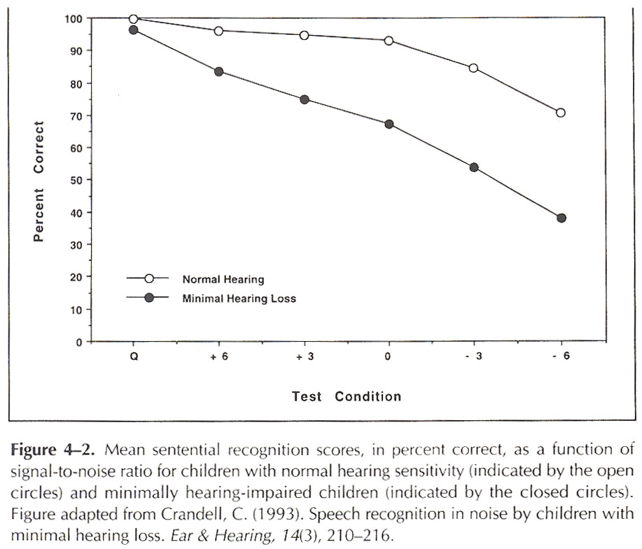

S/N + “little” hearing loss
Normal
Hearing
90%
Minimal
Hearing
Loss
70%
70%
40%
Quiet ₊₆ ₊₃ ₀ ₋₃ ₋₆
Notes:
Slide 9: minimal hearing loss and S/N
This graph brings us back to the topic at hand, the effects of even minimal hearing loss when a listener is exposed to different signal to noise ratios. As you can see, children with normal hearing can recognize sentence materials at 95% or greater even at 0 S/N. The children with minimal hearing loss, had 15-25 dB hearing loss from 500 – 2000 Hz. Even at +6 S/N these children were at a disadvantage. With so much of class instruction occurring between 0 S/N and + 6 S/N it is no wonder that these children will have difficulty attending and progressing at the same rate, to the same level as their peers with normal hearing.

Slide 76
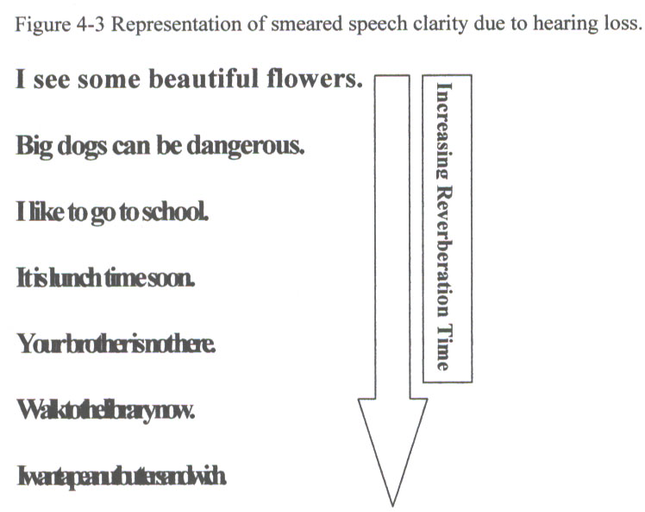

Visual analogy of speech sounds smearing together as RT increases
Notes:
Slide 12: Visual analogy of listening in reverberant conditions
This is a simplified visual analogy of listening when reverberation is smearing the speech recognition characteristics. With effort each of these sentences can be read. Again, the greater the effort that is put into receiving the message, the greater the restriction on the faculties available to process the message. One can clearly imagine the synergistic effects of both excessive S/N and reverberation time on the listening abilities of these ‘invisible children.’

Slide 77
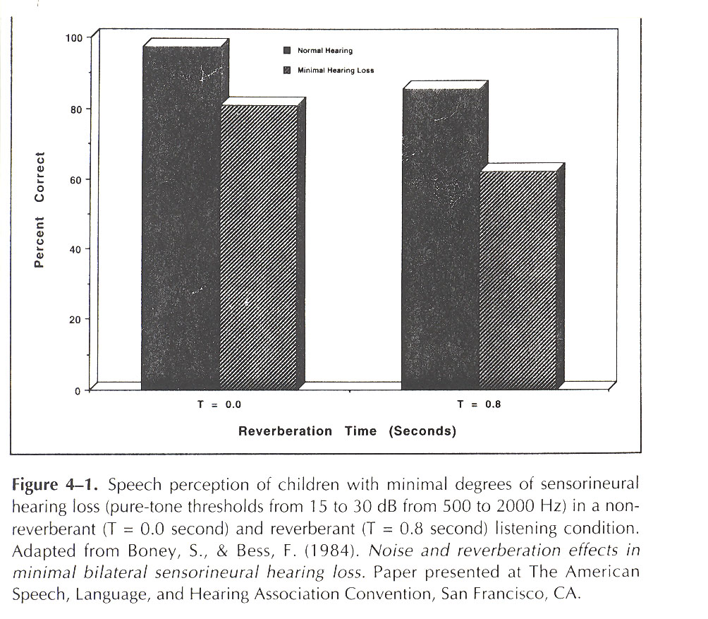
RT + “little” hearing loss
85%
63%
Normal Hearing
Minimal Hearing
Loss
Normal Hearing
Minimal Hearing
Loss
RT = 0.0
RT = 0.8
Notes:
Slide 11: minimal hearing loss and reverberation
This graph provides information about the performance of children with normal hearing and with minimal hearing loss in quiet and when listening at a 0.8 second reverberation time. Many classrooms have RT that exceeds 0.8s.

Slide 78
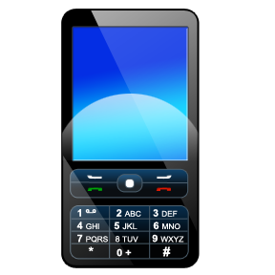
Apps!
There are inexpensive telephone apps that are available for measuring background noise and reverberation
There are national standards in the US and a few other countries for the allowable noise and reverberation in classrooms
Identifying the acoustic setting should
be a consideration in child placement
It is also valuable to determine the
student‘s level of awareness of the
listening setting.

Slide 79
Before LIFE Questions:
Centers’ the student on thinking about listening in the classroom.
Reflects student awareness of the listening environment.
Provides a ‘sketch’ of teaching style
Provides information on seating position in the classroom.
Also asks student how s/he feels about hearing technology.
Not all of the questions need to be asked – this is up to the professional to decide

Slide 80
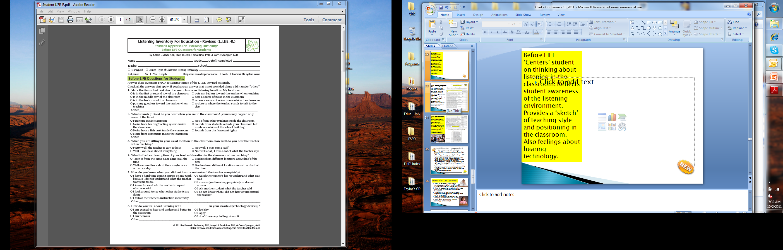

Slide 81
#5. How do you know when you did not hear or understand the teacher completely?
An IMPORTANT question! How often do we ask this?
The other Before LIFE questions set up the student to be more ready to answer this question.

Slide 82
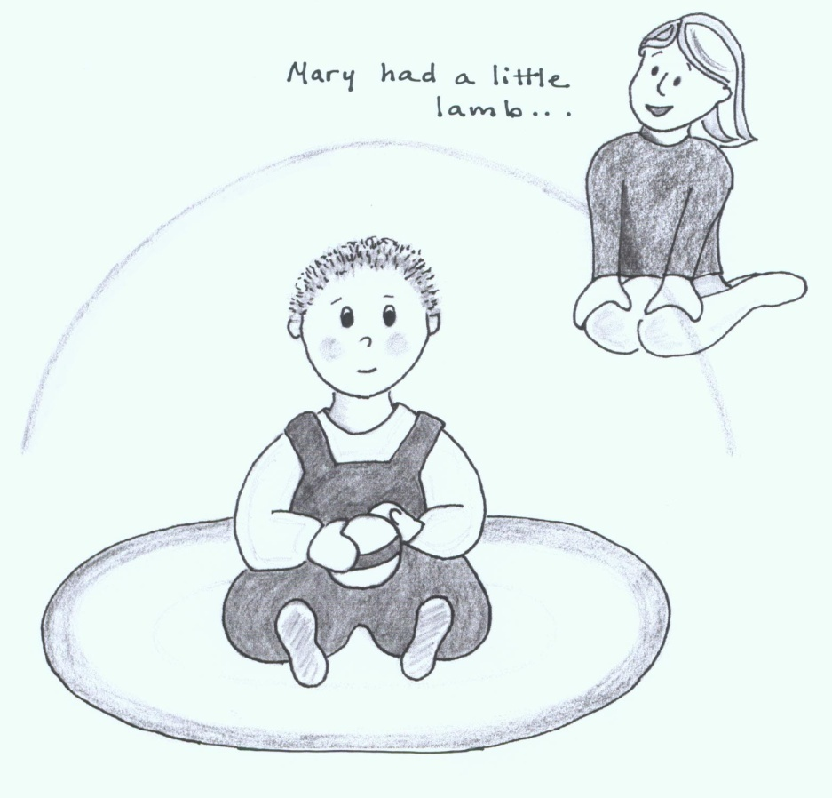
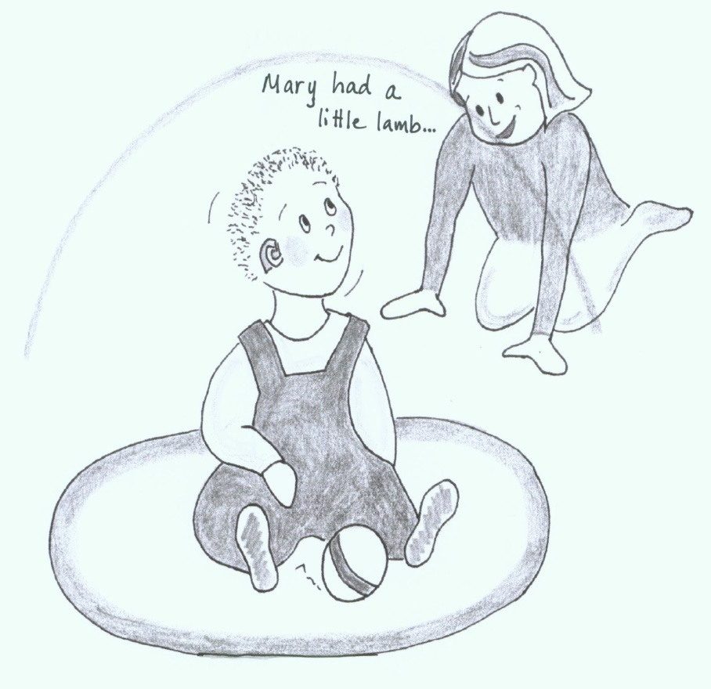
The Listening Bubble Concept
Need to get into the child’s hearing range
Not in range!
In range and listening!

Slide 83
Education about strategies:
  Predicting challenges within the environment
  Skill Building –
    Role as ‘Technology Specialist’
    Building communication repair skills
    Self advocacy skills
  Demonstration/role playing of strategies

Slide 84
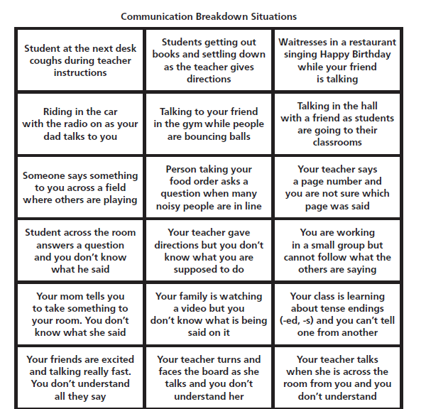
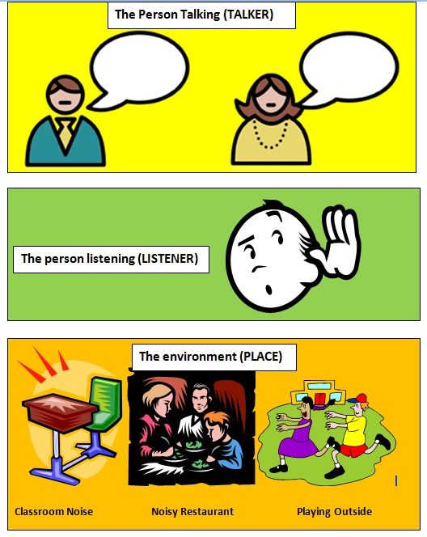
How well does the student predict
challenges within the environment?
Communication Breakdown Situations

Slide 85
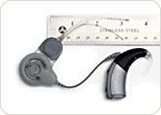

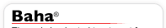
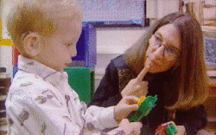
Technology advances abound
Reverberation canceling wireless aids
Dynamic FM varies S/N
as noise level changes
Previously inaudible, high frequencies become audible again. Not only speech comprehension, but also one’s own voice quality can be improved.

Slide 86

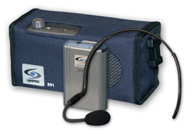
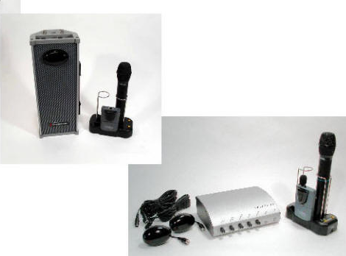
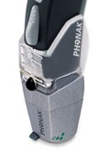
What type of S/N technology is best?
Classroom Sound Field?
Desktop FM?
Personal FM?
Notes:
Slide 16: Technology to address classroom listening needs
Whether you are young or old, the biggest complaint of persons with hearing loss is the difficulty of listening in background noise and reverberation. Various technologies are used to try to improve classroom listening, most notably personal FM systems that fit directly to personal hearing aids or cochlear implant processors, a personal FM that sits on the desktop, and sound field enhancement systems that place one or more loud speakers throughout the classroom. A study was conducted of 28 children; 22 of whom had high quality modern hearing aids and 6 had a cochlear implant. The children, age 8-14 were good language users and truly ‘cream of the crop’ participants that were chosen to minimize the influence of language skills on performance. The study was performed in actual classroom settings.

Slide 87

Sizing up classroom hearing technology
How many “pieces” can a child miss
before learning is affected?
Notes:
Slide 17: Summary slide
This summary chart says it all. Children listening with their personal devices scored no better, and many actually scored worse, when a sound field sound enhancement system was used. For the group, there was no significant difference in the performance with personal devices alone or when they were worn in the presence of a sound field amplification system. When the teacher’s voice was delivered to the child within the critical listening distance via a desktop or personal FM system true benefit was observed. In a nutshell, sound field classroom amplification cannot be assumed to be of any benefit to the child with hearing loss using amplification devices and may indeed be detrimental to some individuals.

Slide 88
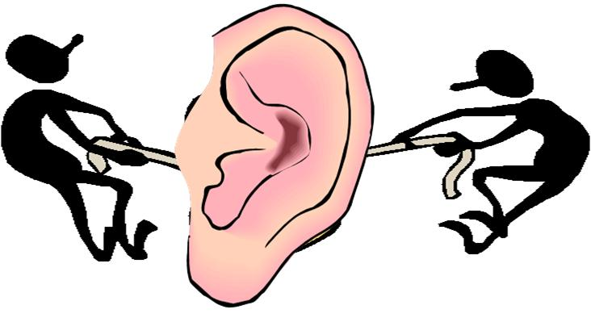
Limitations to
Auditory Access
Background noise and reverberation in room
Audibility of speech (Speech Audibility Audiogram)
Functional speech recognition (find out via the Functional Listening Evaluation)
Knowledge of language of instruction
Type of assistive listening devices used
Who is speaking into the microphone transmitter
Level of effort to listen diminishes cognitive resources to understand
Implications for social interaction

Slide 89
Turn-and-Talk:
What will the school team need to include in their planning for An Li to ensure that he has the best auditory access possible?
What will An Li need to be able to do to help ensure that he receives the same level of instruction as his class peers?
We will open our next session with this discussion!

