Slide 1

Building Social Language & Communication Confidence:
The Key Role of the Family
Karen L. Anderson, PhD
March 10, 2012
http://successforkidswithhearingloss.com

Slide 2
Raise your awareness on:
Ingredients of communication confidence
What can families do?
Foundations of communication confidence
Developmental stages of view of self/others
Appropriate social skill expectations
Self-esteem for risk-taking and continued wear of hearing devices
Fostering children’s self-advocacy skills
Expecting independence with technology
Information for families to share with school

Slide 3
Relative Number of Children by Degree of Hearing Loss
Severe - Profound
Moderate
Mild
Even conservatively
there should be 2x the
number of children with
mild loss served compared to the total of all other degrees
About 1/2
CI
For every 1 child identified with severe to profound hearing loss in both ears there are 2 with moderate and 9 with mild degrees of hearing loss.

Slide 4
Continuum of communication modality
Communication modality needs can
change throughout the day
A
Av
AV
VA
V
Noise, new vocabulary, interest/motivation, fatigue…

Slide 5
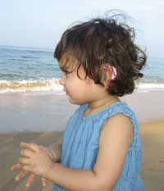
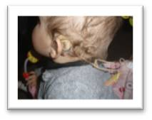
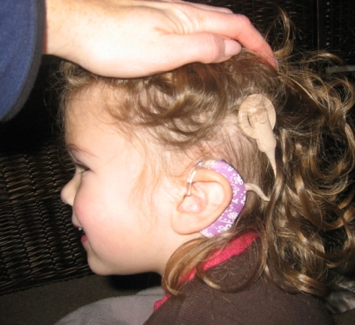
We know..
For most children, the single most effective means to address learning and development issues associated with hearing loss is through the consistent use of hearing technology (hearing aids, cochlear implants, BAHA, FM)

Slide 6
Ingredients of
Communication Confidence
Consistent, dependable communication
Developing attitudes about self in relation to others
Skills socializing and communicating with others

Slide 7


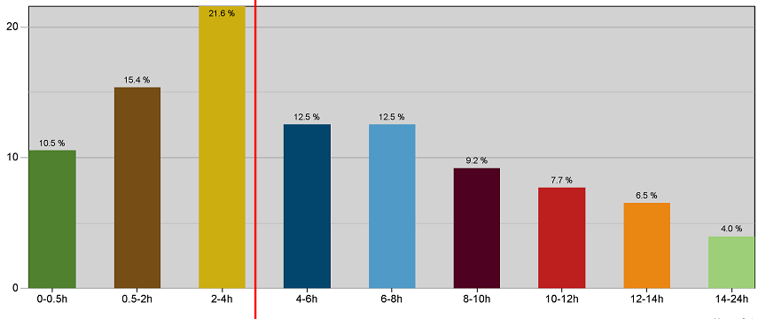
Data Logging Study Findings
8 months – almost 5000 children
40%
Only about
10% wore
“full-time”
.5-2 hours
2-4 hours
6-8 hours
0-.5 hours
4-6 hours
8-10 hrs
10-12
12-14
14+
Percentiles by usage time
40% of children use their aids less than 4 hours per day
Notes:
40% of kids use their devices less than 4 hours per day
Only about 10% achieve hearing aid wear all waking hours
School-aged are in noise about 30% of time – they are more likely to be using FM in classroom settings
Infants are in noise about 20% of listening time – If an infant only has hearing aids on a few hours per day, then 20% of listening time in noise can substantially interfere with incidental exposure to language (language is caught, not taught)
http://www.phonak.com/content/dam/phonak/b2b/Events/conference_proceedings/soundfoundation_chicaco2010/pdf/SoundFoundation_Chicago20 10_Jones.pdf

Slide 8
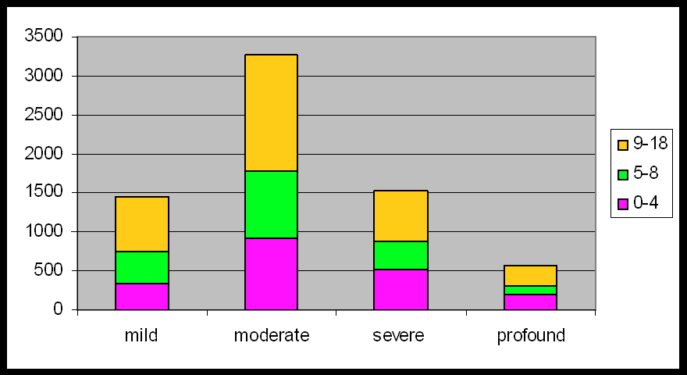
Data logging study
Number of hours by hearing loss degree
Age 9-18
Age 5-8
Age 0-4
Mild Moderate Severe Profound
http://www.phonakpro.com/content/dam/phonak/gc_hq/b2b/en/events/2010/Proceedings/Pho_Chap_12_Jones_Final.pdf
Notes:
72 clinics
28 schools
8 months of data logging
4918 children
8669 ears (1167 unilateral amplification users)
Average AC hearing loss – 56 dB (94% SNHL)
97% wore BTE hearing aids
63% of children in the study used economy aids, 10% basic aids, 22% advanced and 5% had premium hearing aids
NOTICE – fewer aided children in the mild hearing loss category – if they are being fit with aids, they are not wearing them!

Slide 9
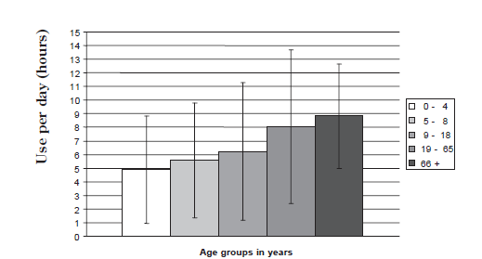
Data logging study
Number of hours by age
3 hrs
in
noise
FM use
2 hrs
in
noise
Age
9-18
6 hrs
Age
5-8
5.5
hrs
Age
0-4
5 hrs
adult

Slide 10

What is ‘confidence’?
a feeling or consciousness of one's powers or of reliance on one's circumstances <had perfect confidence in her ability to succeed>
  There is a need to be able to rely on hearing to be the same from day to day
faith or belief that one will act in a right, proper, or effective way <have confidence in a leader>
  Learned through watching how loved ones act
  Being ‘taught how to act’ by family and others
  Experience - including feedback when behavior is successful or not
  Merriam-Webster.com

Slide 11
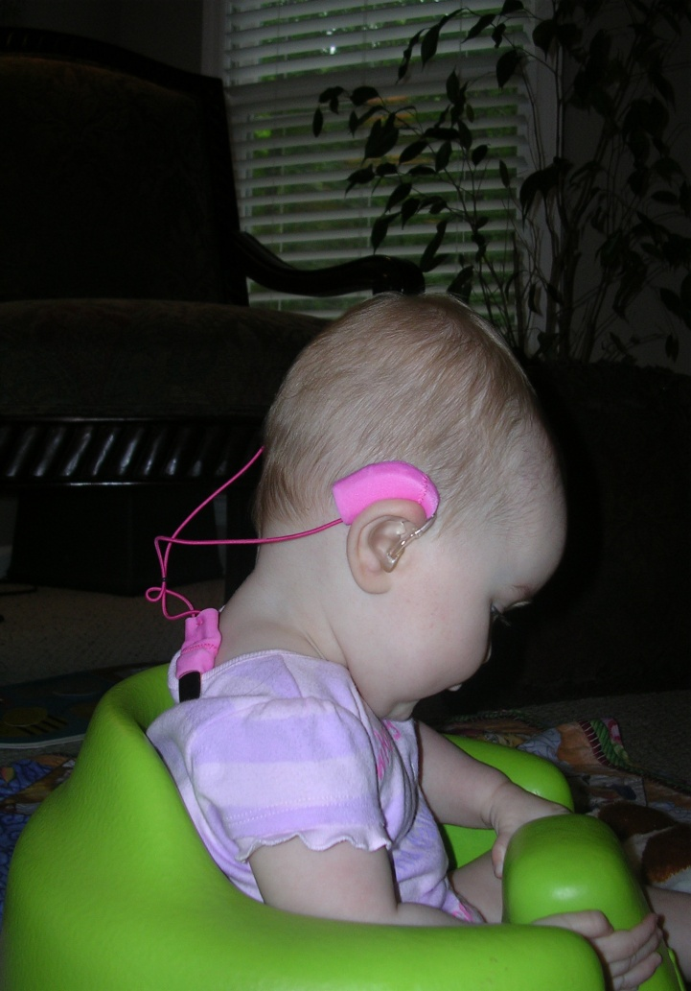
First step to confidence
Hearing aid wear for ALL waking hours
Provides consistent auditory input
‘Hearing the child (and family) can count on’
‘Bond’ with the hearing aids
Concerns about loss, damage
CAN be addressed
Ear Gear – ‘mitten strings’
Headbands, hats – need to be acoustically transparent

Slide 12
Communication expectations:
Consistent, dependable hearing
Do you know where….
Family
talks
I put it in the ..
Child with
HL responds
Great. Thanks.
Person
responds
member
Family communication can be adjusted: “Bob will hear and respond to me as long as we are in the same room.”

Slide 13
Communication expectations: Hearing sometimes and not other times
Do you know where….
Person
Talks
.....
Child with HL
doesn’t realize he was spoken to
BOB! What did you do with...
Person
responds
Family communication is unpredictable: “Bob may have his
hearing aids out and not hear me. I’ll try anyway. I have to
yell at him sometimes to get his attention! It’s easier just
to ask someone else or do it myself.”
Bob’s level of confidence in receiving communication is low.
People yell at him or just ignore him. Bob may not perceive
the situation as related to wearing his hearing aids.
What!?! (feels angry for being yelled at
Child with HL responds
I said, what did you do with…
Person repeats, with some impatience
It’s in the… (feeling anxious or resentful )
Child with HL responds
End result – less exposure to incidental language, fewer
conversational turns, increasing feelings of isolation and
unworthiness. Greater issues making friends & socializing.

Slide 14

A word about psychosocial development
Psychosocial development occurs in stages. Stages are characterized by:
Age 0-1: Trust vs Mistrust: Inconsistency teaches that the world is undependable, unpredictable, dangerous
Need to ‘bond’ with hearing aids now
Consistent, effective communication at home
Age 2-3: Seeking autonomy: develop a sense of being able to handle many problems on their own
Support independence (Me do!)
Expect them to ‘speak for themselves’
Work toward being able to put on devices

Slide 15
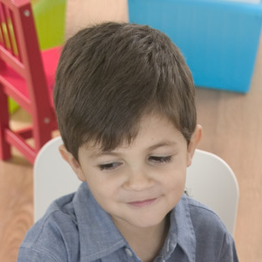
A word about psychosocial development
Age 4-6: Initiative vs Guilt: Begin completing tasks for a purpose and may feel guilt or frustration if they do not perform as well as they think they should.
Require ‘best you can do’, not perfect
Praise effort demonstrated more than result
Foster a sense of pride in accomplishments
Celebrate differences/specialness -everyone is different in their own way
Be alert to growing attitudes that the child may believe their performance disappoints you because they have a hearing loss – this often leads to rejecting hearing devices.
Be openly accepting of the hearing loss & hearing devices – it is part of who your child is and you love him as he is.

Slide 16
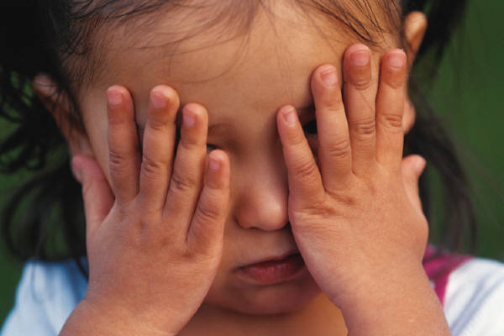
Acknowledging Difference
There will be a time when the child realizes not everyone is wearing hearing aids or CI
In preschool this difference often doesn’t matter at their stage of social awareness
If the child is mainstreamed without any other children with hearing devices at the school, then this may feel like a big difference.
For children with a strong self-concept and an identity that includes recognizing that they have a hearing loss (and it’s okay/special)- it may not be a big deal.
This is learned at home!

Slide 17

A word about psychosocial development
Age 7-11: Eager to complete tasks & accomplish more complex skills. If they are not meeting adult/class expectations they may feel inferior (“I can’t”). Children who feel inferior may resist starting or give up, knowing “it won’t be good”
Encourage him – “I know you can do it”
Treat him as an intelligent individual able to understand and reach conclusions.
Teach a child that failure doesn’t exist – only temporary setbacks on the road to success.
Help him believe he has the ability to succeed no matter how long it takes.
Do not tell him he can or will fail.
Involve him in all audiology appts he is a consumer, not a victim

Slide 18

A word about psychosocial development
Age 12-19: Teens are concerned with how they appear. They are trying to reconcile who they think they are with who they believe society/their group wants them to be. At this stage many children feel like misfits and reject their hearing devices because they want to fit in.
Reinforce that everyone is different in some way
Hearing loss/devices are a part of him. Even if the devices aren’t worn he will still be himself – someone who has hearing challenges. Just more problems; much harder to reach eventual goals.
Respect his expertise as his own Tech Specialist
Be aware of battery consumption – it may be a clue that the hearing aids are being taken off when he gets on the bus

Slide 19

Socialization – not just ‘making friends’
Socialization is the:
Slow, steady process of finding out who you are in relation to others
Vehicle for developing a sense of how to act around other people, judgment, difference between right/wrong
Based in interactions that
  Increase a child’s level of thinking
  Develop their knowledge, values, attitudes
Modality for cooperation and learning in small and large groups
Cognitive development and language are shaped by a person’s interactions with others.
Critical for children to learn to view themselves as part of a group of others who use hearing devices

Slide 20

Social skills include:
Responding to social cues
Saying hello and goodbye
Having interesting things to say
Cooperating by taking turns
Making eye contact, smiling, being polite
Reinforcing and acknowledging other’s comments
Responding appropriately to questions
Being sensitive to the feelings of others
Problem solving
Controlling aggression and other inappropriate behaviors
Knowing the rules of conversation

Slide 21

Rules of conversation
Agree to pay attention to who is talking
No one person does all the talking
Participate in choosing and developing a topic
Take turns in an orderly fashion
Add information relevant to the topic
Provide enough information to convey the message without being too ‘chatty’

Slide 22
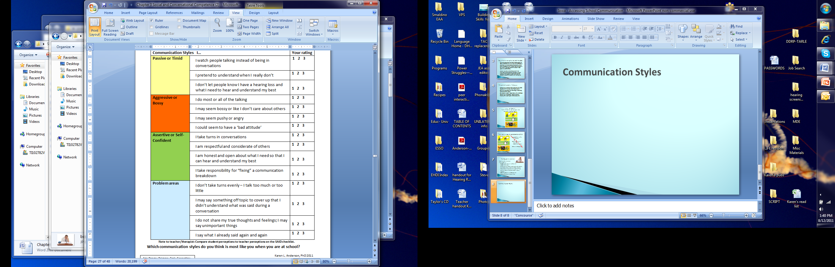

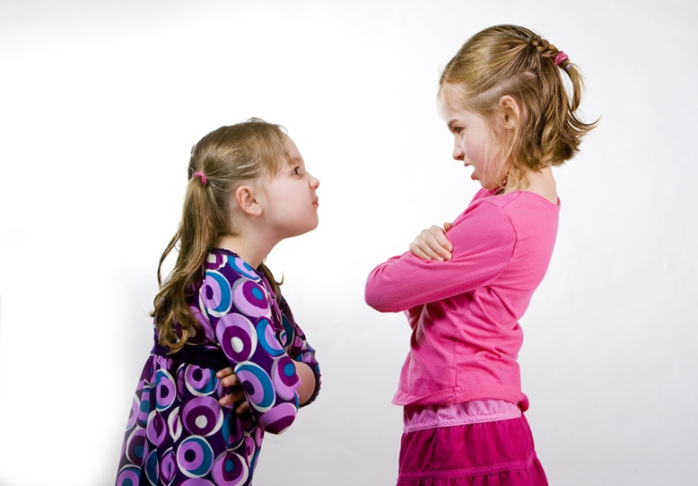

Styles of Communication

Slide 23

Assertive people - know that they have the same rights to be a part of conversations
respect other people’s rights and feelings.
use a pleasant tone of voice and make eye contact
are honest about letting people know what they need for good communication & when they don’t understand
know that misunderstanding is a shared responsibility and are polite when working with others to clear up the misunderstanding
GOAL FOR CHILDREN
WITH HEARING LOSS

Slide 24

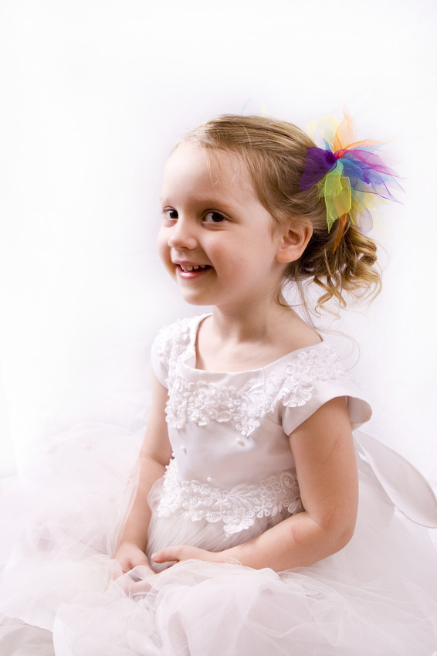
Example: the ‘star’ at preschool
Early ID, hearing aids by age 2 months
AV training – wonderful language
Preschool issues!
Taking turns
Respecting rules
Fitting in
Bossy communication style!

Slide 25
The ‘star’ at preschool
Lack of work completion – too ‘busy’ watching peers at the table to do her work
Result- teacher separated her from her peers to complete her work on the floor
Work was done perfectly – but was this the desired solution?
Lack of understanding of ‘social mores’ – informal unwritten social rules, expectations
Realignment from ‘star’ to ‘student’ expectations
i.e., activities will not be changed even if she is bored

Slide 26
Communication includes Social Cues
Those things we understand from others without needing to be directly told about them.
Social cues are learned early in life and vary from culture to culture.
Children typically learn to ‘read’ their parents moods and know when it is a good time to ask for something.

Slide 27
How are social cues communicated?
Facial expressions
Gestures
Postures
  How is this person feeling?
  Are they done with their conversation turn?
  Are they expecting me to say/do something?
Examples – think about how you express in body language:
“I’m really busy right now”
“Wait just a second and I will pay attention to you”
“I’m upset”
“I’m happy to see you and spend time with you”
Be consistent in your use of social cues.
Explain how you are communicating this way whenever your child missed the cues!

Slide 28
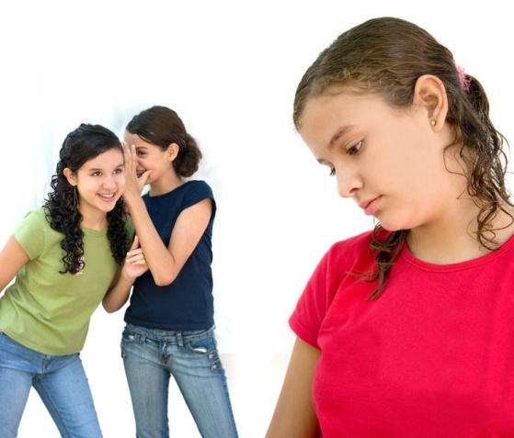
Why is this so important?
Conversations of people with hearing loss often show:
Disrupted turn taking styles
Modified speaking style
Inappropriate topic shifts
Superficial content
Frequent clarification
All of which can affect how other people judge the child as a preferred communication partner.
Communication problems and differences in modes of communication often adversely impact the ability of students who are deaf or hard of hearing to develop friendships (Luckner, Schauermann & Robb, 1994).

Slide 29
How can we shape social skills?
TEACH – Explain what the child should do, be aware of, wait for, think about – don’t assume he knows!
MODEL – Use good social skills yourself, role-play with your child, provide the words for what he’s feeling
WATCH AND SUPPORT
Reinforce good social behaviors – be specific about what s/he did well!

Slide 30

Example:
Providing the words
Mom: If you want to play with Billy let’s talk about what you need to do:
Knock on his door and wait for his mom to answer. Should you bounce your ball there or just wait patiently?
What will you say? (child: Is Billy here?)
You want to know if he can play outside with you, not just if he is at home. (child: Can Billy play?)
Do you think you should say hello to Billy’s mom?
PRACTICE: Hello. Can Billy come outside and play with me?
REFLECT: Ask child later what Billy’s mom said when she answered the door. Highlight that he did well! It worked!

Slide 31
How can we shape social skills?
When the child has a social misstep:
  immediately model what s/he should have said/done
  use words to describe what s/he should have said/done (You mean….)
  explain how it made you feel (ignored, angry)
  describe how what the child did could be interpreted by others in a way s/he didn’t really mean (i.e, by not answering someone may think you don’t care about them or what they say)
Talk about feelings!

Slide 32
Communication Competence
Assumes child has:
Language levels similar to those of peers
Something to talk about
Skills of building a conversation
Knowledge of ‘social & conversation rules’
These are all skills that can be taught, assimilated from indirect exposure and developed through experience interacting.
Using ‘cool’ language

Slide 33

Social language:
Students want to be a part of the group but do not
know how to break in, often because they do not
understand the current vocabulary.
Using the colloquial (hip) terms is important for
acceptance within the peer group.
This language is learned through exposure too
Teen magazines, teen-oriented radio exposure

Slide 34
What is ‘Cool’:
In this case, ‘cool’ can be interpreted as interacting in a way that lets others know you are comfortable with who you are and are in touch with what is important to others your age.
You can introduce hip language while you’re chillin with the child. It may help you get tight and open up future conversations when he may requestion you about his experiences fitting in.
Use the internet! Great resource for ‘cool’ is:
http://parentingteens.about.com/od/talktoyourteen/a/teen-slang.htm
Notes:
Chillin – relaxing
Tight – close in relationship
Requestion – cross between request and question

Slide 35

Steps to build social language
Provide exposure to vocabulary used by peers
Provide plenty of opportunities for children to interact – social language is mainly learned through exposure in social settings
Problem solve and role play ahead of time what kinds of listening challenges can happen and what the child can do if he doesn’t hear what another child says.

Slide 36

Role play moments….Example
“We are going to meet Cindy and her mom at the park this afternoon so you can play together. How will it feel if Cindy says something and you don’t hear it all?”
“I’ll feel bad”
“What can you do?”
“I can tell Cindy that I sometimes don’t hear everything and ask her to call my name or be by me when she talks.”
“Great idea. Let’s practice. I’ll be Cindy and I’ll pretend to say something that you won’t hear.”
Be sure to switch roles so you can demonstrate the language that can be used. Switch back so she can practice using the language.

Slide 37
Communication Competence
Also requires:
Self-esteem to take the risk to engage in communicating with another
Which affects your willingness to ‘put yourself out there’ as an equal communication partner
This is partly founded in your personal identity (self-concept) – who you believe you are in relation to others
Which is rooted in psychosocial development

Slide 38

Self-concept
The ‘lens’ through which children view or identify themselves
Example:
3rd grade girl who is hard of hearing
Language within grade level, works very hard to maintain academics – doing ‘okay’ in class
Hardly ever asks for clarification or help from the teacher
Loner with few peers she talks to, no real friends
Hides her hearing aids, and acts embarrassed when anyone refers to her hearing loss or hearing aids

Slide 39

Self-concept example
Is this student a ‘success’?
Is she comfortable with her identity as a person with hearing loss?
Does she feel like she fits in?
As school gets harder will she be able to maintain her academic success if she is unwilling to ask for help?
Is her denial of hearing aids possibly going to lead to rejection of the hearing aids later on?
Without her hearing aids can she do as well in school?

Slide 40

The stages of facing loss
Denial – I don’t need my hearing aids
Anger – I hate my hearing aids, I hate people coming around because I have a hearing loss
Bargaining – If I pretend I don’t have a hearing loss and hide my hearing aids then I will be the same as my peers
Depression – Just leave me alone
  Sometimes students who continue to use devices go through depression in response to feeling left out by their peer group or “weird”, discontinuing use is a strategy to resolve these issues/feelings.
Stages are an emotional response to a perceived social/identity problem.
We need to address the emotional part, not just provide rational arguments.
Children KNOW they do better with their devices.

Slide 41
Self-concept is learned
Self-concept is learned. It is shaped through experiences, usually with caregivers.
Contrast between two central self-concepts:
Child raised in an environment that celebrates unique and special qualities and encourages independence in hearing aid use & communication
Child who others ‘do for’ (still putting on his hearing aids for him past age 3); who has family members that take responsibility for his behavior, don’t hold him accountable for age-appropriate expectations and excuse inadequate performance.
Child 1 is likely to believe he has special areas of talent and will be a success.
Child 2 is likely to believe he is incapable and requires assistance.

Slide 42

Self-esteem is linked to self-concept
Self-concept is your understanding of yourself and your characteristics.
You can change your self-concept by changing your attitudes, values, or beliefs
A good self-concept is linked to high self-esteem and self-confidence.
Factors affecting children’s self esteem:
  Knowing he is appreciated, wanted, loved
  What he hears you say about who he is/does/accomplishments
  His sense of achievement
  How comfortably he can relate with others

Slide 43
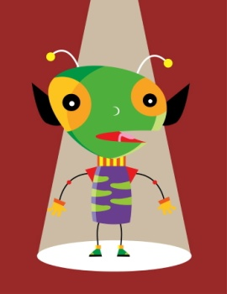
A high self-esteem and self-confidence are needed to advocate
Self-esteem can be called the cornerstone of the ability to advocate for communication needs
Self-advocacy techniques take some risk for students– they need to step forward into the limelight for a short time
Students with hearing loss become very fatigued after listening carefully for long periods. They can miss information that other students do not. They need to have the self-esteem to recognize that they are not ‘being bad’ or ‘stupid’.
We need to help them to problem solve what to do in these situations to cope. Families need to model this problem solving from a young age.

Slide 44
Self-esteem can be increased by:
Appreciating the child
Encouraging the child to make choices
Fostering independence
Giving genuine importance to his/her opinion and listening
Taking the time to explain reasons
Constant source of positive encouragement
Encouraging the child to try new and challenging activities
Telling your child that you love them
Spending time with your child, showing how much you enjoy being with him/her

Slide 45

Self-esteem and self-confidence are the foundation of a child’s communication competence and willingness to advocate for his or her communication needs
How can parents help their child develop in these areas?

Slide 46
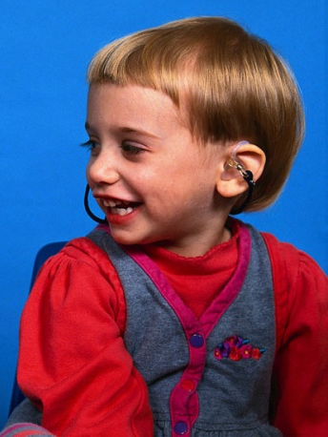
The critical need to narrate
Language is learned through exposure. Parents need to provide the words & concepts….
Talk about hearing technology: name the parts, describe how it works, problem solve choices of what to do when it doesn’t work
Talk about listening challenges and choices: avoiding a place because it is noisy, needing to stand closer because it is noisy, listening to people speaking with an accent is more difficult for everyone, difficulty hearing in the car unless people speak a little louder, etc.

Slide 47
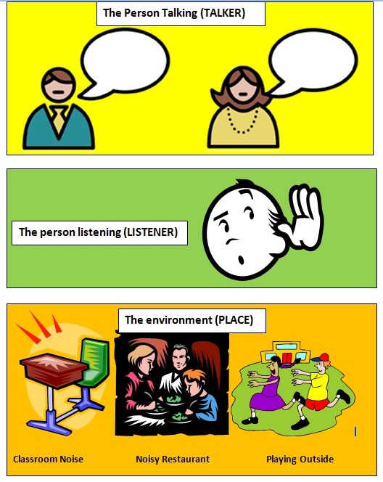
Help your child be aware of listening challenges and source of the problem…..What can he do?
Ask to repeat, talk more slowly, etc
Let people know you have a hearing loss, ask them to clarify
Turn off noise, move away from noise, move closer to person talking

Slide 48

The critical need for parents to narrate
Everyone has a hard time understanding what other people say sometimes – what do you do?
Emphasize that it is important that the child have the same opportunity to receive information as others. It is their right!
Model appropriate ways to request clarification.
The child who enters school with the attitude that they have a right to hear what everyone else hears, the language to request ways he can hear better or ask for repeated information, and the self-esteem to make those requests is lightyears ahead of most students with hearing loss!

Slide 49

Foster development of critical listening skills
Children who use their hearing to learn often hear something even when they miss other information when someone is talking.
Can you make sense out of what you heard?
What were we just talking about? Guess
What part did you hear? (something about lunch)
Use that part to ask someone to repeat (I’m hungry. Did you just say something about lunch?)
Problem solve – if you know there was something you missed but you didn’t hear any of it, what can you do? (ask person to repeat)
The child has some responsibility to ‘repair the communication’ when he misses something.

Slide 50
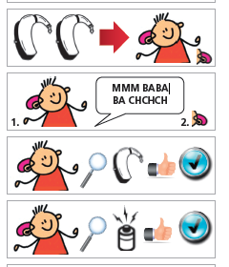
Communication confidence includes expecting independence with hearing technology
Ability to put on amplification and do a quick ‘self-check’ to ensure it is working
Growing involvement/responsibility in daily amplification monitoring activities
Recognizing when a problem occurs with amplification and knowing what to do next
Also independence in taking responsibility to act when the child realizes that information has been missed

Slide 51
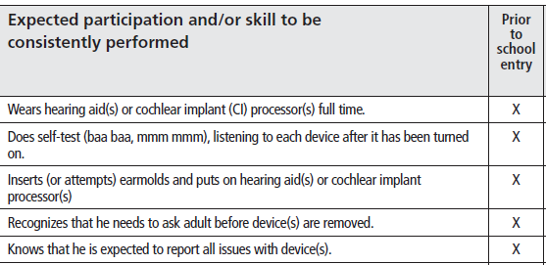
Student Expectations for Advocacy & Monitoring Listening and Hearing Technology
SEAM for School Success = a skill hierarchy
Prior to School Entry

Slide 52

Planning for Improvement:
In addition to academic needs, IEP Present Levels of Performance should consider
Hearing Loss
Language skills
Social skills
Communication style
Communication repair skills
Self Advocacy and independence
Functional listening in quiet/noise at varying distances
Technology needs due to barriers to classroom listening

Slide 53

Gathering Family Observations – Important information for schools!
A student with hearing loss needs to be able to understand the teacher, express his own thoughts, obtain clarification when he does not understand, and interact with classmates as a prerequisite to learning.
Family observations of the child’s listening behavior at home provide valuable insights into difficulties he or she may experience in similar school listening situations.
It is requested that the family complete the Children’s Home Inventory of Listening Difficulties (C.H.I.L.D.) so the Listening Situation Breakdown can be considered by the School Team.
The Understand-O-Meter is provided for score interpretation.

Slide 54
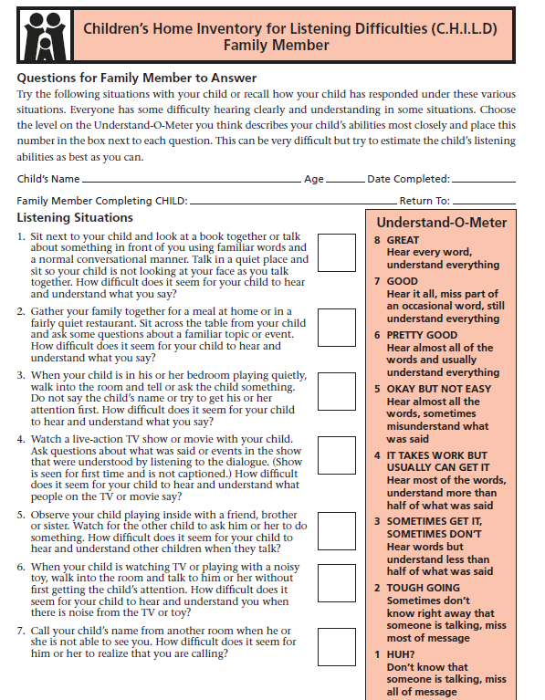
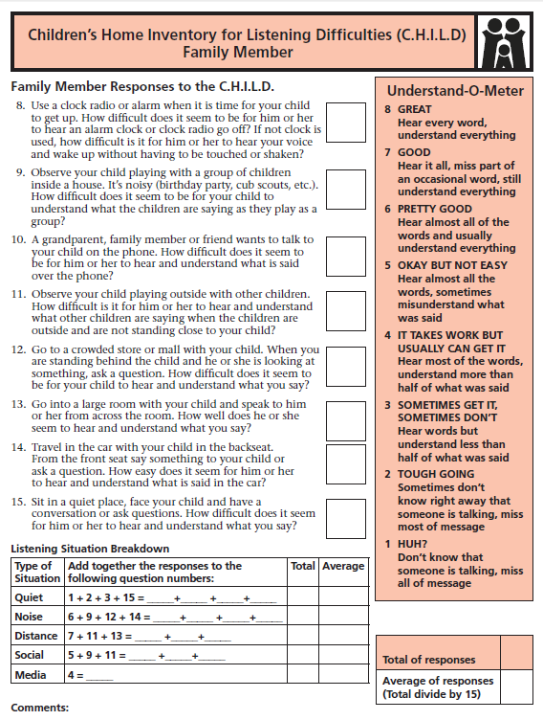

Slide 55

Starting School LIFE
FAMILY +
SCHOOL
L.I.F.E.
Transition from Early Intervention or students who move in to new schools, kindergarten to grade 6
Uses family observations from the CHILD.
Sums scores by type of situation.
Asks about communication style and independence.
Has an Interpretation guide for results.
Values family input
No ‘cookie-cutter’ approach to technology needs.
Simplifies practical results of language evaluation.
Helps with planning for services and program.

Slide 56
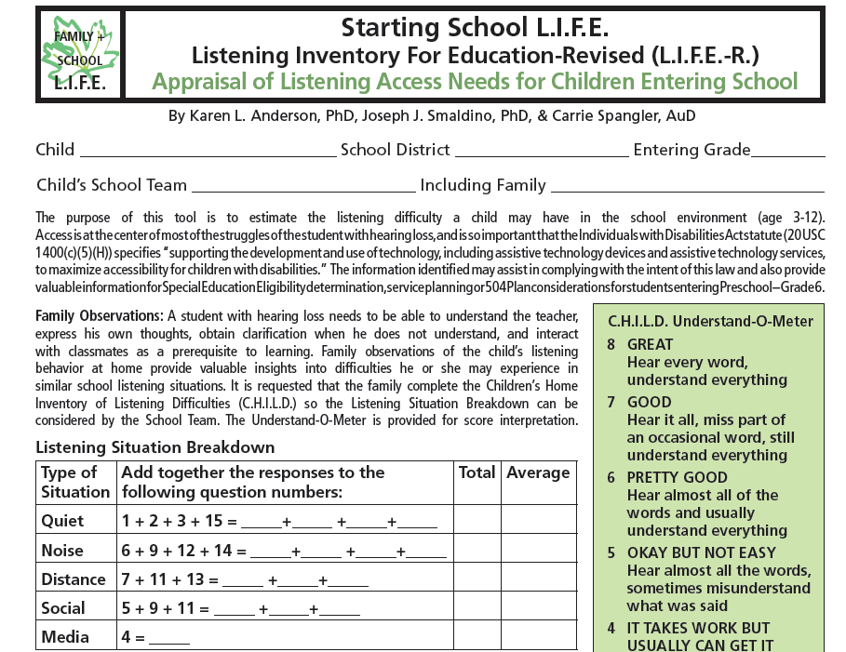

Slide 57
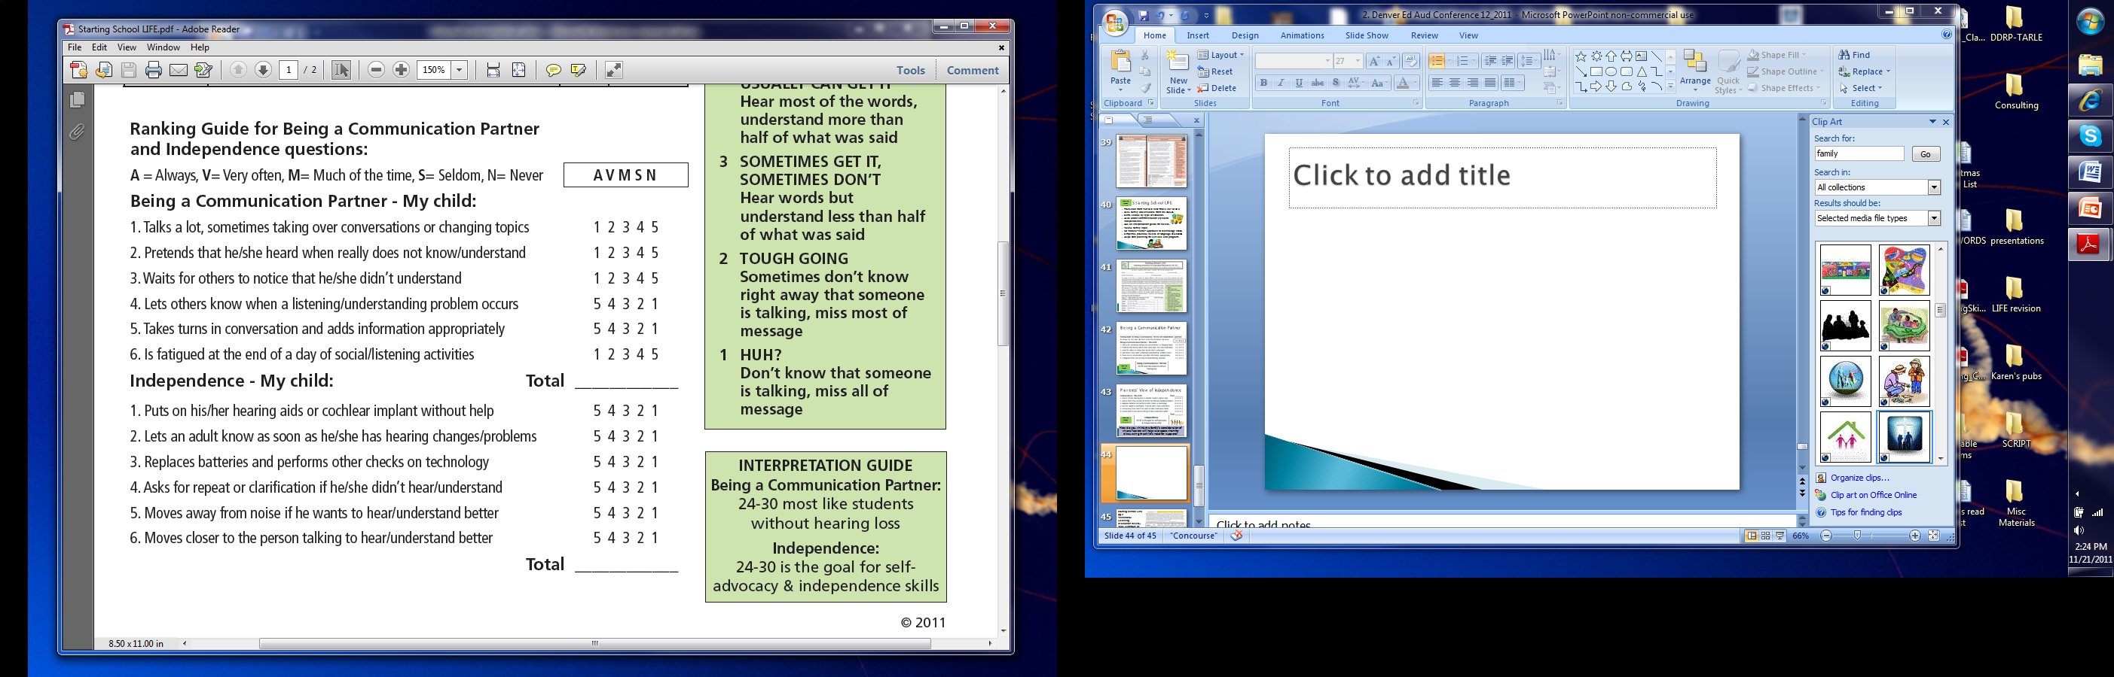
Being a Communication Partner
FAMILY +
SCHOOL
L.I.F.E.

Slide 58
Parents’ View of Independence
FAMILY +
SCHOOL
L.I.F.E.

Slide 59
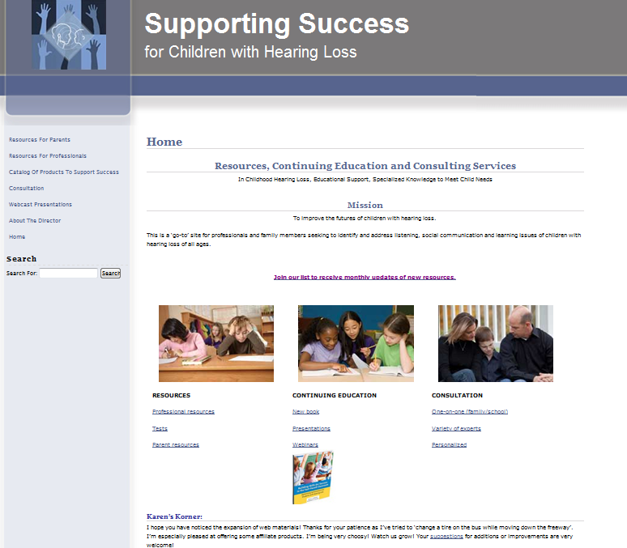

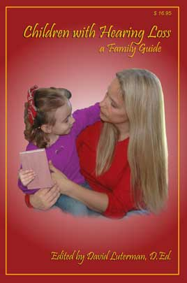
Resources available: http://successforkidswithhearingloss.com
Parents:
FAQs by age
Many topics
Consultation
Resources!
Building Skills for
Success in the
Fast-Paced
Classroom
Children with
Hearing Loss: A Family Guide
SEAM, CHILD, Starting School LIFE

Slide 60

Final Thoughts
If we have high expectations for children
and empower them to advocate for their own
listening and learning needs
they are on the road to
life -long success.

