Slide 1

Building Social Language and Communication Competence
Karen L. Anderson, PhD
March 8, 2012
http://successforkidswithhearingloss.com

Slide 2

Focus of this presentation
Describe changes in demographics that make focusing on social competence so critical
Describe how psychosocial development stages affect self concept and acceptance of hearing loss/hearing devices
Provide strategies to strengthen self concept, define communication strategies and support emotional growth and social identity to improve eventual retention of hearing devices

Slide 3
Changes to Population Served 2008 annual OSEP report
Percent – Deaf/Hard of Hearing | 1996-1997 | 2005-2006 | Change
High school completion | 74% | 87% | +13%
Graduate with regular diploma | 62% | 69% | +7%
Percent of population age 6-21 | 0.1% | 0.1% | --
Time inside regular classroom 80%+ | 39% | 49% | +10%
Time inside regular classroom 40-79% | 19% | 18% | -1%
Time inside regular classroom <40% | 25% | 20% | -5%
Other environments | 17% | 14% | -3%
http://www2.ed.gov/about/reports/annual/osep/2008/parts-b-c/index.html
2/3 educated about ½ or more in regular class

Slide 4
Percent of the number of schools serving students with hearing loss by number per school
Mitchell, R., & Karchmer, M. (2006). Demographics of deaf education: more students in more places. American Annals Of The Deaf, 151(2), 95-104.

Slide 5
Percent of total student population with hearing loss by number at each school
Mitchell, R., & Karchmer, M. (2006). Demographics of deaf education: more students in more places. American Annals Of The Deaf, 151(2), 95-104.

Slide 6

In a nutshell
More have language/skills similar to peers
More ‘deaf’ are functioning as children with mild hearing loss due to cochlear implants
More children are entering their neighborhood schools
More children who never or very rarely see another child using hearing technology
Even with several children in one school, they may not see one another as ‘he’s like me!’

Slide 7

How do we benefit from social groups?
Element of identity – who you believe you are is defined by what groups you are a member of (family, grade, class); adds to our self-esteem
Cooperation – by being in a group we learn to cooperate and work in teams within the group, all of which is facilitated by language use
Developing friendships, varied levels of relationships
Learning from others, pleasure from helping others, meaningfully empathizing with others
All contribute to more positive feelings about school and eagerness to engage in classroom activities
Early rejection by peers is associated with persistent academic & social difficulties

Slide 8

A word about psychosocial development
Psychosocial development occurs in stages. School age stages are characterized by:
Age 4-6:
Begin completing tasks for a purpose and may feel guilt or frustration if they do not produce the desired result.
Typically Theory of Mind is developed within this period and child has the perspective to recognize that not everyone wears hearing technology and misses information due to hearing loss.
Turn-and-Talk: How do you respond to this first ‘acknowledgement of difference’ event?

Slide 9

A word about psychosocial development
Psychosocial development occurs in stages. School age stages are characterized by:
Age 7-11:
Eager to complete tasks and accomplish more complex skills.
If they are not meeting adult/class expectations they may feel inferior (“I can’t”)
If a child feels inferior they may procrastinate, struggle to start work or give up, knowing “it won’t be good”
Increasing need to “fit in” as child approaches middle school age

Slide 10

A word about psychosocial development
Psychosocial development occurs in stages. School age stages are characterized by:
Age 12-19:
Concerned with how they appear and trying to reconcile who they think they are with who they believe society/their group wants them to be.
When the adolescent has balanced the perspective of “What have I got?” with “What am I going to do with it?” he has established his identity
Wanting to be ‘normal’ is…
normal!

Slide 11

The stages of facing loss
Denial – I don’t need my hearing aids
Anger – I hate my hearing aids, hate people coming around because I have a hearing loss
Bargaining – If I pretend I don’t have a hearing loss and hide my hearing aids then I will be the same as my peers
Depression – Just leave me alone
Sometimes students who continue to use devices go through depression in response to feeling left out by their peer group or “weird”, discontinuing use is a strategy to resolve these issues.
Stages are an emotional response to a social/identity issue. Need to address emotions.
Not fully rectified by rational arguments.
Students KNOW they do better with their devices.

Slide 12
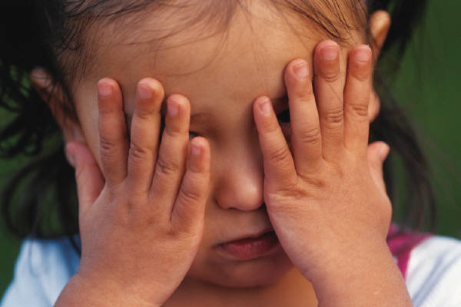
Acknowledging Difference
There will be a time when the child realizes not everyone is wearing hearing aids or CI
In preschool this difference often doesn’t matter at their stage of social awareness
If the child is mainstreamed without any other children with hearing devices at the school, then this may feel like a big difference.
For children with a strong self-concept and an identity that includes recognizing that they have a hearing loss- it may not be a big deal.

Slide 13

PREVENTION IS THE KEY
Ingredients important for success
“Bonded” with their hearing devices
Support from home for device wear
What can be done at school?
Be alert for the ‘acknowledgement of difference event’ and be prepared to
provide a ‘safe place’ to express feelings
relate to ‘everyone is different in some ways’/ specialness
group support – connect students with other DHH students!
Information about what hearing devices do/don’t do
Practice responses to “What are those things?”
Ongoing conversations from school entry!!!
Empower students – they are the “boss of their hearing loss”
High expectations for responsibility/advocacy

Slide 14
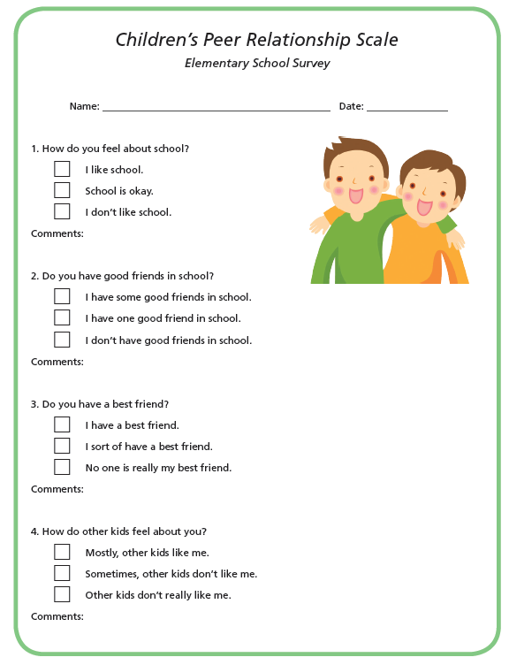
Conversation Starters!
How do you like school?
Do you have good friends in school?
Do you have a best friend?
How do other kids feel about you?
What do you do after school?
Do the other kids tease you about your hearing loss?
Do you know other kids with hearing loss?
What do you think about your hearing devices?
For Grades K-6

Slide 15
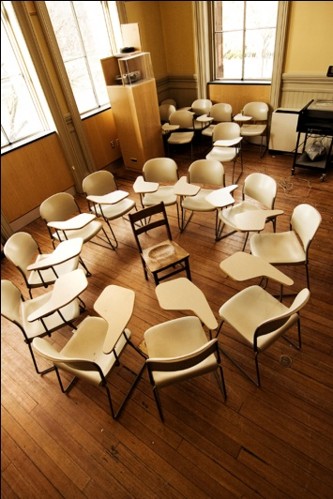
Develop a sense of ‘group’
Bring students together to talk about their hearing loss, challenges and feelings. They can ‘teach’ each other about their hearing loss and share/support challenges with peers/school. (Moodle, facilitated chat rooms)
Ask “What do you think other kids with hearing aids do/feel/try?” Get questions written down, share them with older students and bring replies back to younger students.
Talk about how other students you serve
are challenged, how they handle it.

Slide 16

Group discussions of your tricky hearing loss
Pretend your hearing loss is in the chair next to you:
How big is it?
What does it look like?
Will it ever go away?
4 girls, all Gr 6. Misty has been resisting DHH help.
Describe your hearing loss:
Girl 1 – a little like a baby
Girl 2 – medium sized
Girl 3 – didn’t know
Misty – It’s huge!
A Simple way to obtain important insights!

Slide 17
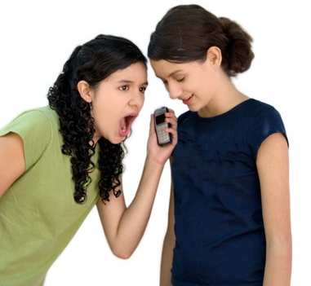
Empowerment! Being the “boss of your hearing loss”
Adolescents are more likely to reject if they feel something is “being done to them” rather than being an active participant
Students should assume the role of ‘direct consumer’ with the audiologist, asking questions, making choices, etc.; EARLY
Color of earmolds/hearing aid case – 1st step
Make connections between neat computers, fancy cell phones and hearing devices – learning how technology works is cool!
Cool ways to answer questions
about hearing devices – practice!

Slide 18

Build Student Skills as ‘Technology Specialist’
Various resources for teaching students about their technology
Learning goes hand-in-hand with increasing responsibility in daily monitoring (more later)
Ideally the student would inservice the teachers on how to use the equipment
Student assumes the role as the individual who troubleshoots first when something isn’t working
PowerPoint presentations, video clips by phone or moodle or photos with descriptions to support student independence with use and troubleshooting tasks
Boss of their hearing loss!

Slide 19
Start talking about middle school in Gr 4
“When kids get to middle school they want to be like everyone else. Why could that be hard for you?”
“Kids in middle school and high school also want to be seen as special individuals who are cool. How do you see yourself as special?”
Gr 5
“When you get to middle school it might be harder for you when you want to be like everybody else. Other kids with hearing loss feel the same way. Let’s see what they said.”
Involve friends!!!

Slide 20
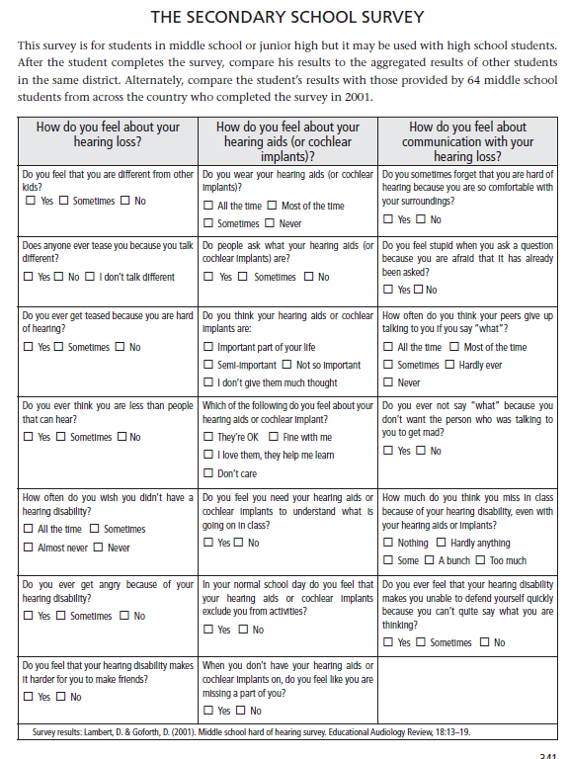
Written by a DHH high school student. Results of 64 MS students across the country.
How do you feel about your hearing loss?
How do you feel about your hearing devices?
How do you feel about communication with your hearing loss?
Do NOT wait for Secondary School!

Slide 21
If a student identifies himself as part of a group of individuals with similar ‘differences’ who are managing to do okay in MS/HS then there is less emotional need to be like everybody else in the immediate peer group.
The student can identify with the ‘doing okay and feeling good about themselves’ DHH group.
Real connections with older DHH students are important in this transition!
Also critical to involve non-DHH friends as the student develops an understanding of who they are in their peer group.
Have conversations that support growth in identity by better understanding “What have I got?” and “What am I going to do with it?”

Slide 22
Teens have different decision-making strategies than adults - linked to brain anatomy and physiology different from adults. Adults cannot force teens to make adult-like decisions.
Behavioral contracts to wear amplification may be successful in the short term, but does not help the teen work through feelings of being different and reconciling how to belong, be liked, find their place in the world and ultimately make appropriate management decisions regarding their hearing loss.
Adults can provide challenges and opportunities to facilitate maturation of cognitive and emotional development by identifying what their perceptions and beliefs are before challenging them to grow in their own understanding of how they want to be and how to get there.

Slide 23
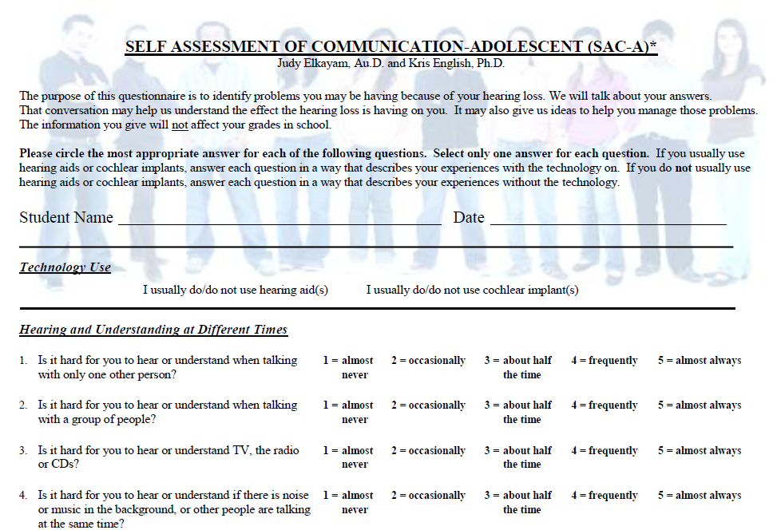
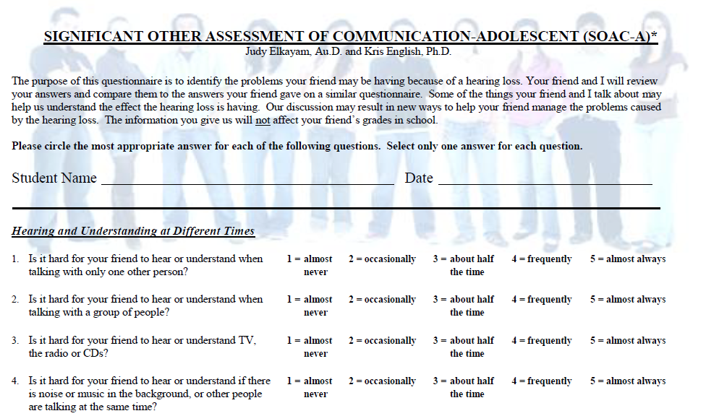
Provides a neutral 3rd thing to talk about. 80% who went through the SAC-A and SOAC-A experience rated it positively even if their behavior was unchanged.

Slide 24
Common themes expressed:
1. Inherent isolation of hearing loss: feeling left out of conversations; others just can’t understand what it’s like to have a hearing loss; futility of talking about it with friends as frustration still occurs
2. Identity and self-concept: difficulty being the only one in school with hearing devices; preference for being with other students with hearing loss and support staff because they understand; challenges finding a social niche; easier to be viewed as deaf but missing information sometimes rather than hearing ‘perfectly’

Slide 25
Common themes expressed:
3. Cosmetics and other hearing device issues: hate having to explain to people; seen as being different
4. Problem solving: classroom can be easier than social situations; need for assistive devices; challenge of rapid speech, whispering, person turning away, background noise
5. Self-acceptance: blaming others for communication difficulties; desire for normal hearing; downplaying need for accommodations when challenged by teachers (“just forget it”); something just to deal with; being unique.
Talk about these issues; brainstorm ways to deal;
provide language and practice!!!

Slide 26
Social Interaction
Social Skill Expectations
Communication Style
Communication Repair

Slide 27

The Student Communicator
Ways to consider functional access:
Social skills readiness
Communication style as a window into communication access/advocacy
Developing skills to repair communication breakdowns as language complexity increases – keeping up with peer abilities

Slide 28
Social Skill Expectations
Social skills include:
Rules of conversation
Responding to social cues
Saying hello and goodbye
Cooperating by taking turns
Responding appropriately to questions
Being sensitive to the feelings of others
Making eye contact
Smiling
Being polite
Communication repair

Slide 29
Social Skill Expectations
Self advocacy
Social skills include:
Problem solving
Supporting others by giving them attention and helping
Having interesting things to say
Reinforcing and acknowledging other’s comments
Controlling aggression and other inappropriate behaviors
Being Cool!

Slide 30

Social language: Being ‘Cool’
Students want to be a part of the group but do not
know how to break in, often because they do not
understand the current vocabulary.
Using the colloquial (hip) terms is important for
acceptance within the peer group.
This language is learned through exposure too
Teen slang – highlight as vocabulary

Slide 31
Socialization – more than making friends
In his theory of cognitive socialization, Vygotsky believed that cognitive development and learning was dependent on sharing through language and continual cooperation among learners.
Communication problems and differences in modes of communication often adversely impact the ability of students who are deaf or hard of hearing to develop friendships (Luckner, Schauermann & Robb, 1994).
Kindergarten teachers say that about 20
percent of children entering kindergarten
do not yet have the necessary social and
emotional skills to be “ready” for school.

Slide 32
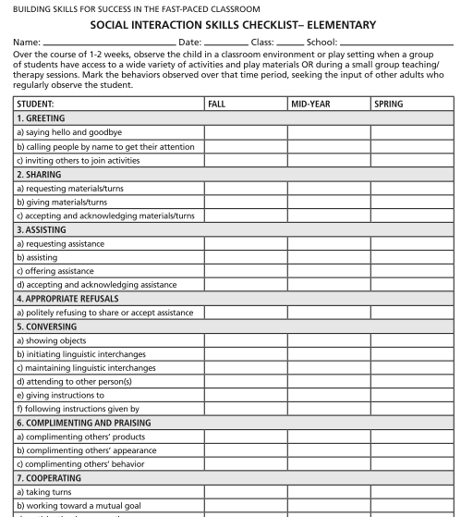

Social skills
should be a
part of the
comprehensive
student
assessment
Data from
Checklists or
Systematic
Classroom
Observations

Slide 33
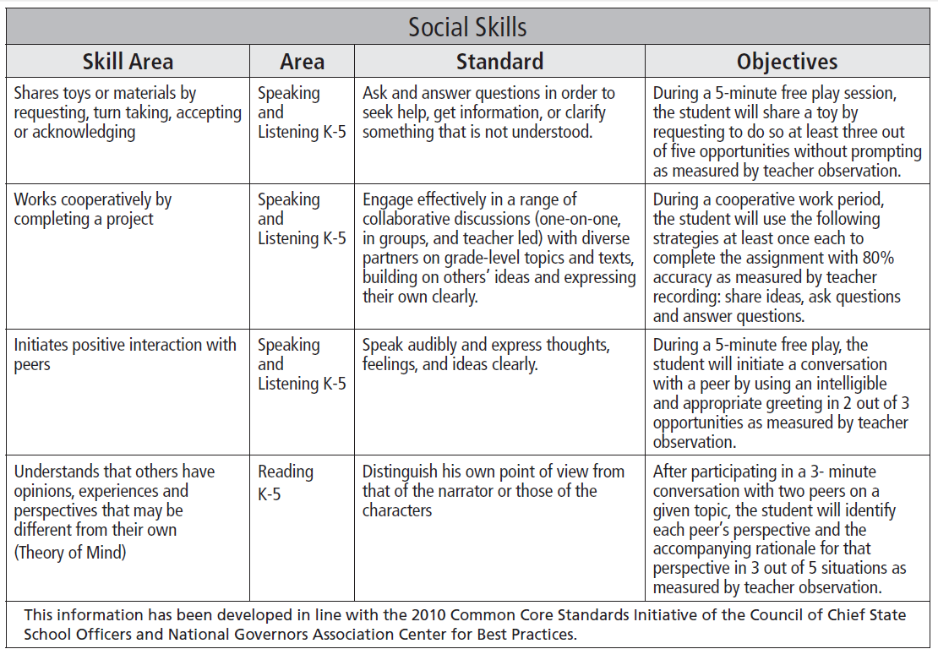
Do any of your students have social skill goals on their IEP?

Slide 34
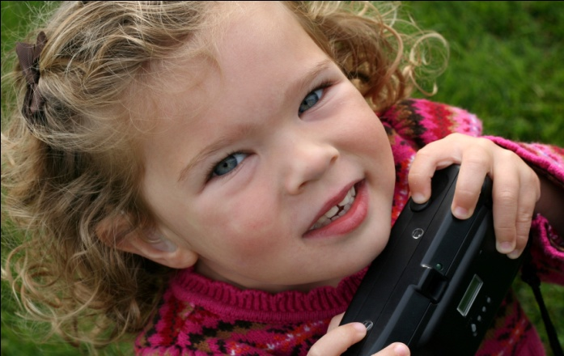
A place to start….
Success for students with hearing loss is not all about academics, audibility and language or language delay
Success is also about how a person communicates – your style
Children can have communication styles that do not help them:
Socialize
Advocate for what they need
Be perceived as capable and equal communicators

Slide 35
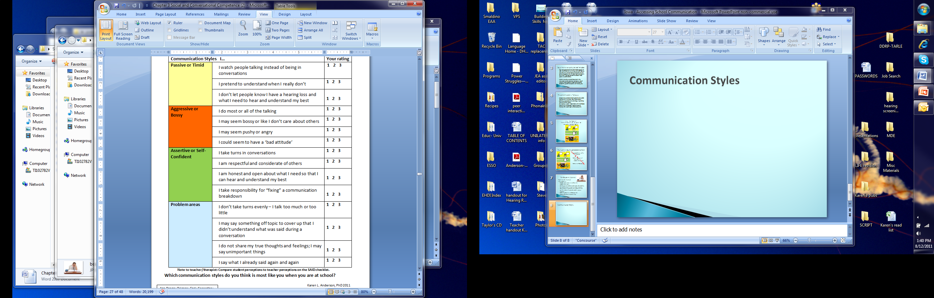
Communication styles
Style: ‘A particular, distinctive, or characteristic
mode of action or manner of acting.’
Do you know students like this?

Slide 36

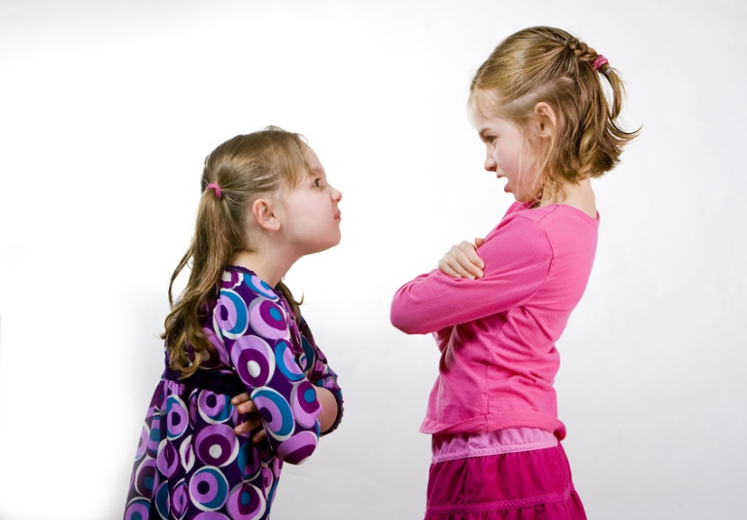

Styles of Communication

Slide 37

Communication styles

Slide 38
Assertive people…
know that they have the same rights to be a part of conversations
respect other people’s rights and feelings.
use a pleasant tone of voice/signing style and make eye contact
are honest and open about letting people know what they need for good communication and when there is an understanding problem
know that a misunderstanding is a shared responsibility and are polite when working with others to clear up the misunderstanding

Slide 39
Communication Styles
Our goal for students is to be assertive about
their listening and learning needs.
What do students have to believe before they
are likely to take responsibility when they
experience a communication breakdown?
Polite doesn’t mean pushover
Role playing situations and language to use
Establish school expectations
Reinforce with home expectations
BEGINNING STEPS TO SELF-ADVOCACY
Communication styles – N. Tye-Murray & Kris English

Slide 40
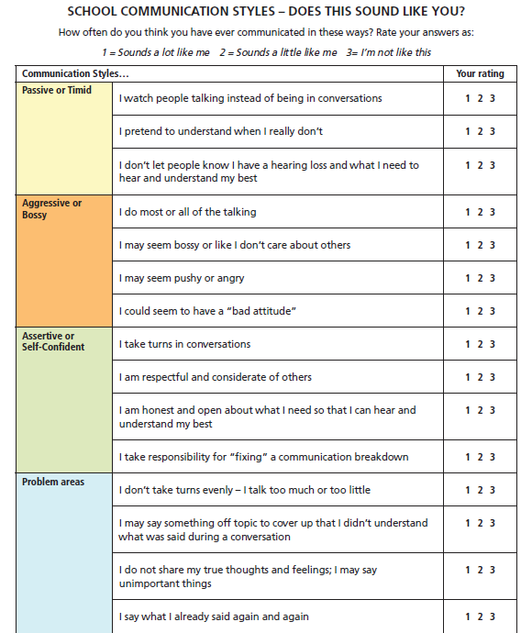
Converse with students about their communication style.
Style varies by situation. Class? Socially? Home?
How to monitor?
How can they become more assertive incrementally?

Slide 41

Present Levels of Performance should include the Hidden Curriculum
Hearing Loss
Language skills
Social skills
Communication style
Communication repair skills
Independence with technology
Self Advocacy (talk on Friday)
Functional listening in quiet/noise at varying distances (talk on Friday)
Needs due to barriers to classroom listening

Slide 42
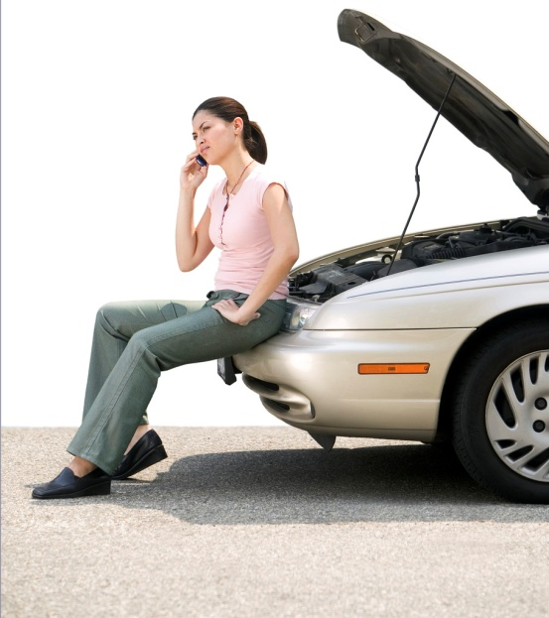
Why Communication Repair?
Communication breakdowns occur whenever the speaker is not understood by the listener.
Many variables can contribute to communication breakdowns, including:
background noise
physical distance
speech intelligibility
fragmented hearing
unfamiliar vocabulary and more.
Everyone experiences communication breakdowns regardless of hearing ability.
We all try to ‘repair’ these breakdowns.

Slide 43
Competence in communication Repair
Competence in repairing communication is based on three skills:
(1) the ability to persist in the communication process until comprehension is achieved
(2) the ability to take on the perspective of the communication partner, allowing for the recognition that a communication breakdown has occurred and
(3) the development of effective alternative communication options.

Slide 44
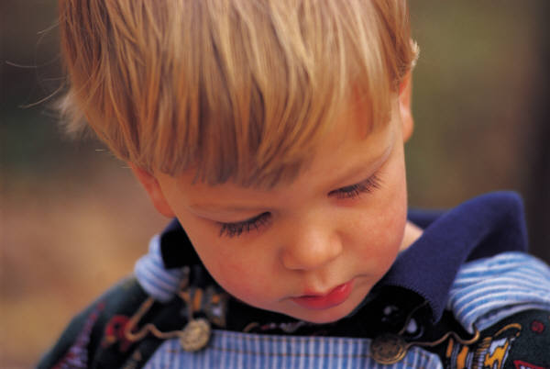
Communication repair from the start….
Young children develop repair strategies as they experience communication breakdowns
It is an integral part of the language acquisition process
Repair strategies are an early developing mechanism

Slide 45
Need for communication repair training
Children with disabilities often have difficulty developing repair strategies without instruction.
Researchers have suggested a relationship between communication breakdowns or lack of repairs and problem behavior.
Children with disabilities more often render a message that is unclear, incomplete or less conventional.
They are often less able cope with the frustration or respond to the respond to the clarification in an acceptable manner.

Slide 46
Implications
Typical language tests used may not be sensitive enough to detect differences in pragmatic use of language specific to communication repair strategies
Children with hearing loss do not spontaneously learn how to cope with communication breakdowns at the same rate, or in the same way, as individuals with normal hearing

Slide 47

It’s a 2-way street
Relatively unsophisticated language learners are sensitive to feedback that their messages are not understood
They are able to adjust so they can accommodate to be understood during conversations
Strategies used to provide clarification change with age

Slide 48
How are CR strategies classified?
3 broad categories of verbal CR; also nonverbal CR
Each broad category has several strategies for a total of 13 plus inappropriate responses to equal 16
REPETITION – no information is added to the original utterance
REVISION – meaning of original utterance unchanged; form is altered
ADDITION – Simple - information is added to the original utterance - Clarifying – specific information added to define, clarify
NONVERBAL - student uses strategies other than verbal
INAPPROPRIATE – student did not comply with request for clarification
Notes:
Have SCRIPT Inventory Response Summary and Scoring Interpretation as handouts.

Slide 49
SCRIPT – Student Communication Repair Inventory & Practical Training
SCRIPT Inventory
obtains a baseline of the strategies that the student already uses when communication breakdowns occur.
The baseline is used to guide the teacher in what other strategies to familiarize the child
Developmental Trends provide guidance on specific skill building objectives

Slide 50
Developmental Trends

Slide 51
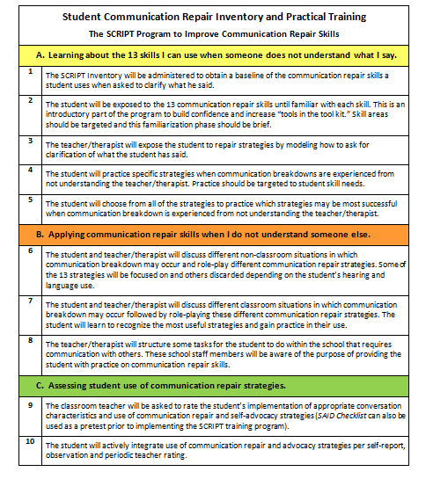
SCRIPT Inventory
is Step 1
of the
SCRIPT
SCRIPT Program Overview

Slide 52
Strategies to move from a passive to a critical listener
Work with families early on about the importance of ‘self-talk’ and increasing child awareness of handling listening challenges
Match class accommodations with child expectations, i.e.,
Teacher will minimize class noise / Student will close classroom door or let teacher know when noise interferes, FM not working (kindergarten)
Minimize use of ‘listening buddies’ to reduce developing dependency
Set up student/teacher discussions about signals student will use when he/she is not understanding

Slide 53
Strategies to move from a passive to a critical listener
Actively work on social skills, integrating an assertive communication style into expectations.
Role play how to respond to different communication challenges using Passive, Aggressive and Assertive styles so that the student has a clear understanding. Once understood, practice via role play at least quarterly.
Pair assertiveness with specific communication repair and self-advocacy skill development and practice in social settings.
EXPECTATIONS
IMPROVED COMMUNICATION CONFIDENCE

Slide 54
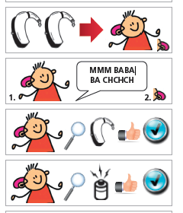
Finally, a word about Technology Independence – It is …
Ability to put on amplification and do a quick ‘self-check’ to ensure it is working
Growing involvement/responsibility in daily amplification monitoring activities
Recognizing when a problem occurs with amplification and knowing what to do next
Also independence in taking responsibility to act when the student realizes that information has been missed

Slide 55
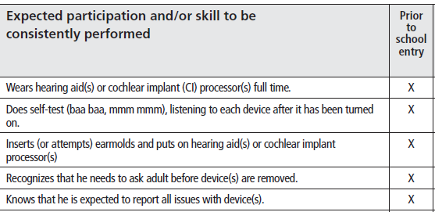
SEAM for School Success = a skill hierarchy) Prior to School Entry

Slide 56
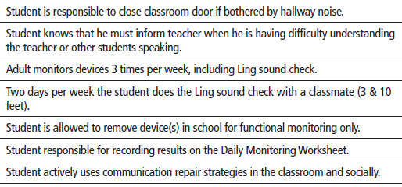
SEAM for School Success = a skill hierarchy) By end of Grade 2

Slide 57
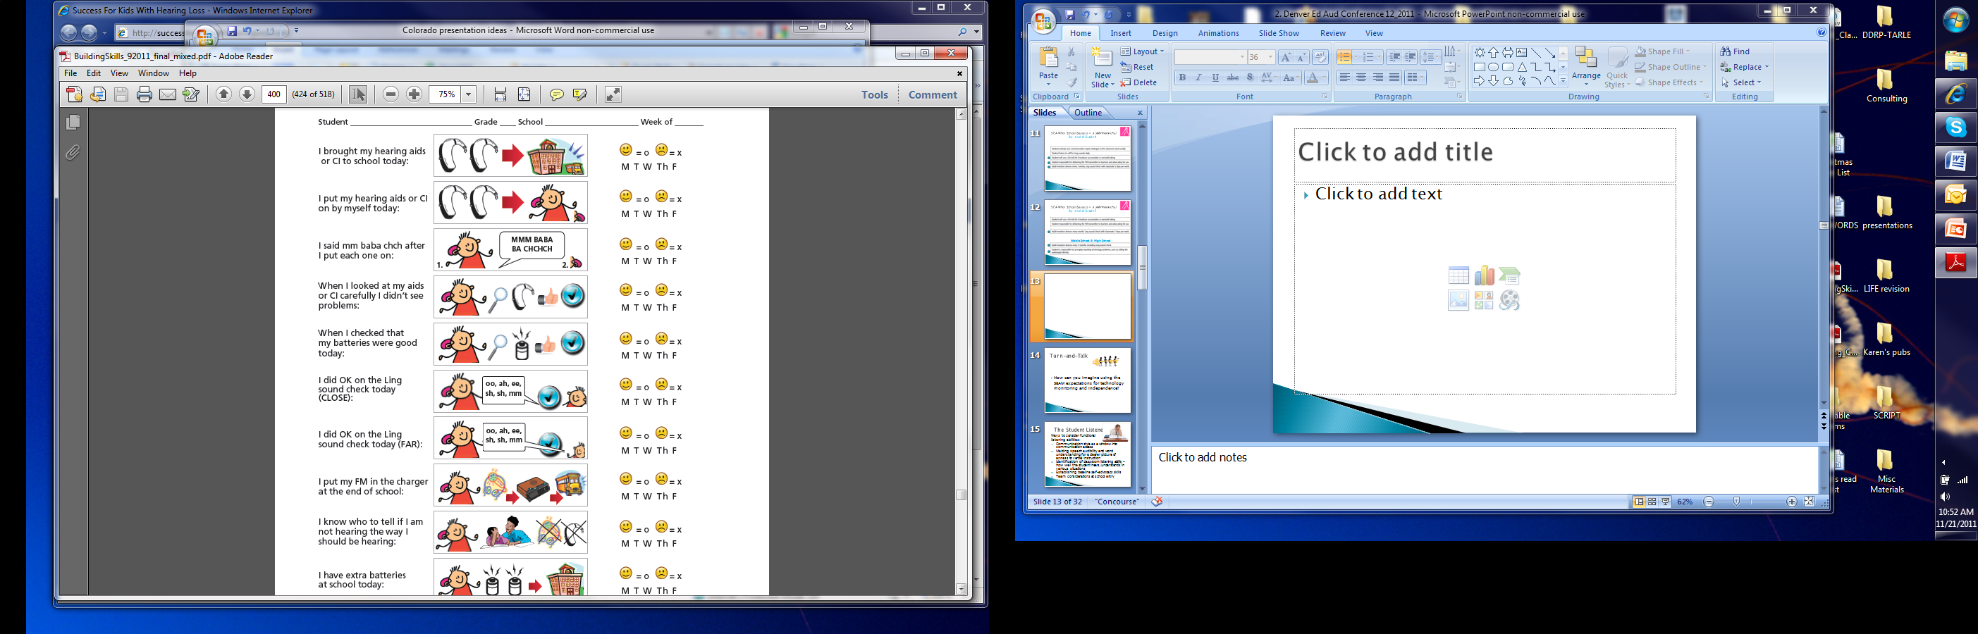
Child friendly
monitoring
tools need to
be available
Age appropriate
tools for older
students too

Slide 58
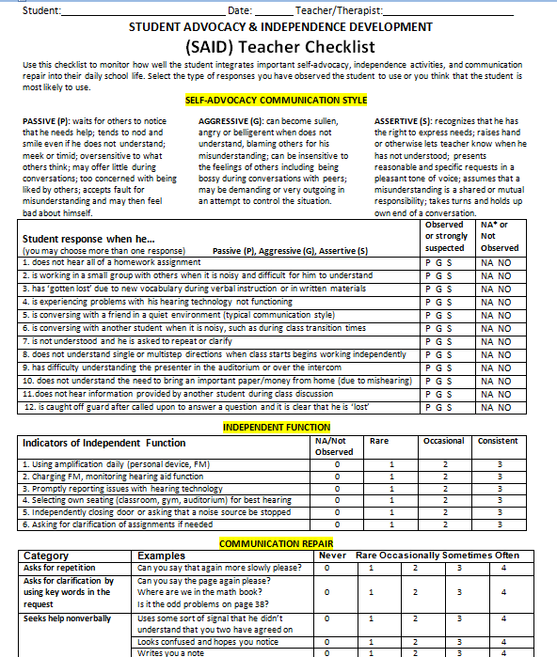

Sets the stage for teacher to understand student needs in communication style, expecting independence with technology and some self-advocacy activities.

Slide 59

In Summary:
Recognize the implications of psychosocial adjustment on self-concept & socialization
Intervene early to develop understanding and attitudes more likely to support device wear
Actively address social skills and supporting the student as a member of a group of students who uses hearing devices
Address communication skill development
Use communication style as an avenue to set the foundation for self-advocacy
Have high expectations for technology independence

Slide 60
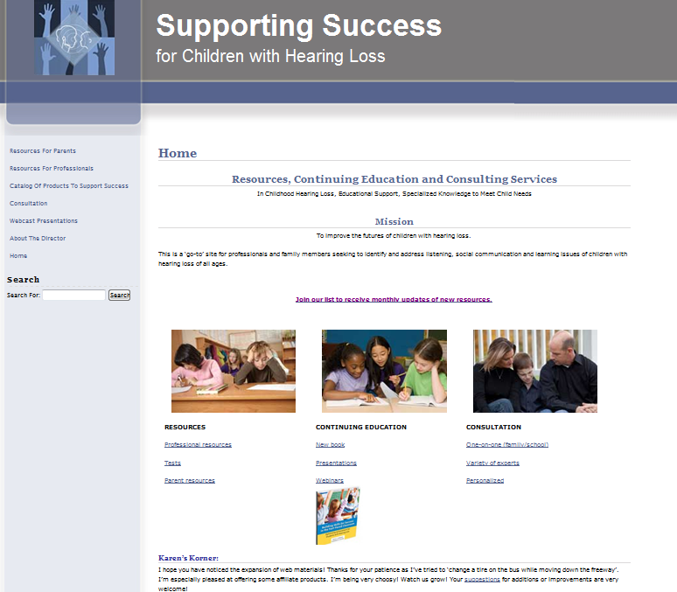
Resources available: http://successforkidswithhearingloss.com
Professionals:
Tests
Many topics
Resources!
Book:
Building Skills for
Success in the
Fast-Paced
Classroom
Children’s Peer Relationship Scale, SAC-A, SOAC-A, SEAM
Thanks for Listening!

