Slide 1

Accessing the General Education Curriculum
Karen L. Anderson, PhD
March 9, 2012
http://successforkidswithhearingloss.com

Slide 2

Focus of this presentation
Access in terms of student audibility of speech and speech perception
Ways to estimate auditory access to classroom communication
Individualizing accommodations
Access activities incorporated into the IEP

Slide 3
Setting the stage – today’s learners with hearing loss
New data from Christi Yoshinaga-Itano
Language growth of 135 children age 4-7
Children were cognitively normal from English speaking families with hearing parents
Median age of ID – 3 months, EI start – 8 months
Assessed 3-4 times from 48-84 months of age
Both cochlear implant users and hearing aid users (mild – severe/profound)
Results: children fell into one of 4 groups

Slide 4
Language Learning during age 4-7 years
45%
Does not reflect gaps that open in the more linguistically complex grades 3+
Notes:
Children seem to fall into different groups based on how their language was developing:
delayed performers (10th percentiles – signif lang delayed)
gap closers – delayed at 4 but caught up by 7
gap openers – okay at 4 but delayed significantly by 7
normal /high performers – 12 m – 7 yrs lang developmt normal or above age level consistently
• N=87 had severe to profound HL.
• N=48 had mild to moderate HL
Delayed Performers: Similar percentage of children with CIs and children with HAs
• Normal/High Performers: Similar percentage of children with CIs and children
with HAs
Only 1 in 4 children with CI maintain normal or above language development.
• Another 1 of 4 children with CIs are gap closers.
Over half of CI have mothers with 16+ years of education

Slide 5
Findings
We tend to be very careful when we are counseling parents about not being concerned about delays in birth – 3 years because ‘they will catch up’. Reality is about 85% of kids with delays DON’T catch up by age 7.
It is often assumed that a student who has no
delays at school entry will continue to be okay.
Reality is that we cannot assume that this is true – about 10% ‘slip’ by age 7.
Experience tells us that many normal/high performers will develop gaps as linguistic complexity and expectations increase grade 3+.

Slide 6
How can we help to prevent gap openers, and increase gap closers?
Ensuring equal access to verbal instruction, then
Focus beyond language and academics on skills that must be mastered in order to fully access & benefit from the core curriculum. Students that:
Recognize they have the right to receive the same information as other students
Recognize challenging communication situations and implementing access activities
Have the ability to repair communication breakdowns
Have the self-concept to advocate for their own listening and communication needs

Slide 7
The focus of IDEA.
Evaluating the student in light of his access to curriculum and instruction
is a critical aspect of determining if his hearing loss is impacting his ability
to make progress in the general education curriculum.

Slide 8
Specially designed instruction:
Means adapting the content, methodology, or delivery of instruction:
to address the unique needs of the child that result from his or her disability, and
to ensure the child’s access to the general education curriculum so that he or she can meet the educational standards that apply to all children within the jurisdiction of the school system.
(National Dissemination Center for Children with Disabilities)

Slide 9

Access is at the center of most of the struggles of the student with hearing loss
Access is so important that the IDEA statute (20 USC 1400(c)(5)(H)) specifies “supporting the development and use of technology, including assistive technology devices and assistive technology services, to maximize accessibility for children with disabilities.”
How do we know that
we maximized
accessibility if we
don’t know baseline?
How can we assess
student access ?

Slide 10
Rights of Children with Hearing Loss
ADA 35.160
Requires public entities to take appropriate steps to ensure that communication with persons with disabilities is as effective as communication with others.
Children with hearing loss have a right to equal access to verbal instruction
“Access denied is opportunity denied.”

Slide 11

Estimating Access to Classroom Communication
Audibility – the opportunity to perceive information (number of pieces in a puzzle)
Speech perception – functional perception of information (how you put pieces together)
We can assess via measurement process and
Via student/teacher reports of ability to access classroom communication

Slide 12
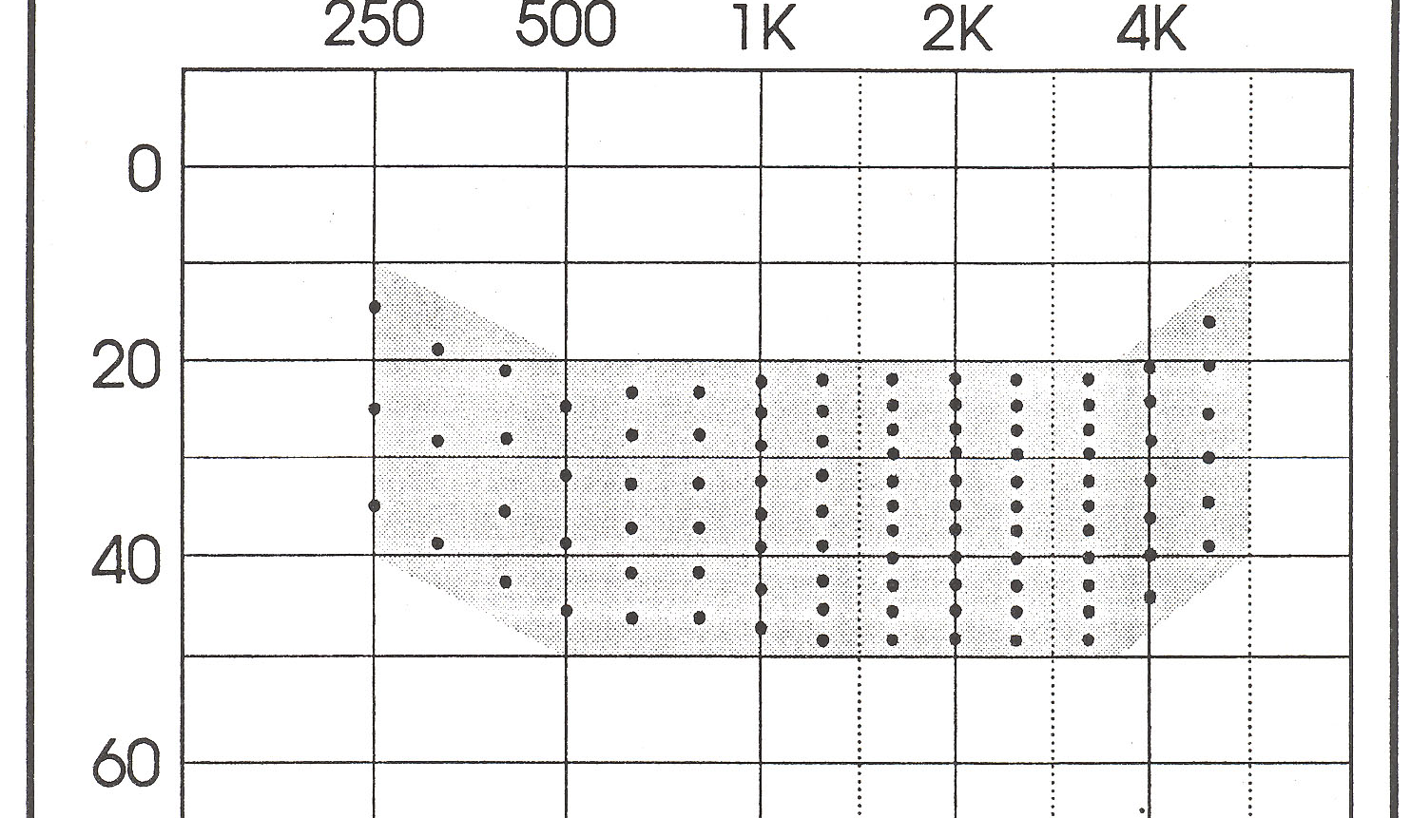
The Count the Dot Audiogram presents a representation of audible speech energy for a 45 dB HL input (audibility)
45 dB HL input

Slide 13
The Count the Dot Audiogram adaptation to represent speech energy for a 35 dB HL input
Who really cares about 45 dB HL in a classroom?
What about 35 dB HL?
-10
What about 50 dB HL?
Imposing a 20-25 dB threshold range
for a 35 dB HL input
10
30
40 dots representing 40% audibility
50

Slide 14
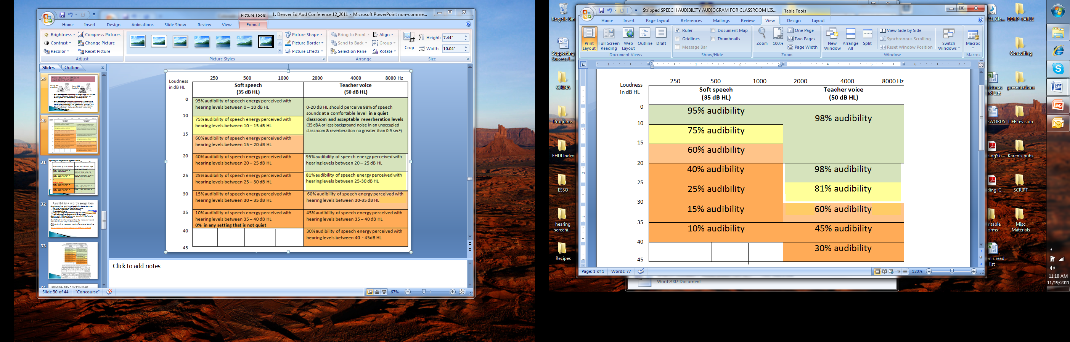

Slide 15
Turn-and-Talk: Audibility
Using the audibility information for 35 & 50 dB inputs: What is the most common aided hearing level range for students in the mainstream that you serve? Based on this, what is the estimated audibility for speech presented at 35 dB and 50 dB?
What does this say about ability to perceive speech in the classroom?

Slide 16

Audibility ≠ word recognition ‘Opportunity’ ≠ ‘Function’
Understanding with limited audibility depends upon:
Clarity of speech signal (hearing loss, noise)
Attention / Motivation/ Ease of listening
Knowledge of topic
Language complexity to be able to guess from context
Adults with 50% audibility may identify 70% of single words and 95% of sentences (Miller & Heise, 1951)
Audibility is compromised by noise and reverb.
Visual cues can help understanding.
This is why it is necessary to do a Functional Listening Evaluation
So how do typically hearing children perform in noise?

Slide 17
Results in % | Age 3-5 M - F | Age 6-8 M - F | Age 9+ M - F
Quiet 50 dB | 98-98 | 98-98 | 99-96
Quiet 35 dB | 95-96 | 97-98 | 98-96
50 dB @ +5 S/N | 93-94 | 94-95 | 97-93
50 dB @ 0 S/N | 91-92 | 91-93 | 95-93
35 dB @ 0 S/N | 90-92 | 91-90 | 91-90
1999 data from Bodkin, Madell, and Rosenfeld
126 typically hearing children ages 3-17 years
Listening at 35 and 50 dB HL.
Age appropriate open set single word lists (NU-C, PBK, W-22)
Competing noise = 4-talker babble.
The typical child performed at 90% or better = GOAL
Notes:
1999 data from Bodkin, Madell, and Rosenfeld
They studied word recognition in quiet and noise for 126 typically hearing and developing children ages 3-17 years
The purpose was to obtain age-appropriate normative data in a variety of listening situations
Speech input was 35 and 50 dB HL.
Age appropriate open set single word lists were used
Competing noise was 4-talker speech babble.

Slide 18
Functional Listening Evaluation
Under Varying Listening Conditions
 | close/quiet 50 dB | close/noise 0 S/N 50 dB | distant/quiet 35 dB | distant/noise 0 S/N 35 dB
Auditory only | 95% or better? | 90% or better? | 95% or better? | 90% or better?
Auditory and visual
A critical question to ask each time a student is assessed: How does the student with hearing loss compare to his typical peers?

Slide 19
Considering Audibility
+
Speech Recognition
+
Speech Recognition in Noise
at 35 and 50 dB HL inputs
 | close/quiet 50 dB | close/noise +5 S/N 50 dB | distant/quiet 35 dB | distant/noise +5 S/N 35 dB
Auditory only
Auditory and visual
Using typical peer data is one way to define the difference in access to verbal instruction.

Slide 20
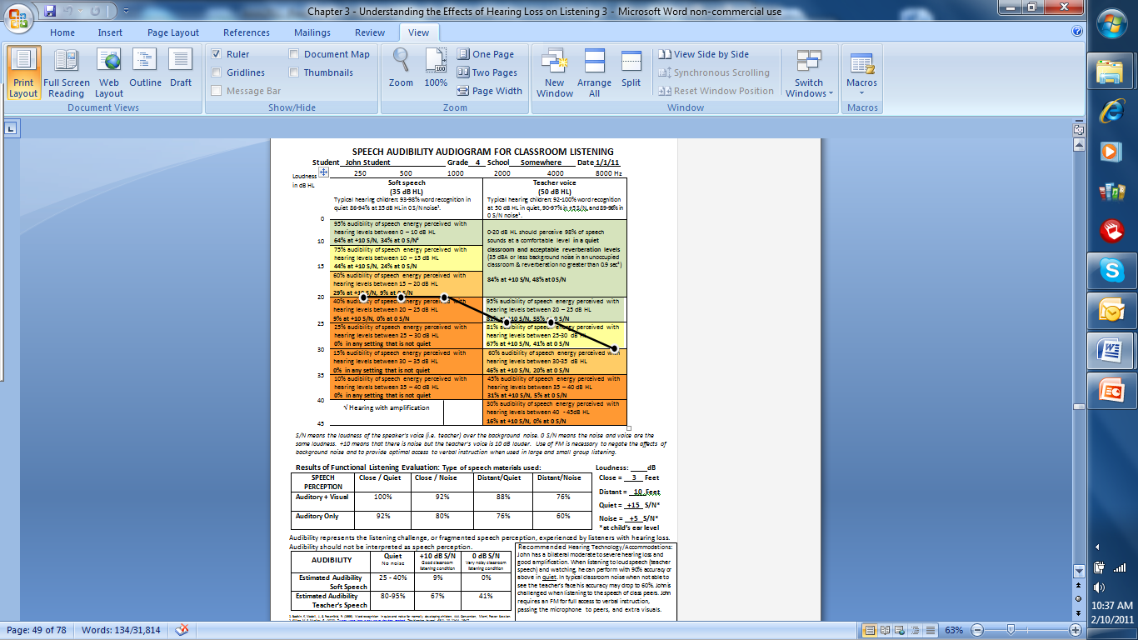

Slide 21

Obtaining the Student View of Challenging Classroom Listening
Listening Inventory For Education – REVISED!
Self-report for students in Grade 3+
Before LIFE questions
LIFE questions about school listening situations
After LIFE questions
STUDENT
L.I.F.E.

Slide 22
LIFE Classroom Situations
Ten revised situations.
Include media, a variety of listening challenges and easy listening situations.
Self-report for grade 3+ (about age 8)
Sum just the items for verbal instruction and class discussion situations.
Total out of a possible 100 points.
Pretest/Post-test use for amplification trials
Choices:
Always easy,
Mostly easy,
Sometimes difficult,
Mostly difficult,
Always difficult.

Slide 23
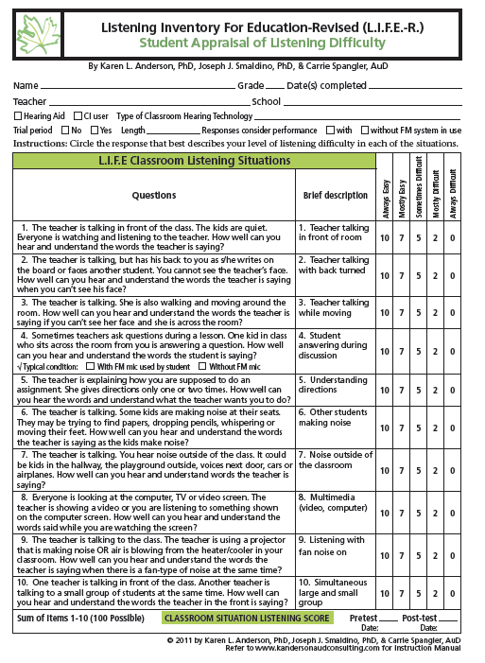
Teacher talking in front of room
2. Teacher talking with back turned
3. Teacher talking while moving
4. Student answer during discussion (FM mic?)
5. Understanding directions (given 1-2)
6. Other students making noise
7. Noise outside of room
8. Multimedia
9. Listening in fan noise
10. Simultaneous large and small group

Slide 24
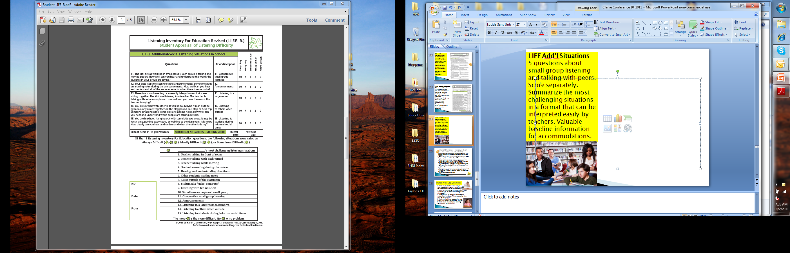

LIFE Additional/Social Listening Situations
Cooperative and small group learning
Announcements
Listening in a large room
Listening to others when outside
Listening to students during informal social times

Slide 25
Summarize the most challenging situations.
Valuable pre/post test information.
Easily prioritized for addressing self-advocacy activities
Highlights areas of need for accommodations
?

Slide 26
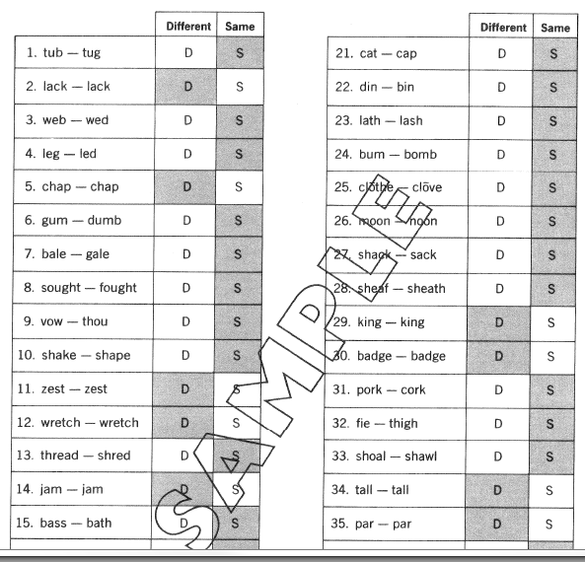
Wepman’s Auditory Discrimination Test (ADT)
40 word pairs
Same/Different task
Form A & Form B
Normed on 2000 age 4-8 year olds
Results in qualitative listening score (-2 to +2)
Can compare skill as age equivalent
Can perform in quiet and noise
Can look at errors
diagnostically for initial, medial, final
Example: Aided mild-severe HF loss had
91% quiet and 75% in noise; presented from 5 ft
Mainly final errors in quiet, mainly initial in noise

Slide 27
Slower pace = increasing learning gaps
Federal laws regarding grade-level content standards do not release students with disabilities from the need to demonstrate proficiency related to state and federal benchmarks (US Department of Education, 2004).
To do so, students must be able to
access curriculum and instruction and
be able to demonstrate knowledge efficiently and precisely.
This ability is dependent upon accurately receiving information from others as well as their capability to communicate their thoughts.

Slide 28
Turn-and-Talk:
How would you use the information from the Speech Audibility Audiogram for Classroom Listening, the ADT and LIFE responses in your eligibility assessment/recommendations?
What does the information indicate about student ability to integrate audibility information (opportunity) with FLE/ADT results (function)?
How could you sum up the information as an estimate of access to verbal instruction?

Slide 29
Gathering Data for Eligibility Determination: We do it this way…
Determining adverse educational affect is an important part, necessary for eligibility
Adverse educational affect = student is not obtaining/processing all of the information from the classroom, resulting in challenges to comprehension, following directions, peer relationships, etc.
Adverse educational affect can be determined by assessments OTHER than normed tests
If we are to PREVENT gap openers from occurring in students with ‘okay’ skills, then we need to look beyond simple test scores to identify true learning issues.

Slide 30
Factors Impacting Access For The Student With Hearing Loss In The Integrated Classroom
The rate and pace of classroom instruction
The rigor of general education curriculum and expectations
The incidental learning/listening issues inherent with hearing loss in integrated settings
The complexity of the language of instruction

Slide 31
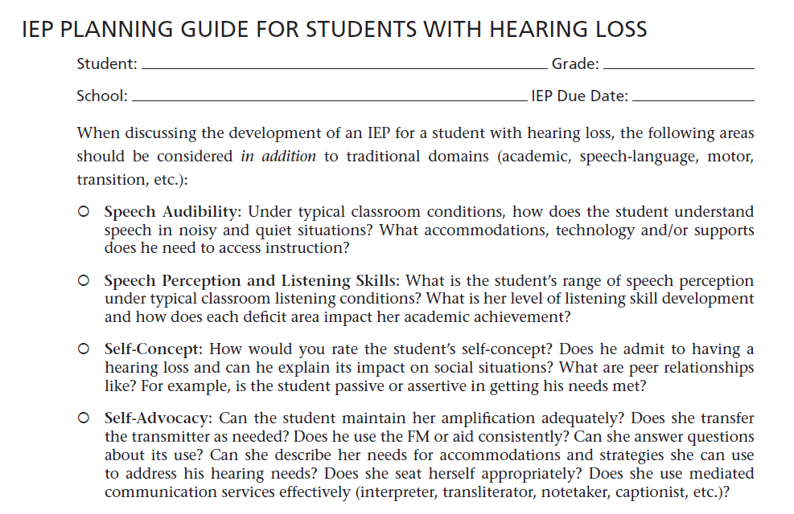
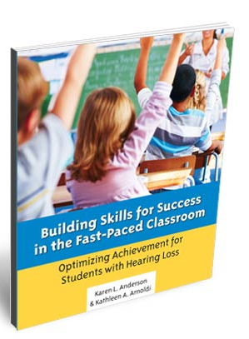
When planning an assessment, what information should be collected & considered?
Speech Audibility
Speech Perception/Listening Skills
Self-Concept
Self-Advocacy
Social & Communication Competence
Communication Repair
Access to Instruction
Additional Considerations
ACCESS via

Slide 32
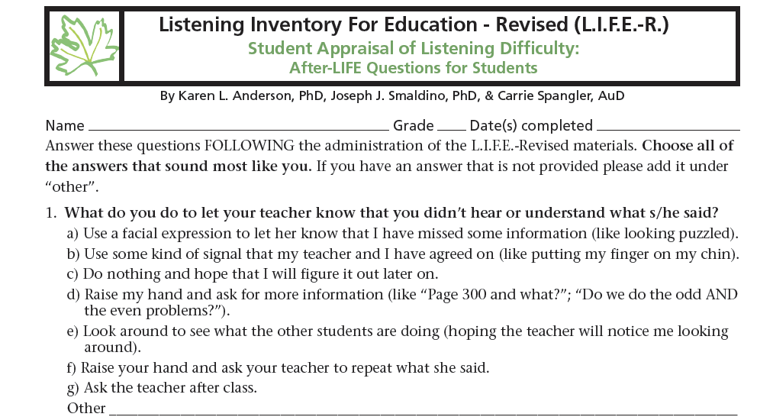
After LIFE Questions – a measure of self awareness and self-advocacy
Baseline measure and to monitor progress toward skills

Slide 33

Other After LIFE Questions
2. What do you do if it is too noisy in your
classroom, making it hard for you to understand what your teacher says?
3. What do you do when a student’s voice is too quiet for you to understand during a class discussion?
4. What do you do when you can’t hear or understand what your friends are saying when you’re hanging out?
5. What are the things you do when you are trying to communicate and it’s noisy?
6. What would you do if your listening technology is not working?

Slide 34
Teacher LIFE-R Checklist: Self-Advocacy and Instructional Access
Only 8 questions; results in percent of total possible
Provides a box to write the student’s IEP goals related to self-advocacy
Response options: Most opportunities, Often, Sometimes, Rarely, NA/Not observed
Teacher comment area RE: student advocating for self
Useful to raise teacher awareness, as a baseline measure and to measure progress in student use of self-advocacy activities
TEACHER
L.I.F.E.

Slide 35
Critical Access Issues
Language of instruction
Environmental print
Test-taking
Classroom rituals and routines
Textbooks
Paper-and-Pencil Assignments

Slide 36
Options for Determining Student Access: Informal Evaluation
Systematic classroom observations
Classroom comprehension checks
Parent, teacher, and/or student interviews
Homework completion record
Performance on weekly spelling, unit tests, etc.
Written and expressive language sample analyses
Grades: assignment and report card
Work samples/student portfolios
Observation/evaluation of student sign language or cueing skills
Staff comments and observations
IEP periodic review statements
Informal checklists completed by teachers
(e.g., SIFTER, LIFE-R)

Slide 37
Informal Assessment
Using checklists is a quick way to obtain specific information in a repeatable manner
Can be used to inform the team of possible areas of concern that may need specific assessment
Can be used to raise teacher awareness of behaviors that may be affected by the hearing loss
Can be used to raise teacher awareness of reasonable expectations for the student
Can be used over time as an indication of progress in skill development and/or use

Slide 38
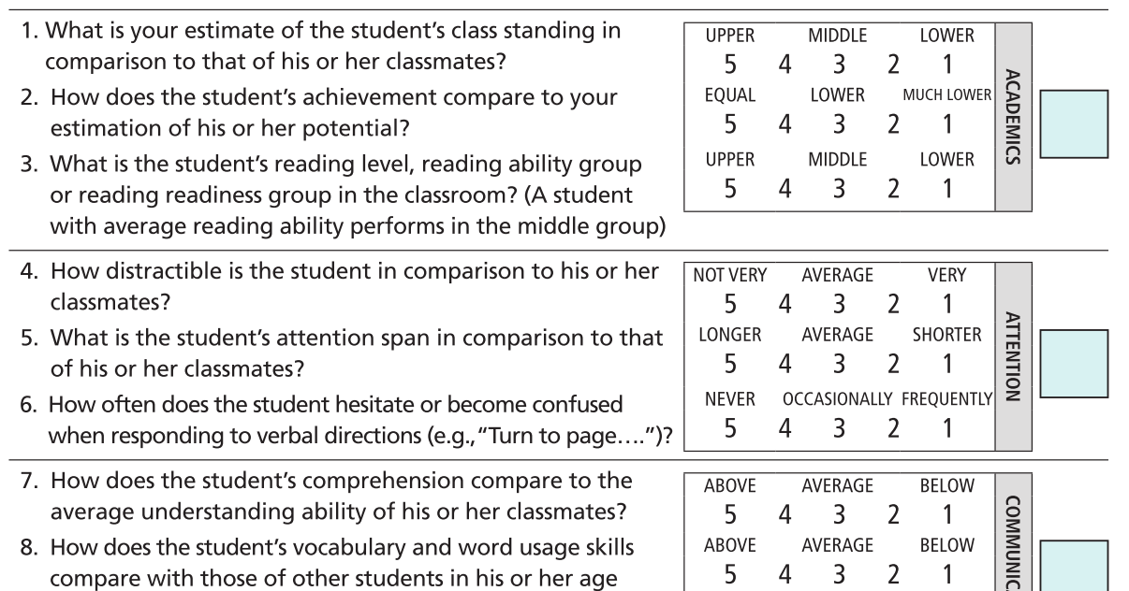
Example: Informal Teacher Interview
Screening Instrument For Targeting Educational Risk – SIFTER
Academics, Attention, Communication, Class Participation, School Behavior – Pass Marginal Fail

Slide 39
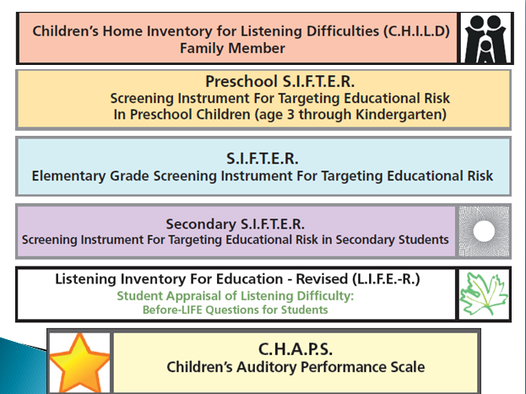

Slide 40
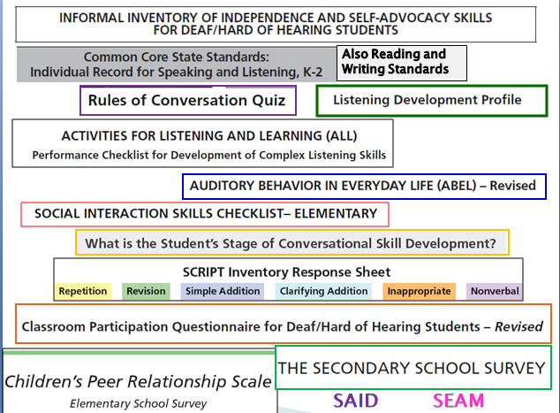

Slide 41
Systematic Observation
A script of classroom interaction with post-observation analysis
A simple record of student behavior
A systematic peer
comparison

Slide 42
Issues Method
Should be chosen based on data needed/concerns requiring addressing:
To what extent did the student understand the main idea/ details of the lesson? The vocabulary and/or language?
Was the student an engaged and active participant during the lesson?
If learning breakdowns occurred, what did the student do?
Did the student appear to understand the directions that were given? Information presented orally by peers? By the teacher?
What compensatory strategies did the student utilize? Visual cues?
What were the student’s social exchanges with peers?
Did the student independently initiate work after an assignment had been given?

Slide 43
Systematic classroom observation
Evaluation results are most meaningful when substantiated by behavior observed in the classroom.
In the Present Levels of Academic Achievement and Functional Performance section of the IEP, the team is required to describe how the disability affects the student’s involvement and progress in the general education curriculum.
Systematic classroom observation will assist in gathering objective data to assist the student’s team with educational planning.

Slide 44
Classroom observations also provide critical student data about the following:
Access to general education curriculum
Utilization of conversational repair strategies
Utilization of advocacy or compensatory skills
Learning and academic progress compared to other classroom peers
Understanding of classroom content and whether there is a need to consider an educational interpreter, transliterator, or a notetaker to increase the student’s level of access
FOR
Eligibility for special education services according to state criteria (adverse educational affect)
Documentation for Present Level of Academic Achievement and Functional Performance (PLAAFP) statements on the IEP

Slide 45
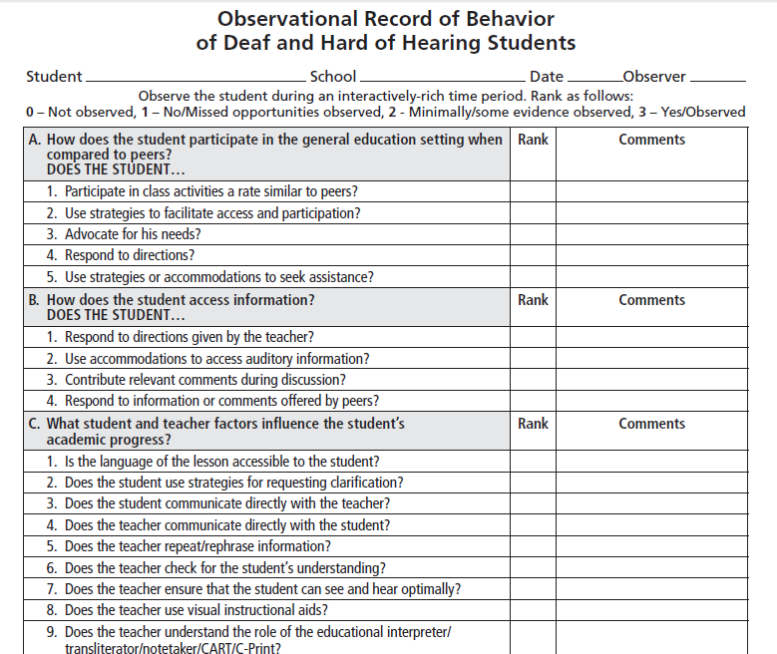

Slide 46
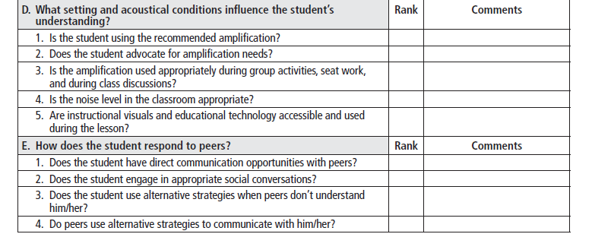
Be systematic in your approach – whatever method you use
PARC! Placement & Readiness Checklists (Colorado) – another option

Slide 47
Data Collection
Use methods that will produce consistent and reliable data
Make sure resulting data is germane.
Several observations may be necessary
Compare to typical peers

Slide 48
Types of recording methods
FREQUENCY – number of times, or how often a student behavior occurs
“Tyler turned to watch his peers offering oral responses 2/9 times or 22% of the time.”
“During the week of March 4 through March 9, from 9:15 to 11AM, Alison stood up and walked away from the instructional activity 26 times. On the average, this was 24 more times than her kindergarten peers.”

Slide 49
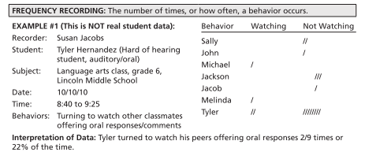

Slide 50
Types of recording methods
DURATION – total amount of time a student is engaged in a specific behavior
“During Marianne’s 45 -minute civics class on October 12, she attended to the interpreter 44% of the time. The longest interval of attending was 5 minutes.”
LATENCY – elapsed time between an event and the expected behavioral response
“In the morning it takes William 7 minutes to follow instruction after the teacher gives a direction. In the afternoon it takes William 4 minutes to follow instruction after the teacher gives a direction.”

Slide 51
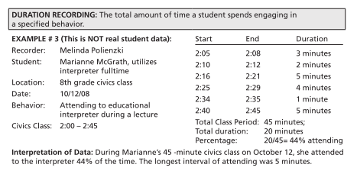

Slide 52
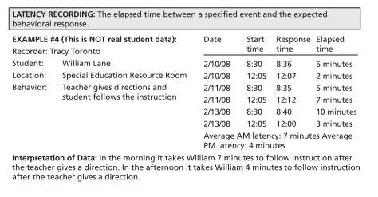

Slide 53
Turn-and-Talk
When/how often do you observe in the classroom?
How long do you usually stay?
Which of the described techniques do you use now?
Which techniques can you picture yourself implementing?

Slide 54
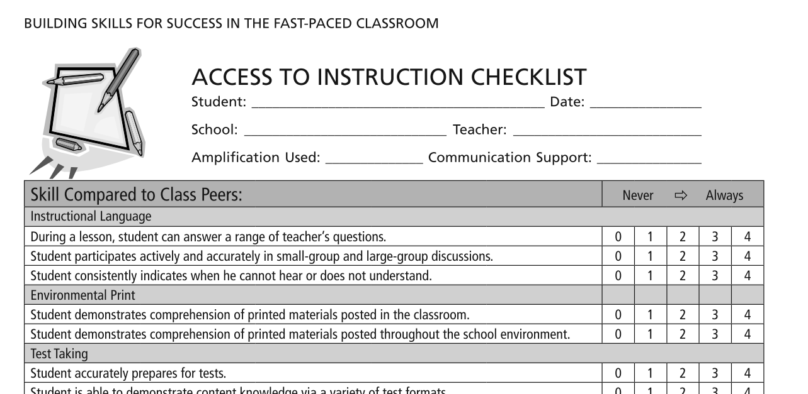
Informal Evaluation:

Slide 55
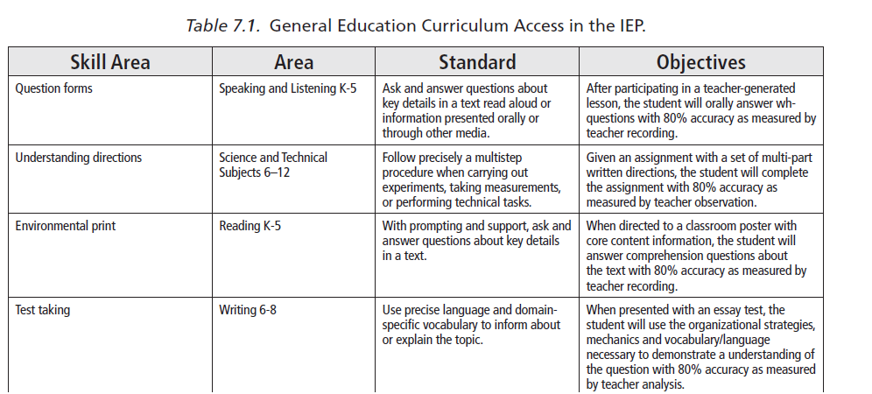
Addressing Access on the IEP Instructional Access

Slide 56
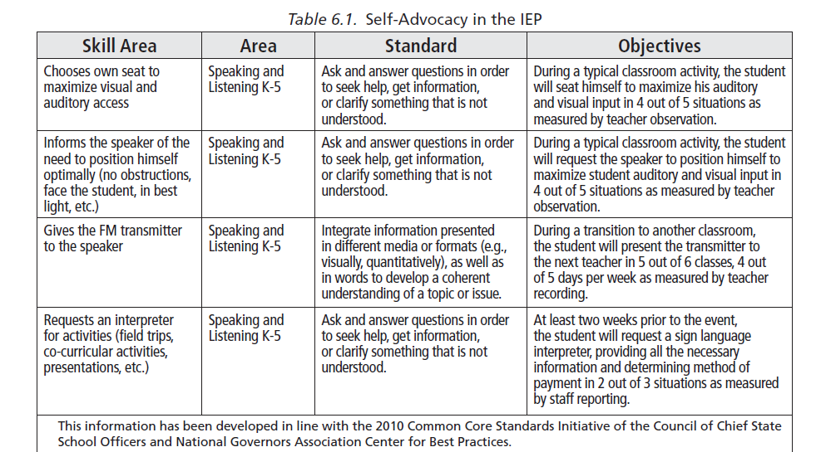
Addressing Access on the IEP Self - Advocacy

Slide 57
Ultimate Goal Regarding Instructional Access:
To increase the student’s capacity for the following:
Knowing the impact of his/her hearing loss on the ability to make progress in the general education curriculum
Determining what accommodations will allow him/her to demonstrate mastery of content
Making or requesting accommodations that will insure optimal access to classroom communication

Slide 58
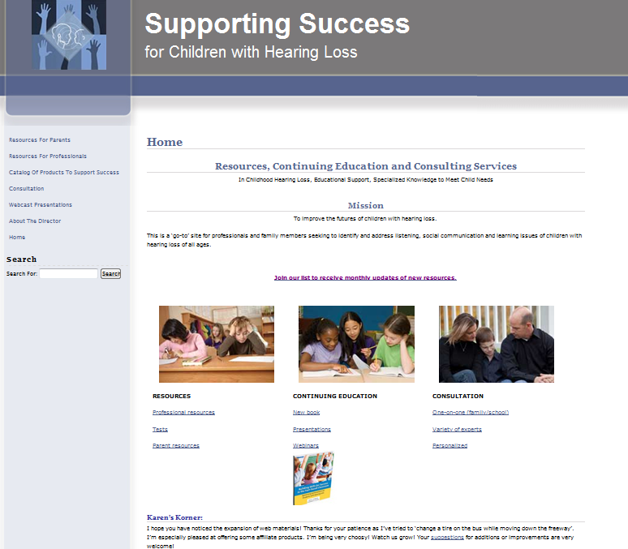
Resources available: http://successforkidswithhearingloss.com
Professionals:
Tests
Many topics
Resources!
Book:
Building Skills for
Success in the
Fast-Paced
Classroom
Speech Audibility Audiogram for Classroom Listening:
FLE, LIFE-R, SIFTERs, PARC,

Slide 59

In summary, we…
Defined access in the context
of the deaf/ hard of hearing
learner
Identified critical components of instructional access
Discussed options for evaluating access
Identified some approaches for teachers and students in supporting access
Thank You for Listening!

