Slide 1

Your Child with
Hearing Loss in One Ear:
What does it mean to grow up with unilateral hearing loss?
What can you do to help him/her now?
Preparing for school success

Slide 2
Learning Outcomes
At the end of this presentation you will be able to:
Describe the possible effects of unilateral hearing loss on learning and future hearing
Use analogies to help understand potential effects and the need for action
Know how to use available materials and services to strive for best child outcomes

Slide 3
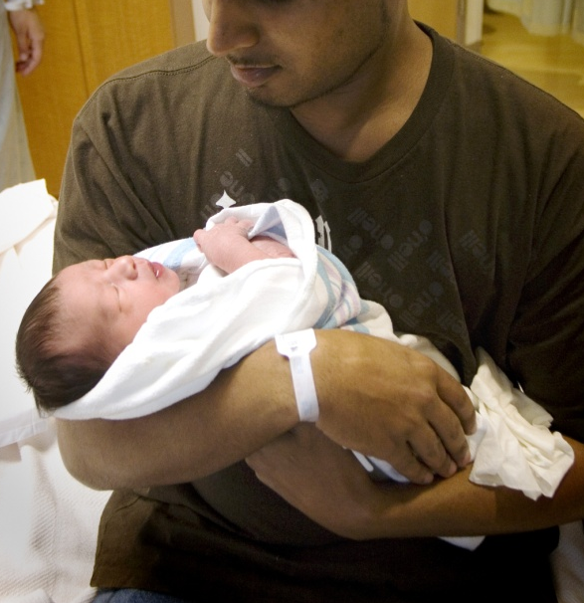
You expected your baby to be perfect
Parents dream of who their babies will be, the joy they will bring and their possible futures, all before they are ever born.
Your baby came with a surprise you never expected or thought about – hearing loss.
You don’t want to believe it.
It doesn’t seem real that your baby could have any problem.

Slide 4
You want to believe your baby is perfect
It is real. You have a baby with a hearing loss in one ear that will never go away.
Maybe that ear looks different. Maybe it looks perfect – just like the other ear.
The hearing loss will be a part of him every day of his life.
You are thankful that hearing loss is only in one ear but don’t want him to have it at all.

Slide 5
It is hard to accept your baby is not perfect
When a baby is so young it is hard to believe that hearing tests can be accurate.
Hearing tests are very accurate, even when babies are only days or weeks old.
Whether you child has some hearing in that ear or no hearing, there is a hearing loss that is part of who she is now and part of the child and adult she will become.

Slide 6

Your child is who she or he is.
Hearing loss in one ear is as much a part of who she is as her eye and hair color.
She will need your love, care and guidance just as if she had no hearing loss.
She is a whole person, even if she
has a hearing loss in one ear.
As parents, you will want to
understand what it means to have
good hearing in only one ear.

Slide 7
How bad can it be? The good ear will compensate for the bad ear, won’t it?
Hearing loss is invisible and difficult to understand, especially when someone seems to hear most sounds or most times but not always.
It is very common to think that because we have two ears that if something is wrong with one ear, the other ear will do the work of two ears.
In reality, we need both ears to perform well in all listening situations.

Slide 8

An analogy to help us understand.
Think about a child who was born with only ½ of one foot. We require two feet to equally support the weight of our bodies as we walk. With only one normal foot, a child will still learn to walk and run, but likely not as fast or smoothly as children with 2 normal feet; especially in rough terrain or when competing in a race. Can the one good foot really compensate for the ½ foot? No, but having only one good foot works fine in many situations.

Slide 9

What to expect at home
Your baby can hear normally with one ear. As you diaper him, feed him, play with him you will see him respond to sound.
He CAN hear.
You are close to him. It is quiet. He is interested in what you are doing.
Thinking about our analogy, this is like walking on flat ground with plenty of
time to get where you want to go.

Slide 10
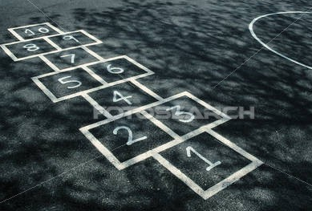
Rugged terrain
Think again of the child with ½ foot playing with other children in a large park with grassy areas, rocky climbing areas, and an obstacle course to jump, skip and hop.
She can play anywhere she likes with the other children, have fun and get exercise.
She will have difficulty experiencing some of the things to do at the park. She may need to work harder, may avoid some, or may be able to do it all, only at a slower pace.

Slide 11
A foot and ear are not the same
The analogy of the child with ½ foot is a starting place to understand that 2 ears are really needed, and one ear cannot do the job of two ears.
There is at least one big difference as we think about the child with only one normal foot and your child with only one normal ear – listening is strongly tied to the ability to learn at home and at school! A foot problem will likely not impact learning.

Slide 12
Language learning, every hour a child is awake, every day, everywhere.
Babies learn language by hearing it around them every day. Parents don’t ‘teach’ children to learn how to talk.
Your child will learn language whenever you interact with him and as he sees you communicate with other people.
Language is caught, not taught.

Slide 13
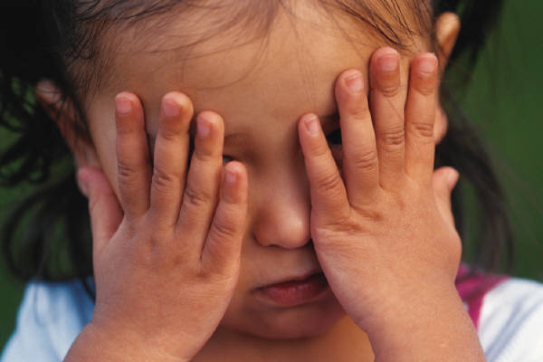
Rugged listening terrain
So “rugged listening terrain” would be any situation in which listening is not easy, specifically:
DISTANCE &
BACKGROUND NOISE.

Slide 14
Every day listening with 2 ears
Hearing is a distance sense.
We monitor what is going on around us with our hearing.
Think about all you hear right now – in the room you are in, sounds from other places in the building, sound from outside.
Two ears working together hear just a bit better than one ear working alone. Summation effect.
We turn our heads to use both ears to locate where sound is coming from. Binaural effect.

Slide 15
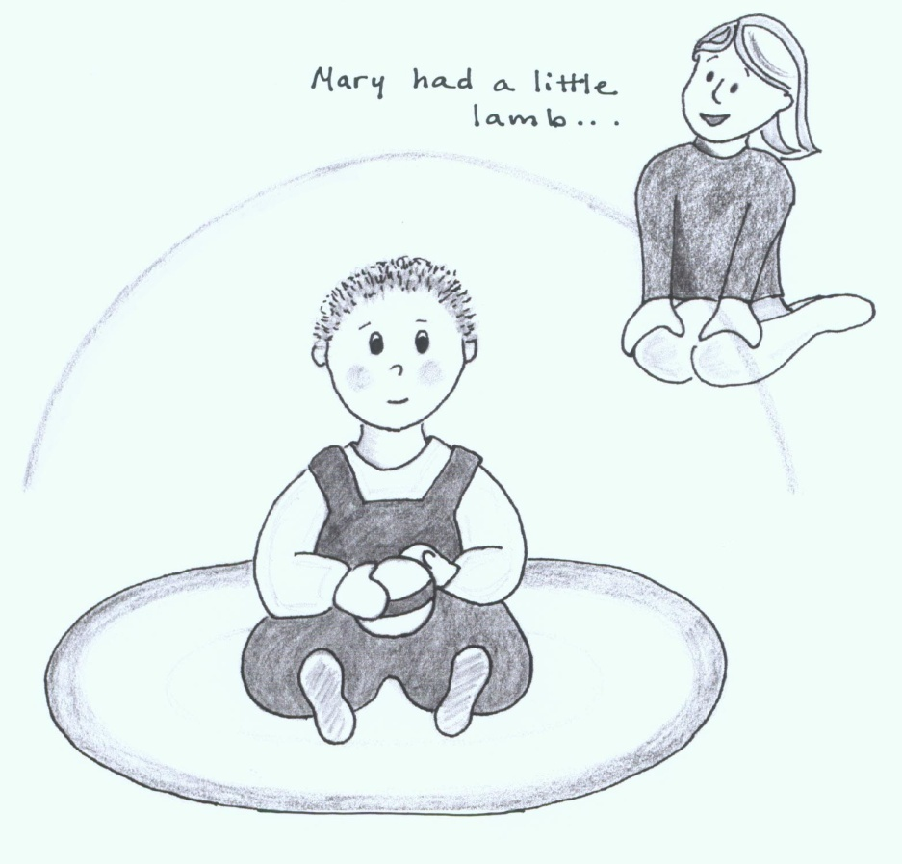
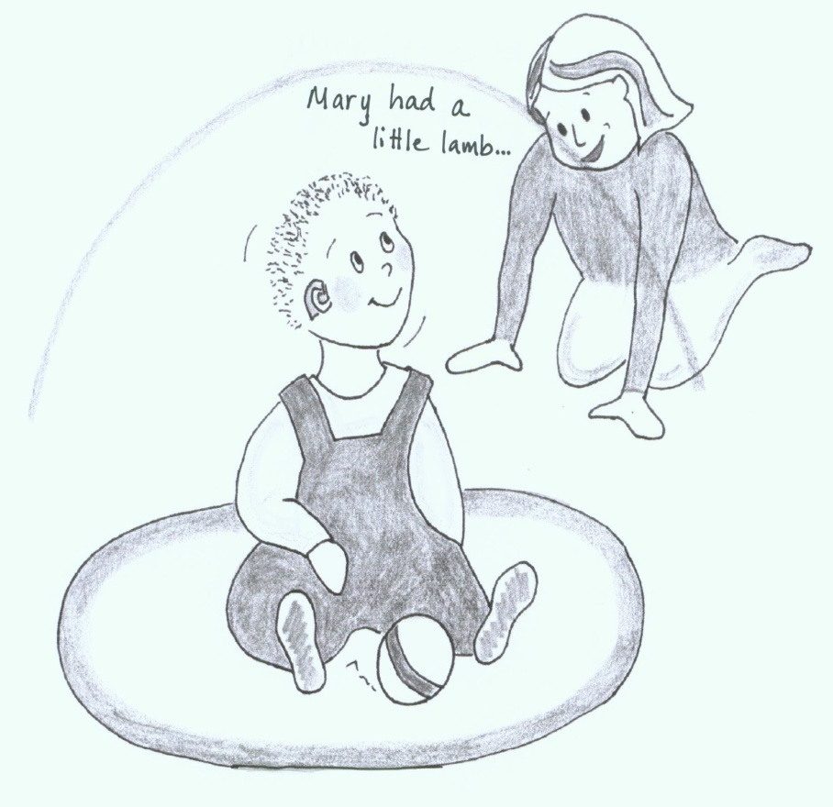
Distance
The concept of the LISTENING BUBBLE
Not in listening range In listening range!

Slide 16
How ‘far’ can a child hear?
It depends! How interested is the child in the sound? How much background noise?
She may hear the cookie jar opening from the next room because she loves cookies.
He may not seem to hear when spoken to from the same room if he is very interested in what he is doing.
BUT children with only one ear do not hear as well as children who have 2 ears that work together.

Slide 17
Observing child behavior when presented with contrived listening activities at different distances
Try the Early Listening Function activities across the room and in the next room
12 Activities: 4 quiet, 4 typical loudness, 4 loud
Loudness calibration is not critical – parent participation in typical environments is critical
Quiet and noise: develop awareness of how having the TV always on limits the child’s perception of other sounds
http://www.kandersonaudconsulting.com/uploads/ELF_Questionnaire.pdf

Slide 18
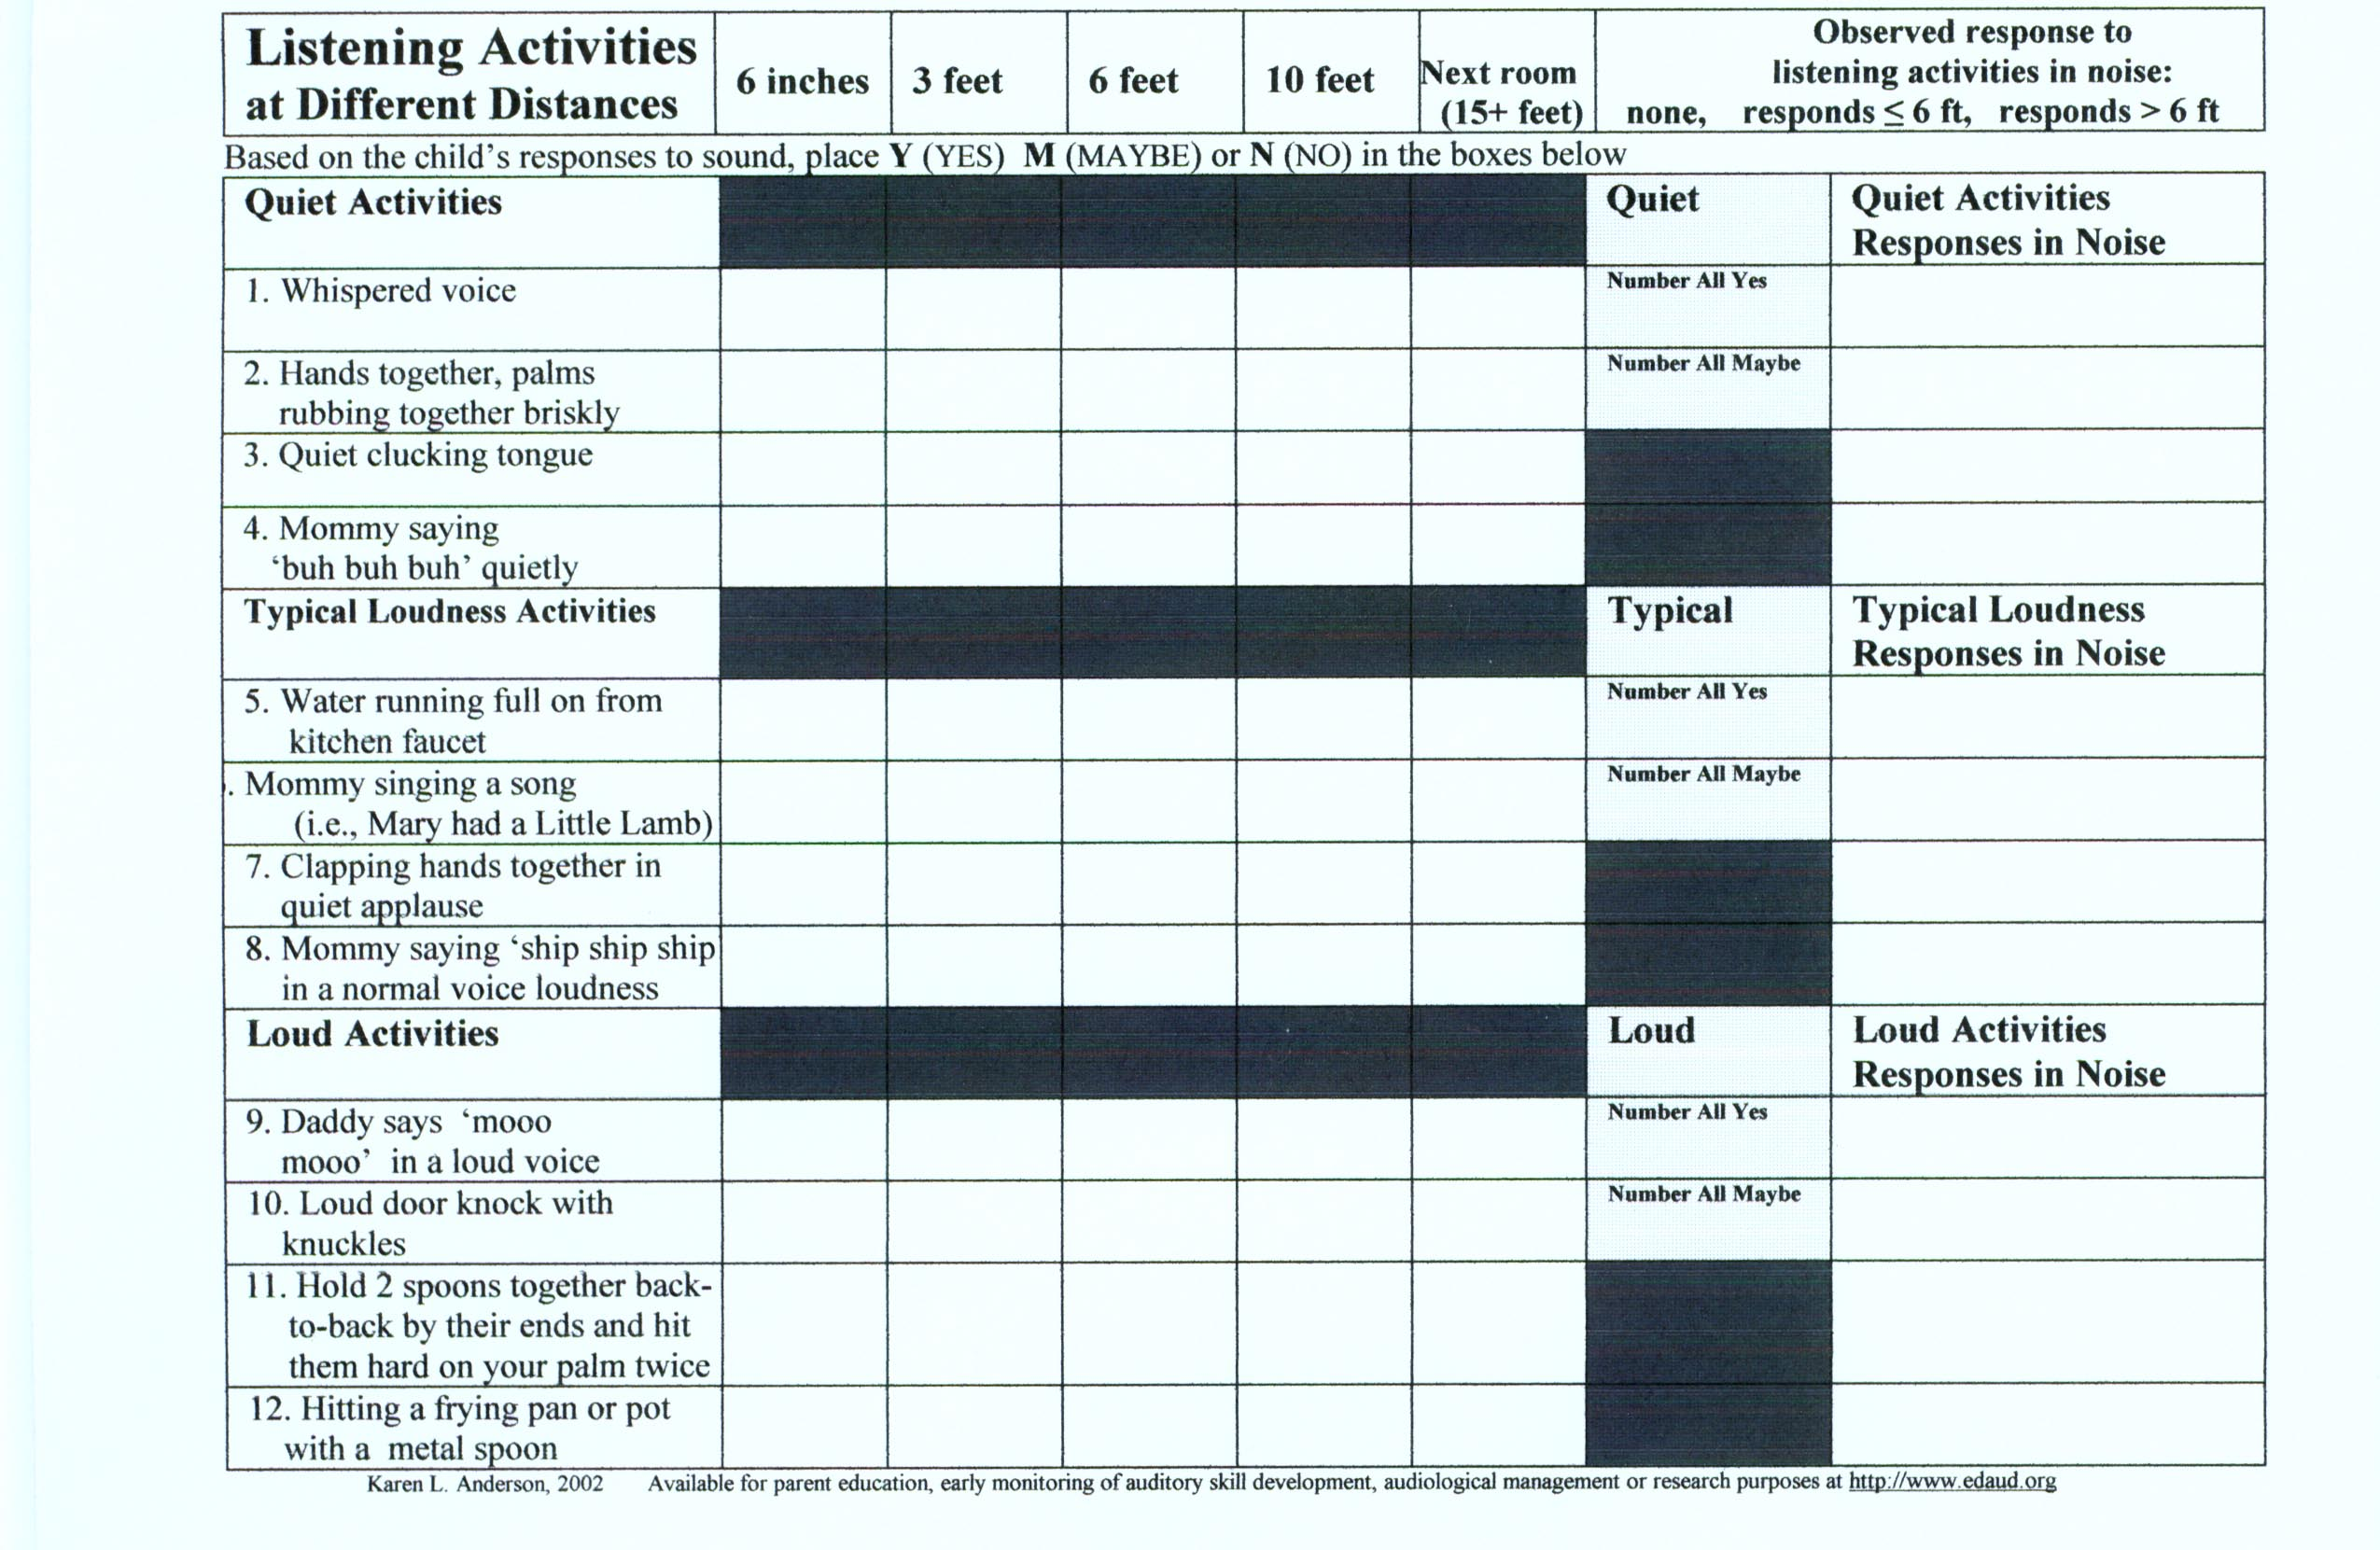
Early Listening Function test

Slide 19

You need to experience it yourself
Buy foam ear plugs at the hardware or drug department of a large store.
Be sure to insert it correctly so it causes a mild (30-35 dB) hearing loss.
Be ready to record your thoughts as you try the different activities.
Make a commitment to yourself to wear one earplug for at least 3 hours.

Slide 20
You need to experience it yourself
Activities to do in your 3 hours:
Spend time talking quietly with someone with the television on in the background.
Have someone talk to you from another room or from across a large room
Use some of the ELF listening activities
  when you are not looking at them
  when you are reading or doing something you really enjoy or that interests you
  with and without background noise.

Slide 21
You need to experience it yourself
More activities to do in your 3 hours:
Listen to a TV show or radio show – don’t turn up the volume.
Have a conversation sitting close with no background noise.
Talk in the car with your ‘bad ear’ toward the person speaking
Talk to someone outside at a distance.

Slide 22
Your thoughts and reactions:
Amount of effort to understand all speech in
Quiet
Across room
Another room
Noise (TV)
In car
Outside distance
Think in terms of Listening Bubble size

Slide 23
Think about it
How much effort did it take you to listen?
How did background noise affect your ability to pay attention and easily understand what was said?
What was the difference between having a conversation within a few feet and from across the room, outside or in the car?
Remember – you already have developed language and have the ability to ‘fill in the blanks’ if you miss part of a word.

Slide 24

Many language opportunities over time
Picture a child learning language as an empty cup that family members fill up drop by drop, spoon by spoon every day.
With every drop a child has the potential to ‘catch’ new words and concepts and learn more about how the building blocks of language go together.
Children exposed to more words
understand more words by age 5.

Slide 25
Hart-Risley 30 Million Word Gap
1995: Betty Hart and Todd Risley spent 2 1/2 years intensely observing the language of 42 families through out Kansas City. They looked at household language use by 1) professional families; 2) working class; 3) welfare families. They gathered an enormous amount of data during the study finding a 30 million word gap between the vocabularies of welfare and professional families by age three. Welfare children heard, on average, 616 words per hour, while children of college educated parents heard 2153 words per hour. Research in the following years found a high correlation between vocabulary size at age 3 and language test scores at ages 9 and 10 in vocabulary, listening, syntax, and reading comprehension.
http://archive.aft.org/pubs-reports/american_educator/spring2003/catastrophe.html

Slide 26
More language used, more language learned!
Families’ Language and Use Differ Across Income Groups
 | Families
 | Professional |  | Working-class |  | Welfare
Measures & Scores | Parent | Child | Parent | Child | Parent | Child
Recorded vocabulary size | 2,176 | 1,116 | 1,498 | 749 | 974 | 525
Average utterances per hour | 487 | 310 | 301 | 223 | 176 | 168
Average different words per hour | 382 | 297 | 251 | 216 | 167 | 149

Slide 27
Potential for many missed language opportunities over time
Again picture a child learning language as a cup that family members fill up drop by drop, spoon by spoon every day.
With every drop and spoonful a child has the potential to ‘catch’ new words.
EVERY DAY children with only one good hearing ear will miss part of the language that is said around them
Children exposed to many words
will be less affected by missing some.

Slide 28
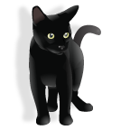
Distance scenario 1 – young child
Mama is folding laundry on the bed while John crawls on the floor. Mama gives John 2 socks as she is folding. She talks about the pants, colors of the shirts, two socks and socks going on John’s feet.
After a bit John sees the cat and crawls away into the next room. Mama can still see him and she now talks about the cat.
John may not hear every word clearly, but has many opportunities to catch language.

Slide 29
Distance scenario 2 – young child
Mama is folding laundry on the bed while John crawls on the floor.
After a bit John sees the cat and crawls away into the next room. Mama sees him and tells him to leave the cat alone.
John did not have many opportunities to catch new language that describe things that interest him. He would have greater consequence if he missed any words due to hearing with only 1 ear.

Slide 30
Hearing ‘through’ noise
People have 2 ears to help them locate sound and also to help listen in noise.
Without even being aware of it we use both ears when we are listening in noise by pointing one ear a bit more to the person we are trying to listen to and the other ear a bit more toward the noise. Our heads actually help to block out a bit of the noise so the one ear can ‘tune in’ better to the speaker or preferred sound.

Slide 31

Listening in noise with one ear
Children with only one normal hearing ear have greater difficulty locating where sounds are coming from and understanding speech or recognizing sounds when there is competing noise.
Children with one hearing ear will need more time to locate sounds and it will take more effort to focus on sounds in background noise. They are more likely to ‘tune out’ in noise.

Slide 32
Background noise - scenario 1
Mama is doing dishes and Marie is on the kitchen floor playing with plastic containers and a large wooden spoon.
Except for when she is running water, mama talks about the big dish and the little dish; the red top and the green top; the spoon going bang, bang - providing the language that describes what Marie is interested in at the moment.

Slide 33
Background noise - scenario 2
Mama is doing dishes and Marie is on the kitchen floor playing with plastic containers and a large wooden spoon.
Mama is running water, and the television is on. Mama tells Marie to play.
Marie stops playing in a few minutes and Mama wonders why she bothered getting out things for Marie to play with.

Slide 34
Potential impact of hearing loss in one ear on language learning
As many as one out of every three children with only one good hearing ear develop delays in the number of words they say by the time they are 15 – 18 months old.
1/3
Not keeping a child’s daily ‘cup of language’ full will have consequences!

Slide 35
Background noise - scenario 3
Mama is doing dishes and the television is on. Marie is on the kitchen floor playing with containers and a spoon. Mama tells Marie to play with the dishes.
Marie soon stops playing and crawls away toward a house plant. Mama tells her to not touch. Marie pulls the plant. Mama rushes over and tells her she is a bad girl.
Marie tuned out in background noise. She had no warning before seeing Mama mad.

Slide 36

Potential behavior & social issues
Children with unilateral hearing loss may find it hard to hear directions and soft speech. That can lead to frustration and poor behavior. One out of five children develop behavior or social issues.
1/5
As children get older
they may think that
other people are
talking about them
when they really just
did not hear what was said, especially by peers.

Slide 37
How we learn ‘rules of behavior’
Think about it – how did you learn to not touch something that is hot?
A parent told you to not touch, showed you what ‘hot’ meant, and repeated it often.
Children need to know the expectations, why it is wrong (hurt, dirty, impolite, mean), and to be praised when they are behaving well.
They also can learn by overhearing when another child is scolded or warned.

Slide 38
Learning to behave with 1 ear
Children may:
Miss early warnings (don’t touch it Marie)
Need more explanation or more times in which expectations are explained (plants grow in dirt, dirt is messy, plants can be hurt if you pull on them, sometimes leaves are sharp, etc)
Not learn by example as quickly (see another child warned or scolded but missed what the child did or said)

Slide 39
Fair chances to good behavior
Warnings should be given in close, no background noise, when the child is paying attention
If another child is being warned or scolded the reason why should be made clear to the child with one hearing ear
Explain again and again – the why of expectations (this builds language too!)
Make sure your child really heard and understood the warning before you punish

Slide 40
Those subtle social rules
Children in ‘rugged listening conditions’ often miss subtle social exchanges.
May hear 2 children close by speaking. When the child looks up he sees the other children looking at him. The child who wasn’t able to catch part of what the others were saying may think that he was being talked about. He may feel self-conscious or even angry.
Social scenarios should be role played.

Slide 41
Something families need to know!
Hearing does not always stay the same.
Children can have ear infection that can cause hearing loss in both ears. This additional hearing loss will affect them more than other children because they are relying so heavily on their one better hearing ear for listening and learning.
Hearing can be damaged by loud noises, even when they occur only once.

Slide 42
Families need to know…
Hearing does not always stay the same.
It appears that one out of
every four children with one
normal hearing ear will develop hearing loss in their better hearing ear.
1/4
This appears true for the children normal
looking ears, not those born with a deformed
ear. We cannot predict which children will
end up having permanent loss in both ears!

Slide 43
Any additional hearing loss…
In the better hearing ear
Or in the poor hearing ear
WILL increase the child’s chance of developing greater listening, language, behavior and learning issues.
This does NOT mean that ¼ of these children become deaf in both ears, just that some amount of additional hearing loss – great or small - will develop.

Slide 44
Hearing in only one ear IS a big deal
Children with developmental issues related to hearing normally in only one ear do not outgrow them by school-age.
Children with unilateral hearing loss are at 10 times the risk for school problems as those with 2 good ears.
1/3 – 1/2 of children with unilateral hearing loss repeat a grade or require special education services in school.
We do not know what predicts problems!
33-50%

Slide 45
WHAT TO DO - #1
The most important thing to do is to advocate for your child’s needs.
Some physicians and audiologists may not be aware of the research we now know about the potential consequences to 1/3 to 1/2 of children with unilateral hearing loss.
We do not know how to predict which children will be affected – it could be your child. You may prevent issues from developing by helping your child now!

Slide 46
WHAT TO DO - #2
Since one out of every four children with unilateral hearing loss develops hearing loss in the better ear it is critical for your child to have his or her hearing checked by the audiologist regularly.
Every 3 months to age 1 year
Every 6 months from 1-3 years
Get prompt medical care for suspected ear infections
Teach him to avoid loud noise!

Slide 47
WHAT TO DO - #3
Try a hearing aid. If your child has hearing in the worse ear (i.e., thresholds between 35 – 75 dB) then it may be possible for a hearing aid to ‘balance out’ the child’s hearing ability – meaning provide near normal hearing in the poor hearing ear. Amplification could help with sound location and listening in noise!
Children who are deaf in one ear may have too much hearing loss to cause improvement. Ask your child’s audiologist for more information.

Slide 48
A hearing aid – but he hears fine in one ear!!!
Think back to our analogy with the child who was born with ½ foot. If there was a prosthesis (like a strap on foot) that would allow the child to walk gracefully with a normal gait, to run similar to, but maybe not as fast, as other children - would it make sense for the child to use it? Would it help him as he is learning to walk? Would it help him fit in better when playing with other children because he could keep up more easily?

Slide 49
Parent comments on hearing aid use
Other parents of children with unilateral hearing loss have tried hearing aids and said:
· He doesn’t talk so loud when wearing his aid.
· He was missing one half of everything before he got his aid.
· He hears sounds he never heard before.
· Doesn’t interrupt people in group situations now.
· It is a very positive thing.
· Audiologists and doctors say children with only one good hearing ear will be fine—they are not fine!

Slide 50
Try it and see….
A hearing aid usually helps a child with unilateral hearing loss, but not always.
The only way to tell is to try a hearing aid and watch for improved listening – the difference may be subtle but important!
Does the hearing aid help the child “catch language” and “keep the teacup full”?
Does it help in locating sound source?
Does it help in listening at a distance or in background noise?

Slide 51
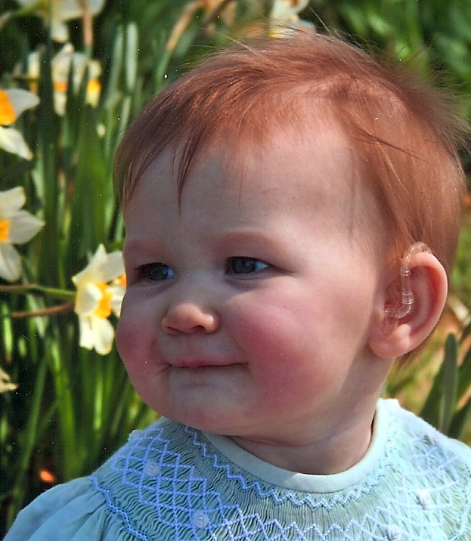
How soon should we try a hearing aid?
The earlier a child tries amplification and gets used to ‘balanced hearing’ the easier it will be for him or her to adjust to hearing with both ears and want to wear the hearing aid all the time.

Slide 52
Another thought about hearing aid use
Brains develop due to constant stimulation.
With ¼ of children potentially developing hearing loss in both ears, early stimulation of the poor hearing ear may end up making a real difference in the child’s ability to compensate if all or most hearing is lost in both ears.
Think of it as ‘keeping an ear in reserve if the worst happens (and it may!).

Slide 53
Observing for changes with the hearing aid
Changes may be subtle and can improve over time as the child learns to listen with 2 ears and gets practice in challenging situations such as listening across distance and in background noise.
The Early Listening Function activities when presented at a distance may help identify changes. http://www.kandersonaudconsulting.com/uploads/ELF_Questionnaire.pdf

Slide 54
ELF Infant & Young Child
Amplification Use Checklist
COMPLETING THE ELF CHECKLIST MAY ALSO HELP IDENTIFY SUBTLE CHANGE IN LISTENING AFTER A NEW HEARING AID
Parents circle 1-5 scale: Agree, No Change, or Disagree
My child appears to:
1. Be more aware of my voice
2. Be more aware of environmental sounds
3. Search more readily for the location of my voice
4. Have an increased amount of babbling or talking
5. Have more interest in communicating
During ELF listening activities, the size of my child’s listening bubble:
1. Has improved for quiet sounds voices
2. Has improved for typical sounds and voices
3. Has improved for loud sounds and voices
4. Has improved for listening in background noise
Describe specific situations when you noticed improvements in listening ability:

Slide 55
WHAT TO DO - #4
Get help. Most states provide services to families of infants and toddlers (to age 3) who have unilateral hearing loss.
These early intervention services would include someone coming to your home and/or the child’s day care to talk about the child’s hearing needs and what can be done to help learning.
They may also help you find out how to obtain a hearing aid trial.

Slide 56
Help when trying a hearing aid
Most people have not used hearing aids or ever seen one on a young child.
Early intervention professionals typically include teachers of the deaf and hard of hearing or speech language pathologists who can help you learn how to accomplish daily hearing aid wear.
They can also help you to watch for improvement in listening behaviors (do the ELF with the help of the EI teacher).

Slide 57
Help to ‘keep the language teacup full’
Families are a child’s first and most important teachers.
Early intervention teachers can help families to learn how they can communicate with children in ways to really stimulate language learning during everyday activities.
Some families use simple signs with their very young children to boost early language growth – you may find this fun too.

Slide 58

Track how your child’s language is growing
At least every 6 months your early intervention teacher will check how your child’s language is growing.
Ask for a list of typical vocabulary to hang on your refrigerator as a reminder.
An example: MacArthur checklists at http://www.kandersonaudconsulting.com/Early_Intervention.html
Remember, children with normal hearing in one ear can develop language at a normal rate until 15-18 months.

Slide 59
Behavior and social rule learning
The early intervention teachers can also help you to teach proper behavior to your child – consistency and being sure the child really understands is the key!
Describing and role playing social interactions can start very early and really help a child’s self esteem and understanding by the time he or she starts school.

Slide 60
Start thinking about school early
Even children who have great language and typical behavior will still be at a disadvantage when it is time to start school.
Classrooms for young children are typically active and noisy places where the teacher is often across the room.
How much of a challenge does it seem to be for your child to function in this environment?

Slide 61
The challenges of today will be the challenges of tomorrow…
Parents can identify situations in which their child may be having more trouble listening.
These situations can be useful to identify as you start thinking about preschool or kindergarten.
A child who has challenges at home in noise and at a distance is likely to in school as well.

Slide 62
Children’s Home Inventory of Listening Difficulties
One way that families can consider how a child is functioning in different listening situations is to complete the CHILD test.
There are 15 different listening situations and families rate how well they think their child is able to listen and understand in each setting.
Obtain the CHILD test at:
http://www.kandersonaudconsulting.com/uploads/child_questionnaire.pdf

Slide 63
CHILD: Children’s Home Inventory of Listening Difficulties
For ages 3 years to approximately 12 years (young child plays with others, not parallel play)
Provides 15 listening situations typical of the home environment
Understand-o-meter
2 Forms:
  Parent completes items
  Child completes items (age 7-8+)
Can compare parent and child responses; use as a means to discuss need for home FM, assistive devices, changes in family communication dynamics

Slide 64
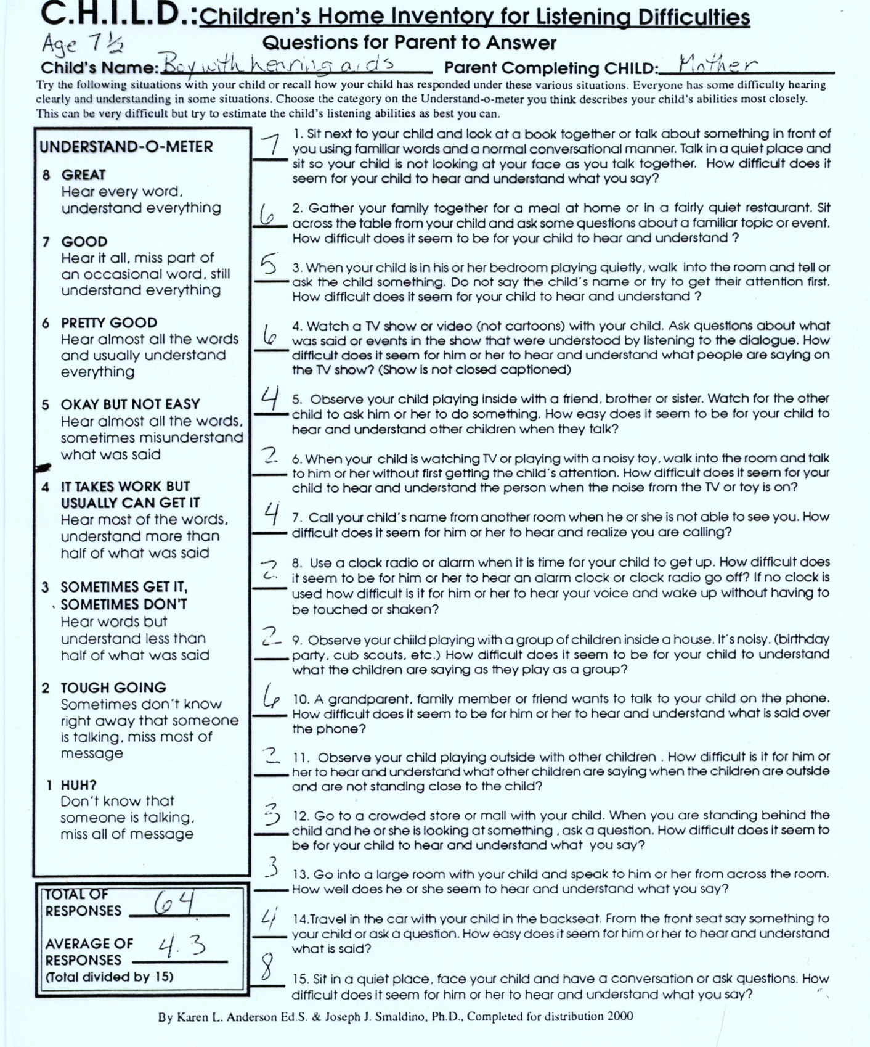
Example of CHILDREN’S HOME INVENTORY OF
LISTENING DIFFICULTIES - CHILD

Slide 65
Considerations for school
If your child has language and other skill development within the normal range by school age you will know that your helping him or her as a young child was successful!
Only children that demonstrate ‘adverse educational affect’ will be eligible for specialized instruction (special education) services as deaf or hard of hearing.

Slide 66
Considerations for school
As a child with normal hearing in only one ear, he or she will be at a learning disadvantage throughout the school years.
This is a ‘limitation to a life skill’ that will make your child eligible to be considered for accommodations in the classroom. This can include special seating, amplification, and other daily supports.
For more information refer to the unilateral hearing loss handout at:
http://www.kandersonaudconsulting.com/Listening_and_Learning.html

Slide 67
Summary
Your child has a hearing loss that will affect him throughout his life.
Your child’s hearing may change.
Try amplification as early as possible.
Without early assistance your child may develop language delay and/or social or behavioral issues.
Children with unilateral hearing loss are at 10 times the risk for school problems.
Get help from early intervention ASAP!
Monitor language growth regularly.
Plan for your child’s transition to school.

