Slide 1
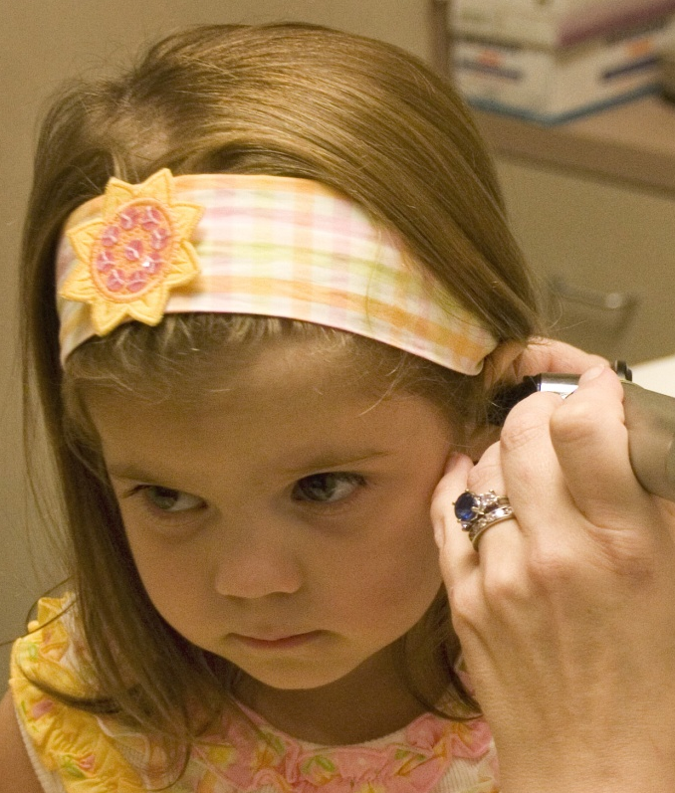
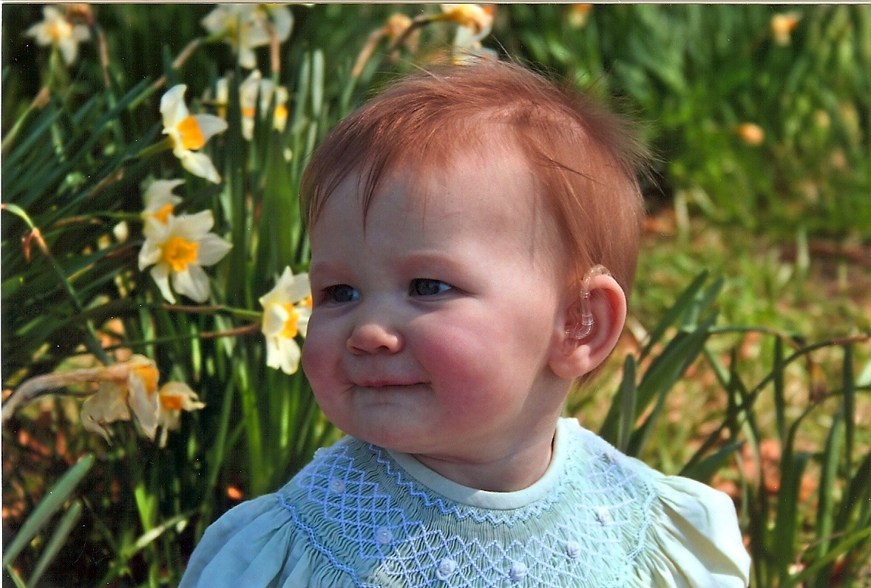
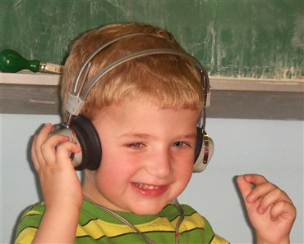
Hearing Screening in Early Childhood: What, Why, How
Karen Anderson, PhD
Developed for the Minnesota Department of Education
2011
Notes:
This presentation has been developed primarily for Coordinators of Early Childhood Education programs in Minnesota. The information has been prepared by Dr. Karen Anderson. Dr. Anderson is an experienced educational audiologist and has also served in the state Early Hearing Detection and Intervention programs in Florida and Minnesota as well as working as part of the Management Team of the Part C program in Florida. She has been the Chair of the American Academy of Audiology committee that has prepared guidelines for Childhood Hearing Screening. Thus, Dr. Anderson has substantial knowledge of IDEA regulations as they pertain to infant, toddler, and early childhood programs along with a thorough knowledge of hearing screening principles and practices.

Slide 2
Information covered in this presentation
Why is screening for hearing loss in early childhood important?
What are methods of hearing loss identification for ages 6 months to 5 years?
Pros and cons of different methods
Notes:
Training objective:
It is intended that individuals viewing these professional development materials will be able to provide information on each of these points following the presentation.

Slide 3
Requirements to perform hearing screening
Part C of the Individuals with Disabilities Education Act
Part C (2004) provides for early intervention services for infants and toddlers under the age of 3. As part of the early intervention services, each state is required to have a child find system to identify, locate and evaluate all children with disabilities.
The Part C regulations at 34 CFR §303.322(c) require that the evaluation and assessment of an infant or toddler be based on informed clinical opinion, and include the following:
(ii) An evaluation of the child’s level of functioning in each of the following developmental areas:
(B) Physical development, including vision and hearing.
Notes:
The 2004 Part C regulations require each state and locality to have a system to identify, locate and evaluate all children with disabilities, including those with hearing loss. It is further required that the evaluation and assessment of all children referred to Part C include an evaluation of functional hearing.

Slide 4
Part C requirements continued
In addition, for a child who has been evaluated for the first time and determined eligible under Part C, an individualized family service plan (IFSP) must include “a statement of the child’s present level of physical development (including vision, hearing, and health status), cognitive development, communication development, social or emotional development, and adaptive development. … This statement must be based on professionally acceptable objective criteria.” 34 CFR §303.344(a).
Notes:
For children found to be eligible for Part C early intervention services it is required that a statement of functional hearing ability be included on the IFSP.
It is further stipulated that the statement of functional hearing ability be based on professionally acceptable objective criteria.

Slide 5
OSEP clarification, Nov. 6, 2003
The Office of Special Education Programs (OSEP) provided clarification on the necessity of providing audiological evaluations to infants or toddlers with suspected communication delays.
“…under Part C, an infant or toddler suspected of a communication delay, whose hearing has not been tested and for whom an audiology evaluation is determined needed, must receive an audiology evaluation as part of the evaluation required to be conducted under 34 CFR §303.322(c)(ii)(B). This evaluation is needed in order to reflect the child’s present level of functioning on the IFSP.”
Notes:
The Office of Special Education Programs (OSEP) has listed on their website a November 6, 2003 letter of clarification regarding whether audiological evaluations must be provided to an infant or toddler referred to Part C, who is suspected of having a communication delay, whose hearing has not been tested, and for whom an audiology evaluation is determined to be needed.
OSEP clarified that yes, if the IFSP determined that an audiology evaluation was needed, that it must be performed with Part C as the payer of last resort.

Slide 6
Part C summary
If the agency acts consistently with: “the very fact that they have a speech delay means that further audiological testing is warranted to rule out any late-onset hearing loss” then audiological evaluations should be provided for these children.
Even if the agency does not enact this belief, it is still required to use objective criteria to assess functional hearing to fulfill the present level of performance statement on the IFSP.
Notes:
It is typical for approximately half of children served by state Part C programs to be eligible primarily due to concerns about communication delay. From a risk standpoint, if the agency truly wanted to identify children with previously unidentified hearing loss it would make sense to obtain a hearing evaluation on every child found to have a communication delay in the absence of other disability conditions. Since doing so is NOT required by Part C, many agencies instead opt to identify hearing loss by some type of systematic screening of each child undergoing eligibility evaluation or IFSP assessment. This screening must utilize objective criteria per 34 CFR §303.344(a).

Slide 7
Requirements to perform hearing screening
Head Start
In the Head Start standards for training, qualifications and conduct of home visits, offering annual hearing screening for children from birth to entry into kindergarten, when needed is required. (Public Law No: 110-134).
Head Start Performance Standards require that an auditory screening be conducted within the first 45 days of enrollment (1304.20 Child health and developmental services).
Notes:
§ 1304.20 Child health and developmental services.
In collaboration with each child's parent, and within 45 calendar days of the child's entry into the program, grantee and delegate agencies must perform or obtain linguistically and age appropriate screening procedures to identify concerns regarding a child's developmental, sensory (visual and auditory), behavioral, motor, language, social, cognitive, perceptual, and emotional skills (see 45 CFR 1308.6(b)(3) for additional information).

Slide 8
Head Start Continued
Grantee and delegate agencies must obtain direct guidance from a mental health or child development professional on how to use the findings to address identified needs.
(iii) Obtain or arrange further diagnostic testing, examination, and treatment by an appropriate licensed or certified professional for each child with an observable, known or suspected health or developmental problem; and (iv) Develop and implement a follow-up plan for any condition identified in 45 CFR 1304.20(a)(1)(ii) and (iii) so that any needed treatment has begun.
Notes:
If a child has been identified as failing Head Start or Early Head Start hearing screening, direct guidance from a child health professional must occur to provide guidance on how to address the identified needs. An appropriate child health professional can be a physician or an audiologist in the case of failed hearing screening however only an audiologist can diagnose permanent hearing loss in young children.

Slide 9
Head Start & EPSDT
Head Start requires that EPSDT screening be conducted. EPSDT (in accordance with section 1905(r) of the Act), must include screening services and a comprehensive health and developmental history -- (including assessment of both physical and mental health development);
Hearing is listed under required screening services. “At a minimum, include diagnosis and treatment for defects in hearing, including hearing aids.”
The periodicity schedule for Periodic Screening, Vision, and Hearing services in Minnesota specify subjective hearing screening measures through age 3 and objective screening at age 4, 5, 6, 8, 10, 12, 14, 16, 18 years.
Notes:
§ 1304.20 Child health and developmental services for Head Start, (a) Determining child health status, specifies that the Head Start agency shall (ii) Obtain from a health care professional a determination as to whether the child is up-to-date on a schedule of age appropriate preventive and primary health care which includes medical, dental and mental health.
EPSDT screening for children under age 4 specifies that subjective measures be used, with the exception of age 3, for which either subjective or objective measures may be used. Therefore, evidence that the child has received EPSDT screening from their health care professional would not satisfy the Part C requirement that objective criteria be used to assess functional hearing status.
Agencies that operate Head Start programs are not required to implement objective hearing screening measures. They are however required to follow up any child not passing hearing screening so that diagnosis and treatment can occur. It is not enough just to screen and refer to the family without follow up to ensure that diagnosis and treatment has occurred.

Slide 10
Requirements to perform hearing screening
Part B of IDEA 2004
Provides rules and regulations for special education for children between the ages of 3 and 21 and states that "each public agency must conduct a full and individual initial evaluation" to identify a disability and subsequent eligibility for special education services
300.304(b)(3):Use technically sound instruments that may assess the relative contribution of cognitive and behavioral factors, in addition to physical developmental factors.
300.304(b)(4): The child is assessed in all areas related to the suspected disability, including, if appropriate, health, vision, hearing, social and emotional status, general intelligence, academic performance, communicative status and motor abilities.
Notes:
As eligibility is determined for individual children who are 3-5 years of age, hearing screening must occur only if the evaluation team deems it appropriate. If it is performed, screening via use of technically sound instruments must occur. This would infer that a subjective measure would not be a suitable means of hearing assessment when determining eligibility for specialized instruction.

Slide 11
Affects of Hearing Loss on Development
Risk Factors
Approximately 1/6 of the population of children with hearing loss have it as one of a number of symptoms comprising a syndrome.
Thus, early hearing detection and intervention (EHDI) screening for hearing loss in newborns has decreased the delay in identifying children with syndromes that are not physically obvious.
Over 400 syndromes have been identified that include hearing loss.
Notes:
More children born prematurely and/or with obvious disabilities are surviving.
Hearing loss is the most common birth disorder.
In about half of children with hearing loss the cause is due to genetic abnormality.
Approximately 30-40% of children with hearing loss will have additional disability conditions.
Hearing loss is invisible and is not effectively identified by child behavior alone.
Therefore, it is critical for hearing to be screened in infants, toddlers and preschool aged children who have additional disabilities, even if they passed newborn hearing screening. Hearing loss can occur at any time and is not predictable due to family history or lack of a history of familial hearing loss.

Slide 12

We hear and see with our brains.

Slide 13
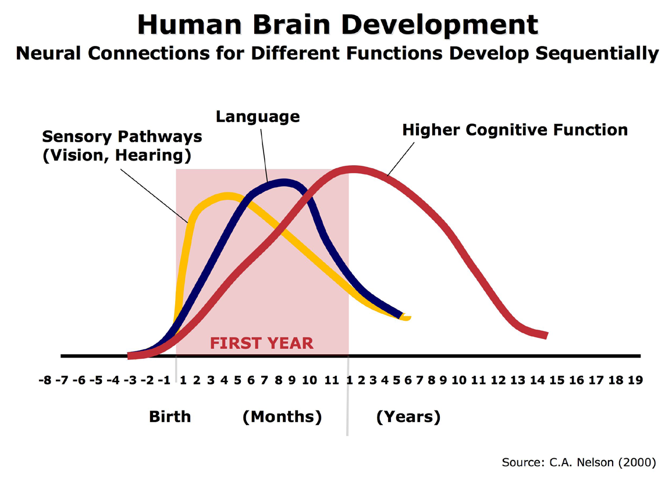
Notes:
The Harvard Center on the Developing Child has a brief on the science of early brain development. As can be seen on the figure, hearing and vision stimulation create initial neural connections. Brains are built over time with the neural connections related to sensory input establishing first. Later, more complex brain functions are built on earlier, simpler connections.
Young children naturally reach out for interaction through babbling, facial expressions, and gestures, and adults respond with the same kind of vocalizing and gesturing back at them. In the absence of such responses—or if the responses are unreliable or inappropriate—the brain’s architecture does not form as expected, which can lead to disparities in learning and behavior.
Excerpted from the Harvard InBrief – included in resources at the end of this presentation.

Slide 14
The Early Developing Brain
How a brain develops hinges on a complex interplay between the genes you are born with and the experiences you have
Early experiences have a decisive impact on the architecture of the brain, and on the nature and extent of adult capacities
Early interactions don’t just create a context; they directly affect the way the brain is “wired”
Notes:
Hearing loss, even minimal or fluctuating, provides a barrier that reduces the amount of language stimulation a child will be exposed to in their environment.
The reduced stimuli to the brain has the ability to affect the number of neural connections that are developed.
Unidentified hearing loss will affect the degree to which the child will benefit from the experiences they have.

Slide 15

Brain Development and Urgency to Amplify
Construction of brain pathways is dependent upon sensory input
Due to the reliance on hearing as part of foundation building of brain pathways it is critical to fit hearing aids to infants with hearing loss within 1 month of diagnosis, preferably no later than 3 months of age.
Hearing aids are assistive technology devices and therefore are to be provided by Part C to meet the unique developmental needs of children with hearing loss.
Notes:
In an OSEP policy letter it was clarified that:
Appropriate Part C services must be available to all eligible children and their families
Are designed to meet the developmental needs of the individual child
Assistive technology devices are among those included as early intervention services
At no cost to families (unless a sliding fee system is in place)
Thus, our knowledge of brain development in combination with evidence based practices supporting amplification as early as possible supports the provision of amplification through Part C to eligible infants and toddlers without undue delay.
http://www2.ed.gov/policy/speced/guid/idea/letters/2003-1/goodman032503earlyinter1q2003.pdf

Slide 16
Hearing and Development
Vision and hearing are your distance senses
95% of all learning is through your distance senses
90% of learning is incidental
Language is learned incidentally
Incidental exposure to language or experiences only occurs if the child is within ‘earshot’

Slide 17
A barrier in information gathering!
We hear with our brains – these pathways develop most in the first few months of life
Children tune into speech about a year before they begin to say actual words
Hearing loss is a barrier to children being exposed to speech that typically will delay their readiness to begin talking
AND their neural pathways will NOT
develop optimally unless they are
consistently stimulated before
6 months of age!!!!

Slide 18
Language is
CAUGHT not TAUGHT
Notes:
Babies learn language by associating a word or concept with something they are interested in. The fleeting interest of the baby is what drives their language learning. Anything within their sight or hearing can catch their interest – if paired with language then new words are learned. If a pairing between interest and language happens repeated during daily activities, the likelihood of the child learning language to describe the activity or thing of interest increases. Early intervention and early childhood education is all about how to make the most of a child’s teachable moments!

Slide 19
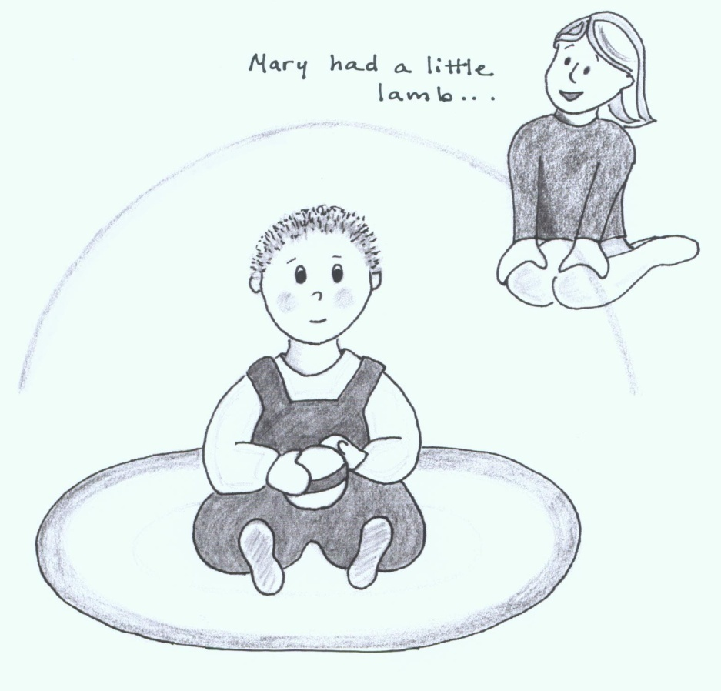
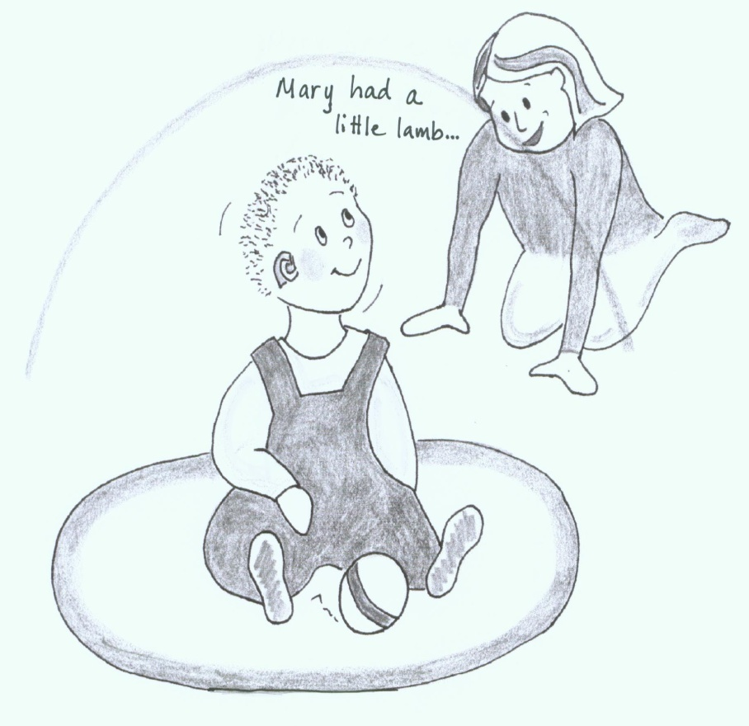
The Listening Bubble
Not in range! In range & listening!
Out of ‘ear shot’ means language is not caught!
Notes:
Hearing loss affects how close a sound has to be before it is heard
Any background noise will interfere
The size of the ‘listening bubble’ depends on the degree of hearing loss, voice quality, other noises, etc.

Slide 20
Hearing Does Not Develop
Children can hear starting in the womb at about 4 months gestation
When born, children hear as well as adults (or better) but need to learn what sounds mean
When born, children with hearing loss are already behind in sound awareness/identification
A child with normal hearing will develop auditory skills needed to detect, identify, and comprehend what sounds in their environment mean – all during the first few months of life
Children with hearing loss must be exposed to a specific hierarchy of experiences so that they learn these skills; even for children with mild loss
Notes:
Many children prefer the sound of mom’s voice when they are born because they have been hearing her for 5 months. The experience hearing before birth is an aid to bonding as well. Children with hearing loss are often without in-the-womb listening experience.

Slide 21

Experience for Yourself!!
Hearing loss affects how loudly sound is perceived
Slight loss (20 dB) -similar to loss due to ear infection
Mild loss (30 dB) -about ½ with this much hearing loss do not wear hearing aids

Slide 22
Experience for Yourself!!
Hearing loss can affect perception of different pitches
Missing many high pitch sounds (s, f)
Hearing only the low pitch sounds (oo, aw)

Slide 23
UNFAIR SPELLING TEST
2 lists of words
Number your paper from 1-10 for each of the two lists. Do not change your volume setting or repeat.
Consider trying to learn language for the first time with these hearing losses!
Notes:
After you complete the spelling test you can find the correct words written on the very last slide.

Slide 24
Won’t most children with hearing loss be identified by newborn screening?
Even with universal newborn hearing screening not all children with educationally significant hearing loss will be identified:
  Newborn screening is at 35-40 dB whereas significant hearing loss starts at 16-20 dB so many children with mild hearing loss are not identified
  Children with hearing loss right at the cutoff will often pass upon retest after newborn screening
  Some families decline newborn hearing screening or do not obtain follow up hearing evaluations if their newborn failed screening (about 3% of fails)
  Progressive and late onset hearing loss occur after the newborn period
Notes:
The 30 dB hearing loss that was simulated represents a degree that will NOT be identified by newborn hearing screening. The newborn hearing screening equipment is not set in a way to identify hearing loss under 35 or 40 dB HL.
Less than 1% of families refuse to have their newborn’s hearing screened.
Nationally, the loss to follow up or loss to documentation rate for children failing newborn hearing screening is 40%. This means that the results of follow up rescreening or hearing evaluation is received in only 60%. In Minnesota that loss to follow up rate is only 2.6%, so most children identified with hearing loss in early childhood will be due to late or progressive hearing loss and not missed hearing loss due to lack of follow up of failed newborn hearing screening.

Slide 25
How many children should be identified? Estimates vary
NIDCD suggests 6-7 per 1000 children have permanent hearing loss in addition to the 3 per 1000 likely to be diagnosed shortly after birth1
The National Health & Nutrition Evaluation Studies (NHANES) for the periods of 1976-80 and 1988-94 screened children from 6-19 years of age indicated that the estimated 3/1000 prevalence of permanent hearing loss in infants can be expected to increase to 9-10/1000 children in the school-age population 2
Notes:
References:
1 - Bamford et al., 2007; National Institute on Deafness and Other Communication Disorders, 2005
2 – NHANES studies: http://www.cdc.gov/nchs/nhanes.htm

Slide 26
What about for
Early Childhood?
Data gathered on screening performed on Early Head Start children ages 0-3 and follow-up suggests that approximately 2 of every 1000 children screened in early childhood settings are being identified with a permanent hearing loss3.
So it is conservative to assume that an additional 2-3 children with permanent hearing loss will be identified in early childhood and at least another 3 or 4 per 1000 children in elementary school.
Notes:
The Eiserman screening study of Early Head Start had multiple stages. Due to this it was estimated that 20% of the total number of children with hearing loss were lost to follow up. Thus, the anticipated number should be 2-3/1000 screened, or a doubling of the number of children found with significant hearing loss shortly after birth.
3. Eiserman, W., Hartel, D., Shisler, L., Buhrmann, J., White, K., and T. Foust. 2008. Using otoacoustic emissions to screen for hearing loss in early childhood care settings. International Journal of Pediatric Otorhinolaryngology, 72:475-482.

Slide 27
Types of hearing loss
Permanent hearing loss is relatively rare. Far greater in number are the children who experience middle ear effusions associated with hearing loss.
Early Head Start hearing screening for children ages 0-3 identified 18 children per 1,000 to have transient conductive hearing loss secondary to fluid or infection behind the eardrum3.
Notes:
In the Eiserman Head Start screening study the children with permanent hearing loss and those with loss due to middle ear effusion were not effectively differentiated by the screening method used. Due to this and the extensive rescreening stages in which 20% of children failed to be rescreened the 18/1000 finding likely underestimates the actual proportion of children with hearing issues due to middle ear effusion versus due to permanent hearing loss.

Slide 28
A common problem
About 90% of children under the age of 3 have experienced at least one episode of ear infection or fluid.
An estimated 35% of pre-school children experiencing intermittent hearing loss secondary to repeated episodes of ear infections with some untreated for extended period of time4
Notes:
Refer to the electronic brochure Ear Infections and Language Development developed by the US Department of Education and the American Speech and Hearing Association for more information. http://www2.ed.gov/offices/OERI/ECI/earinfections.pdf
4 - American Speech-Language-Hearing Association: Causes of Hearing Loss in Children. Available at: http://www.asha.org/public/hearing/disorders/causes.html

Slide 29
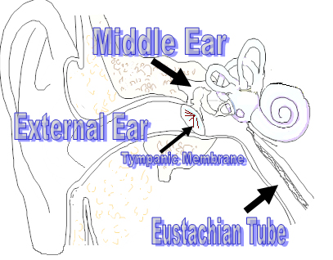
Fluid or infection behind the eardrum, in the middle ear space, can cause significant temporary hearing loss. Young children are more prone to ear problems because the Eustachian tube is much more horizontal and bacterial from the throat can more easily invade the middle ear space. Lower immunity and allergies also contribute.
Adult
Notes:
A bit about the realities of middle ear problems:
When your ears ‘pop’ you are actually letting air into the middle ear space. When you experience a cold your swollen throat often makes it difficult for your ears to pop as often, resulting in a build up of negative pressure (vaccuum) in which your ears feel ‘stuffy’. This is because the tissues in the middle ear space absorb air. People with Eustachian tube dysfunction have problems with not enough air entering their middle ear spaces. If a vaccuum continues for an extended period, clear serous fluid can be pulled from the tissues. As the middle ear space fills up with this fluid the eardrum returns to it’s natural resting place and the person experiences relief from the pain or stuffiness associated with retracted eardrums. This clear fluid can cause a minimal hearing loss and it is a wonderful medium for any bacteria that migrate up the Eustachian tube from the throat and enter the middle ear space, thus causing an acute ear infection. If an acute infection does not resolve spontaneously or following a course of antibiotics the material behind the middle ear can continue to multiply until the eardrum ruptures and a draining ear results. It takes about 14 days for a ruptured eardrum to heal. Only 2 of the 3 layers of the eardrum heal. If this reoccurs numerous times the child’s eardrum may lack the integrity to actually hold a pressure equalization tube if one were to be inserted. Thus, it is important for children who have had chronic middle ear problems for more than 3 months to be identified and treated medically.

Slide 30

Who SHOULD we identify?
Our primary target is young children with permanent hearing loss in one or both ears
A long history of fluctuating hearing loss secondary to chronic, recurrent middle ear effusion has been correlated with delays in speech/language development and affects on the ability to listen in noise.
A single screening will not differentiate children with chronic ear problems from those with the occasional ear problem due to a cold.
The most effective screening protocols will strive to differentiate between potential permanent and temporary hearing loss.
Notes:
Hearing loss is both a health and education issue. Permanent hearing loss or longstanding/permanent conductive hearing loss caused by chronic middle ear problems are at high risk for resulting educational issues.
One of the most serious concerns about conducting hearing screening in the young child population is the reality that middle ear effusion is very common and yet it is usually not developmentally or educationally significant. Ear infection is the most frequently cited reason for young child medical appointments. The medical community is not concerned about the presence of fluid or infection behind the eardrum unless it has been present for 3 or more months.
As we consider how best to identify significant hearing loss in this population we must be concerned how to identify the highest risk children from the number who that are experiencing typical, transient middle ear issues – all of whom may be identified by hearing screening. .

Slide 31
A word about unilateral hearing loss
About 20-25% of newborns identified with permanent hearing loss after hearing screening have unilateral hearing loss.
It is a common misperception that hearing loss in one ear will not cause any developmental concerns
1/3 develop expressive language delays
1/5 develop behavior/social concerns
1/4 develop hearing loss in their better ear
These children are at 10 times the risk for school failure or special education than normal hearing peers
Any transient hearing loss due to ear infection will increase the risk of delay
Notes:
About ½ of children born with hearing loss in one ear will appear to have little difficulty developing typically and performing well in school.
About ½ will either repeat a grade or end up requiring special education services.
Development is typical until about 15-18 months after which expressive language and behavior/socialization concerns arise.
Children born with hearing loss in one ear are increasingly being fitted with a hearing aid prior to 6 months of age.
Hearing can decrease at any time and progressive or late-onset hearing loss does not always occur in both ears. It is important to identify toddlers and preschoolers with permanent unilateral hearing loss.

Slide 32
Methods of screening for hearing loss in young children 6 months to 5 years
Informal observation and parent interview
Checklists
Traditional pure tone hearing screening
Otoacoustic emissions
Tympanometry
Notes:
Next will be a description of each of these methods.

Slide 33
Informal observation and parent interview
Asking if family members have any hearing concerns has long been considered sufficient to identify hearing problems in most early intervention programs, even when there are primarily communication development concerns.
Some early intervention programs have included informal observation of the young child when a bell or other noisemaker is used as a measure of functional hearing ability.

Slide 34

Checklists
At least one checklist is available that lists ‘red flag’ questions for hearing loss and auditory milestones by age to allow identification of possible delays that could indicate a hearing loss.
As part of the health history it is common for early intervention programs to ask questions about the result of newborn hearing screening.
Questions may also be asked about a child’s history of ear infections or permanent hearing loss in the family.
Notes:
Florida Early Steps: Parent Interview Protocol for Child Hearing and Vision Skills http://www.cmskids.com/home/resources/es_policy_0710/Attachments/3_SHINE_Parent_Interview_Protocol.pdf

Slide 35
Traditional pure tone hearing screening
This hearing screening method requires a response from the child; typically dropping a block into a bucket when they hear a beep through earphones.
Pure tone hearing screening methods are usually successful with typically developing 3 year olds. Success is possible with some children as young as 24-30 months.

Slide 36
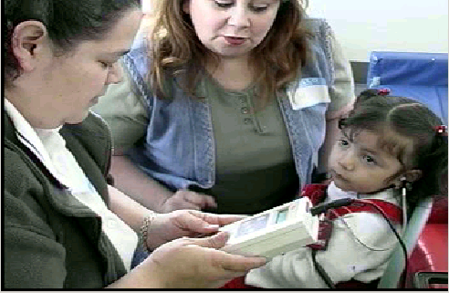
Otoacoustic emissions (OAE)
A small tip into the ear as the child listens to a soft clicking. A healthy cochlea will send back a very soft echo that is measured by a microphone. The test provides information about how the child is hearing, but does not tell how much hearing or the type of hearing loss.

Slide 37
Tympanometry
Tympanometry checks how well the eardrum moves and how well the eardrum and middle ear system send sound to the inner part of the ear.
Tympanometry does not tell if a child is hearing or not. It indicates if there is fluid in the middle ear which can cause temporary hearing loss.
It can also tell the size of the child's ear canal. If the child has tubes, the test shows that the tubes are working right.

Slide 38
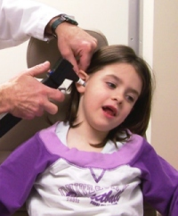
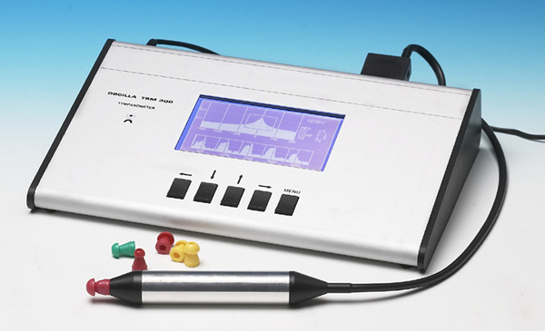
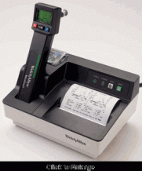
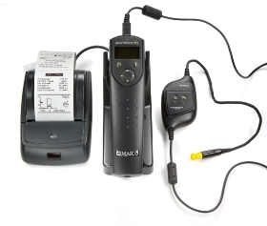
Tympanometry
OAE/tymp
Combination
unit

Slide 39
Informal observation and parent interview PROS & CONS
PRO – minimal training, no equipment cost
PRO - family centered; assumes parents are aware if a hearing problem is present
CON - Hearing reduces the size of a child’s listening bubble. For all but the children with severe to profound degrees of deafness, there will be conditions under which they are observed to respond to sound.
CON - The younger or less developmentally mature the child, the easier it is to mistakenly assume that hearing is normal.
CON – Does not meet the requirement for professionally objective assessment criteria.
Notes:
Each of the hearing losses simulated toward the beginning of this presentation will NOT be identified via informal observation and are unlikely to be identified via parent interview. All unilateral hearing loss will remain unidentified.
Even children with moderate and severe degrees of hearing loss will respond to sound if it occurs close to the ears and loudly enough.
Children that primarily have communication concerns are at risk for permanent hearing loss. Children with syndromes and cranio-facial deformities are also at high risk for permanent hearing loss. For example, 50-90% of children with Down Syndrome have co-existing significant hearing loss.
Early intervention programs are charged with identifying functional hearing concerns. In the case of these high risk populations it is even more important for hearing loss to be ruled out. If it is not identified and a child is diagnosed with hearing loss upon transition to preschool the early intervention program may be held liable for damages if the family chooses to litigate.

Slide 40
Checklist PROS & CONS
PRO – inexpensive, requiring only copying costs
PRO – minimal training needed
PRO – provides a systematic means for the IFSP team to consider functional hearing ability that can be applied across early intervention programs
CON - Using parent questionnaires found that this method of identification misses at least 80% of mild hearing loss or does not differentiate between those with and without hearing loss.
CON – Does not meet the requirement for professionally objective assessment criteria.
Notes:
In 40-60% of cases of otitis media with effusion neither children nor their parents report significant complaints relative to the disease (Burkey et al., 1994; Rosenfeld, Goldsmith, Tetlus, & Balzano, 1997).
Parent report is highly inaccurate in identifying children experiencing non-acute otitis media with effusion, with or without substantial hearing loss (Burkey et al., 1994; Olusanya, 2001; Lo et al. 2006; Gomes and Lichtig 2005).

Slide 41
Traditional pure tone hearing screening PROS & CONS
PRO – many schools and Health Departments already have access to this equipment due to school hearing screening
PRO – considered the optimal choice for identifying hearing loss in preschool and school age because it can identify even mild loss
CON – Many three year olds are challenging to screen and populations younger than three are too difficult to test effectively in mass screening
CON - Even more challenging to successfully screen developmentally delayed populations
Notes:
Pure tone hearing screening remains the gold standard for hearing loss identification because even mild hearing loss can be identified.
Hearing screening of preschool and school-age children age 3 years and above should be first attempted with pure tone techniques. Young children should be screened using conditioned play audiometry (drop the block in the bucket).
Pure tone screening requires a response by the child. It is not an objective measure but it has been found to be reliable in identifying hearing loss in typical preschool and school age children.

Slide 42
OAE PROS
PRO – meets the requirement for professionally objective assessment criteria.
PRO – quick and painless, often successfully completed by trained personnel using distraction techniques (child looking at video)
PRO - Equipment applies pass/fail criteria preventing screening personnel from making this judgment

Slide 43
OAE CONS
CON – requires purchase of OAE equipment, tips, cleaner.
CON – requires significant training of personnel otherwise can-not-test rate can be as much as 50%
CON – requires the child to be still and quiet
CON – OAE screening equipment is typically set to identify hearing losses greater than 35-40 dB, so many mild hearing losses are missed
CON – the presence of middle ear fluid or pressure will also cause a screening failure
Notes:
The development of OAE screening techniques has made quick and objective identification of hearing loss in very young and developmentally delayed children possible. Screening challenges can occur frequently for insufficiently trained personnel. Although operation of the equipment is simple, obtaining a valid screening result on active infants or defiant toddlers requires a variety of strategies that are best learned through supervised practice.
With the high rate of middle ear effusion in the infant and toddler population a relatively high rate of failure on OAE screening can be expected as the equipment does not differentiate between possible permanent hearing loss, transient middle ear effusion and poor test technique.
Because OAE equipment does not identify mild hearing loss of 30 dB or less it is imperative that each OAE screening failure be follow up to determine if permanent mild hearing loss is present as the degree of hearing permanent hearing loss that would be present would most likely be of educational or developmental concern.

Slide 44
Tympanometry PROS & CONS
PRO – use of tympanometry in conjunction with OAE screening will differentiate children who are likely failing from middle ear effusion from those who are likely to have permanent hearing loss
PRO – quick, painless and is not as sensitive to movement or background noise as OAE
CON – NOT a hearing test
CON – requires purchase of equipment, tips, cleaner
CON - requires training on how to use equipment
CON – should be done in conjunction with otoscopy to identify possible draining ears or those with holes in the eardrum
Notes:
Tympanometry has been used in some school hearing screening programs for 30 or more years, primarily as a means to categorize children who do not pass pure tone screening as not passing due to probable middle ear effusion from those who may have a permanent hearing loss.
With the advent of OAE screening in young child populations it is very advantageous to include tympanometry screening so that the program can prioritize children who fail OAE screening and pass tympanometry screening as these are the individuals most likely to have permanent hearing loss.

Slide 45


Implementation Costs & Issues 0-5
Checklist/Parent Interview/Observation method
Cost
  Minimal cost for materials and training
  Possible litigation for missed hearing loss
Issues
  Does not meet requirement for objective assessment criteria
  Miss/hit rate approximately 80/20 (permanent loss)
  Individual cost to children in terms of limitations on potential progress due to hearing loss, despite provision of quality early intervention services
Notes:
Although it would be convenient and low cost to implement a checklist or observation method to identify hearing loss in young children, this method only identifies those children with the greatest degrees of hearing loss and fails to identify over ¾ who have hearing loss.
It does not meet the criteria required by 34 CFR §303.344(a) for objective assessment.
Reference for miss/hit rate: Olusanya B. Early detection of hearing impairment in a developing country: what options? Audiology 2001;40:141–7.

Slide 46
Implementation Costs & Issues 0-3
OAE screening method
Cost
  Approximately $4500 per OAE screener
  Ongoing costs for tips and tip cleaning time
  Suggest ½ day or more training of screening personnel. Training should include oversight by an experienced and highly trained person during initial use of OAE
  Time needed for repeated follow up screening to see if hearing problem resolves over time as a means of reducing over referral rate due to OAE inability to differentiate transient from permanent hearing loss
Issues
  Miss/hit rate 20/80 depending
  Rigorous protocol needed for screening/rescreening to manage loss to follow up rate and identify referrals
Notes:
OAE screening does meet the criteria required by 34 CFR §303.344(a) for objective assessment.
OAE does not identify all children with mild hearing loss. That said, there is NOT a practical-to-use technology that can be used with this age group as a screening method that WILL identify all mild hearing loss cases.
The Eiserman study of Early Head Start conducted initial OAE screening and then two additional screenings within a 6 week period for the children who failed the initial screening and those who failed the initial and second screening. With every rescreening there was additional loss to follow up by families who refused or did not follow through on obtaining the rescreening. (reference for 20/80 hit rate: Eiserman, W.D., Hartel, D.M., Shisler, L., Buhrmann, J., White, K.R. & Foust, T. (2008). International Journal of Pediatric Otorhinolaryngology. 72, 475-482.)
Because of the high prevalence of middle ear effusion and the low prevalence of permanent hearing loss it is likely that a physician will assume that a transient middle ear problem was the cause of the OAE failure.
If the family follows through with the medical appointment and if there is middle ear effusion present (1) the medical community’s first management technique for ear problems is ‘wait and see’ and (2) the American Academy of Pediatrics recommends observation management until it is demonstrated that middle ear effusion continues unabated for at least 3 months and (3) 85% of young children’s ear problems will resolve within 3 months. Due to the cost of medical care and the fact that most parents work, loss to follow up for the course of the 3 months of observation management occurs frequently.
Therefore, referral of every child failing OAE screening to their primary medical care provider would likely result in a delay of referral for a hearing evaluation until after 3 months - if the receiving ear, nose, throat physician chooses to obtain a hearing assessment. This assumes that the family has followed through with the medical appointments during the observation management period. If the child presents with clear ears on the first medical appointment the physician may just question the parent about hearing and speech development concerns and choose to conclude that the OAE failure was due to transient middle ear effusion rather than referring the child for an audiological evaluation. However, if the family can report that the child failed three OAE screenings over the course of 1-2 months the primary care physician may be more likely to refer the child for an audiological assessment if the ear are clear on the day of the medical appointment. If the family has no concerns about hearing or speech development the physician may choose again to conclude that the OAE failures were due to transient hearing loss that resolved.

Slide 47
Implementation Costs & Issues 0-3
Tympanometry & OAE Screening
Cost
  Approximately $4500 for OAE, $3500 for tympanometer or $7000 for a combined tympanometer/OAE unit
  Ongoing costs for tips (<$50/yr) and tip cleaning time
  Same training needed as OAE screening only
Issues
  Miss/hit rate of 6/94
  Agency must decide on referral practices and follow up for children with apparent middle ear effusion (fail OAE/tympanometry)
Notes:
OAE screening does meet the criteria required by 34 CFR §303.344(a) for objective assessment.
If possible, children with failed OAE and pass tympanometry results should be referred to an audiologist for hearing evaluation. Unless the agency provides hearing evaluation at no cost to families, most medical plans require that a physician make a referral to an audiologist. Due to the tendency of the medical community to assume that hearing loss is transient, rather than permanent, the agency or program needs to remain involved and support the family in pursuing a hearing evaluation for children who have been identified by objective means to have hearing concerns. Medical clearance from the physician that there is no middle ear effusion present does not fulfill the need to obtain an appropriate hearing evaluation to address the hearing concern.
For children who have fail results both with OAE and with tympanometry there remains the chance that both a transient and a permanent hearing loss co-exist. If the primary concern is communication delay then the agency or program needs to remain involved and support the family in pursuing appropriate follow up. Medical clearance from the physician that there is no middle ear effusion present does not fulfill the need to obtain an appropriate hearing evaluation to address the hearing concern. The agency or program may choose to repeat the OAE/tympanometry screening following receipt of information from the physician that the ears are clear. If abnormal screening findings continue, it is strongly suggested that the agency or program assist the family in obtaining a hearing evaluation.
The agency or program must decide how to handle the children who fail OAE and tympanometry but do not have communication development concerns. The following is offered for consideration:
Recommend that a child be seen by a physician soon if it is close to the time for a well-child check anyway.
Rescreen with OAE/tympanometry after 6 months (or sooner at family request) with no referral for pass/pass, referral to a physician for fail/fail and referral to an audiologist for fail/pass. Check communication development progress to determine if typical rate of development has occurred over the 6 months.
Reference for miss/hit rate: Lyons A, Kei J, Driscoll C. Distortion product otoacoustic emissions in children at school entry: a comparison with pure-tone tympanometry results. J Am Acad Audiol 2004;15:702–15.

Slide 48

Infant/Toddler Screening Summary:
Time, Money, & Effectiveness
Although the checklist/observation method of hearing loss identification is most simple, it is not effective nor does it fulfill the requirement for objective assessment criteria.

Slide 49
Infant/Toddler Screening Summary:
Time, Money, & Effectiveness
OAE screening fulfills the objective assessment criteria at the cost of the equipment, training, and serial rescreening time until a referral can appropriately be made.
Serial rescreening often competes with high caseload demands and intervention needs resulting in lack of completion in a timely manner.
The time taken for rescreening is ultimately time lost to appropriate intervention if a permanent hearing loss is truly present.

Slide 50
Infant/Toddler Screening Summary:
Time, Money, & Effectiveness
OAE/tympanometry screening is at high initial cost for equipment and training, but results are more accurate with less staff time to rescreen children with common ear problems.

Slide 51
Preschool Hearing Screening
Conditioned play audiometry is still the ‘gold standard’ for ages 3 and 4
If child cannot be conditioned then OAE could be used.
Tympanometry will help to differentiate between probable middle ear effusion and possible permanent hearing loss
Monitoring of preschoolers with recurrent chronic middle ear effusion can be an important related service for those in Special Education preschool settings with language delays.
Children who are Down Syndrome and those with cleft palate issues are also at high risk for continual hearing problems and merit hearing monitoring.
Notes:
Many children outgrow middle ear problems around the age of 3 years although approximately 10% continue to experience middle ear problems and fluctuating hearing loss into elementary and high school.
If you plug your ears with your fingers the degree of hearing loss you experience can be compared to transitory hearing problems that accompany occasional fluid or infection behind the eardrum. Pain is only a symptom in a little over half the cases of ear infection. Children who have had many recurrent ear problems can experience up to 50 dB of hearing loss (average conversational speech is at a loudness of 45 dB HL).
If a child with communication delay continues to have chronic middle ear problems it is important to consider the affect of hearing loss on learning in the educational planning process.

Slide 52
Summary
It is hoped that this presentation
  Raised your awareness of the legal requirements for hearing loss identification
  Raised your awareness of issues related to hearing loss in young children
  Raised your awareness of the complexities of screening for hearing loss in young children
  And provided you with the information needed for your agency or program to determine next steps for implementing or improving a hearing screening initiative.

Slide 53
Resources
OSEP 11/6/2003 audiology evaluations letter of clarification
Head Start health and developmental services
Minnesota EPSDT periodicity schedule
The Harvard Center on the Developing Child Brief on early brain development.
OSEP 3/25/03 assistive tech letter of clarification
Ear Infections and Language Development e-brochure by US Department of Education and ASHA
Parent Interview Protocol for Child Hearing & Vision Skills

Slide 54
Answers to the Unfair Spelling Test
Is ‘hearing’ with this type of loss enough to really learn complete language incidentally?
1. fill
2. catch
3. thumb
4. heap
5. wise
6. wedge
7. fish
8. shows
9. bed
10. juice

